Slide 1
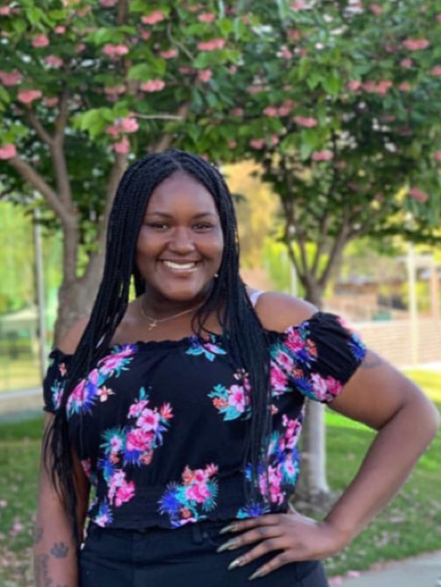
Meet Jack Kent cooke scholar Thyra Cobbs
Thyra Cobbs was named an Undergraduate Transfer Scholar by the Jack Kent Cooke Foundation in 2021. She studied at Los Medanos College for three years and graduated with an Associate Degree for Transfer in Psychology. Thyra is a first-generation LMC student who will transferred this fall to UCLA, where she plans to major in Psychology and African American Studies, with a minor in African Studies. Her goal is to earn a Ph.D. in Psychology from Stanford University, and she aspires to become a research psychologist serving the African American community. She would also like to teach Psychology and African American Studies at a community college.
During her time at LMC, Thyra was highly engaged with the College community, participating in many programs and clubs such as Umoja Scholars, Alpha Gamma Sigma, and Black Student Union to name a few. She also served on several LMC committees, including the Shared Governance Council.
Source: LMC Press Release, May 14, 2021

