Slide 1

Contra Costa Community College District
Environmental Scan
Highlights
(a narrative summary)
September 9, 2013
Gregory M. Stoup
District Office of Research and Planning

Slide 2

Areas covered
The information in this summary is limited to the most salient findings from the environmental scan. A more detailed profile and complete set of metrics is provided in the full report.
1. County Demographics
Age distribution
Ethnicity profile
Origin of Birth / Language spoken
Educational Attainment
2. Market for High School Graduates
Feeder school performance and trends
Capture rates
3. Workforce & Income Summary
Labor market trends
Income and housing market strength

Slide 3
CCCCD Fall Headcount since 1978
Peak of Recession
Peak of Recession
Peak of Recession
Brentwood Campus opens
San Ramon Campus opens
Prop 13
Fee Increase
Enrollment Fees begin

Slide 4
CCCCD Fall Headcount since 1978
Peak of Recession
Peak of Recession
Peak of Recession
DVC
San Ramon Campus opens
Brentwood Campus opens
CCC
LMC
Twenty year period of flat growth with episodes of punctuated enrollment
Period of decline
Period of growth

Slide 5
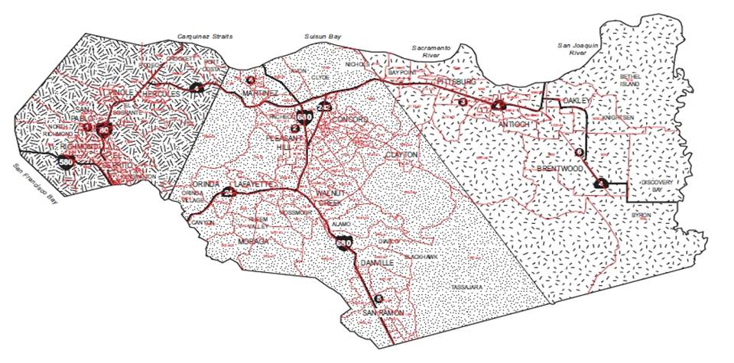
Environmental Scan Geography
West County
Central County
East County
LMC
CCC
DVC
Brentwood
San Ramon
Contra Costa county was broken up into three regions using census tracks associated with each college’s service area.

Slide 6
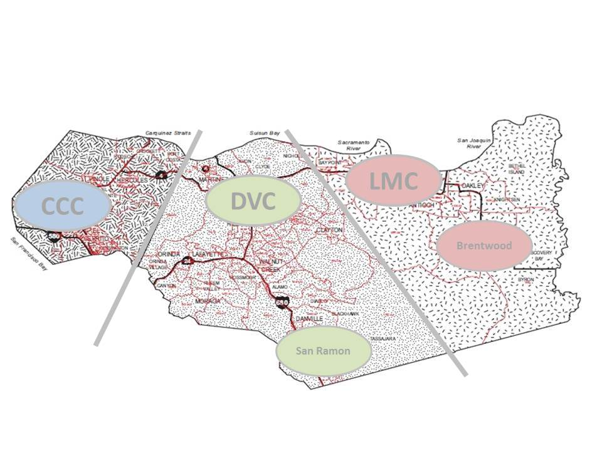
Contra Costa County
Demographic Trends

Slide 7
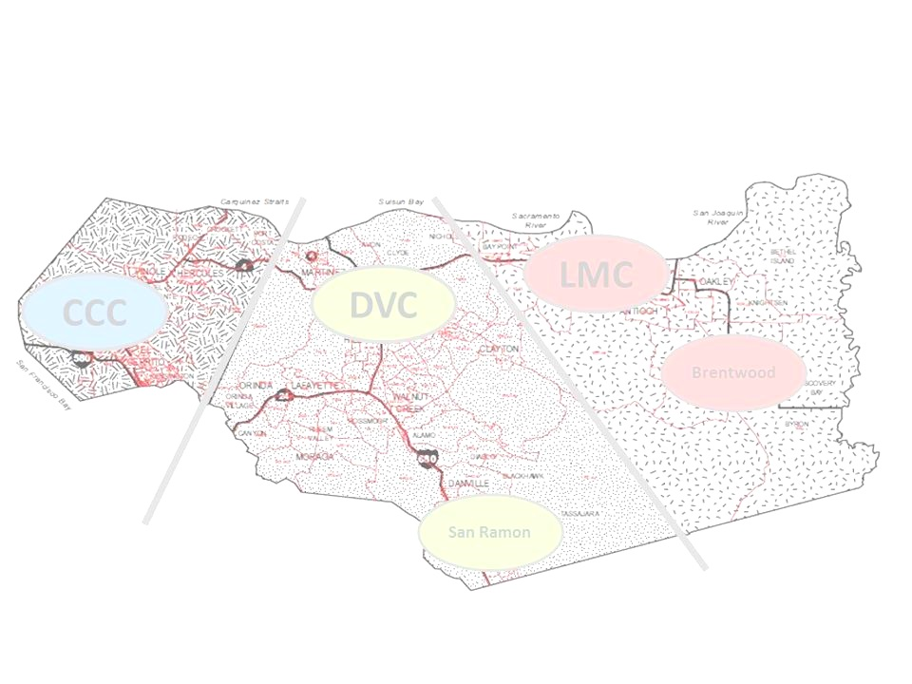
Contra Costa County
Demographic Profile (2011)
Size
Population = 1,037,000
Growth Rate = 9.4% per decade
Age Distribution
Under 19 yrs old = 27%
20-24 yrs old = 6%
25-44 yrs old = 27%
45-64 yrs old = 28%
65+ yrs old = 12%
Ethnicity Distribution
American Indian = 0.2%
Asian / Pac Is. = 15%
Black / Af. Am. = 9%
Hispanic = 24%
Two or More races = 3.4%
White = 48%
Other race = 0.4%
Gender
Female = 51%
Male = 49%
Foreign Born
US Native Born = 76%
Foreign Born = 24%
Language Spoken at Home
English Only = 67%
Other than English = 33%
Education Attainment
High School or less = 30%
AA/AS Degree or some college = 31%
Bachelors Degree = 25%
Graduate or Prof Degree = 14%
Note: Fastest growing groups by volume highlighted in orange

Slide 8
Contra Costa County’s Regions
Overall population
East County
Second largest region
Slightly larger than the West county with 275K residents
Rapid growth
Growing three times faster than the County overall
West County
Third largest region
Home to roughly a quarter of a million residents
Slow growth
Growing at one-third the rate of the county average
Central County
Largest region
Houses nearly half the county’s roughly one million residents
Modest growth
Growing slightly slower than the county average
Note: Growth rates are derived from recorded population growth from 2000 to 2011.
Data sources: U.S. Census Bureau; American Community Survey.

Slide 9

Age Distribution
East County
Youngest
Highest concentration of those under 19 yrs old (36%) in county
U-Shaped growth
Strong growth in both the younger & older age groups.
Only region not experiencing decline in 25-44 yrs old (+1% growth)
Central County
Deepest age pool
Has more residents in every age group than either the West or East County
Aging by growth in middle aged & elderly
Has the highest concentration of county residents 45-64 yrs old and 65+ yrs old
Very rapid decline in one segment: those 25-44 yrs old (-19%)
West County
Most diverse by age
Most balanced age distribution in county
Aging by decline in youth
Net decline in residents under 44 yrs old and slow growth of those 45 yrs old and older
Experiencing decline in all three segments of those under 44 yrs old: Under 19 yrs old ; 20-24 yrs old; and 25-44 yrs old
Note: Growth rates are derived from recoded growth from 2000 to 2011.
Data sources: U.S. Census Bureau; American Community Survey.

Slide 10

Ethnicity Narrative
East County
Bimodal population
Three of every four residents are either White or Hispanic
Rapid growth among minorities
Growth in Hispanic residents outpaced all other ethnic groups combined
Fastest growing region among African Americans
Most rapid decline of White residents
West County
Ethnically diverse
Highest concentration of residents of Asian African Americans & Hispanic decent.
Rapid decline of African-Americans; Edging toward parity with the county
Rapid decline in African American population (-28%)
Slowest growth in Asian residents
Only area to experience an increase in White residents
Central County
Least diverse
Nearly two of every three residents are White; all remaining ethnic groups having lower concentrations than the county average
Growing more diverse
Rapid growth among Asian (67%) and Hispanic residents (44%)
For every new Hispanic resident the region lost one White resident
Note: Growth rates are derived from recoded growth from 2000 to 2011.
Data sources: U.S. Census Bureau; American Community Survey.

Slide 11
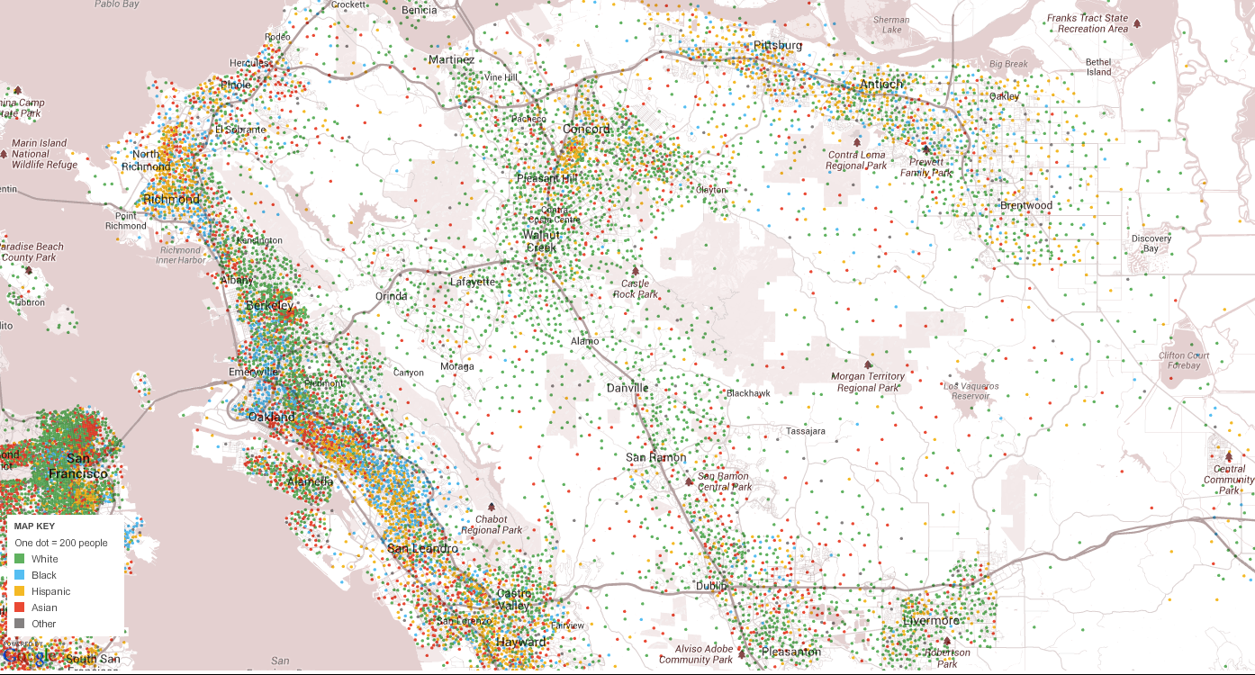
Distribution of Racial and Ethnicity Groups in
Contra Costa and Alameda Counties
Maps were taken from the New York Times online resource titled: Mapping America: Every City, Every Block
(link: http://projects.nytimes.com/census/2010/explorer?ref=us).
Map source data come from the Census Bureau's American Community Survey, based on samples from 2005 to 2009. Because these figures are based on samples, they are subject to a margin of error, particularly in places with a low population, and are best regarded as estimates.

Slide 12

Origin of Birth and Language Spoken
Central County
Origin of Birth
Low density but fast growth among foreign born residents
Roughly four in five residents are Native US born
However, over 80% of all new residents are foreign born
Language Spoken
Highest density of English speakers but transforming
With roughly three in four residents speaking English at home the Central county has a higher concentration of English speakers than the county overall
However, all the growth in new residents has be among non-English speakers
West County
Origin of Birth
High and growing density of foreign born residents
Highest concentration of foreign born residents (32%) and growing; all the growth in population is occurring within this group
Language Spoken
English speakers soon to be the minority
Nearly half (45%) of residents don’t speak English at home and this group is growing at seven times the rate of the rest of the region
East County
Origin of Birth
Rapid growth of foreign born pushing region toward parity with the county
Roughly four in five residents are Native US born
Yet experiencing the fastest growth of foreign born residents in the county
Language Spoken
Fastest growth among non-English speakers
One in three resident speak a language other than English at home and the non-English speaking group is growing faster here than the rest of the county
Note: Growth rates are derived from recoded growth from 2000 to 2011.
Data sources: U.S. Census Bureau; American Community Survey.

Slide 13

Education Attainment
West County
Slightly less educated than the county overall
Nearly 40% of the population has no more than a High School diploma
But growing more educated
Three of every four new residents has a Bachelors degree or higher
East County
Least educated region
Less than 20% of the population has bachelors or graduate degree
Strong growth in community college credentials
The fastest growing segment are among residents with an Associates Degree or having some college
Central County
Home to the most educated population
Over 50% of the population has a Bachelors and/or graduate degree
And growing still more educated
All the new resident growth is among people with Bachelors and graduate degrees
Note: Growth rates are derived from recoded growth from 2000 to 2011.
Data sources: U.S. Census Bureau; American Community Survey.

Slide 14
Contra Costa County
The market for high school graduates

Slide 15
Contra Costa County
The market for high school graduates
Size
Graduates = 11, 270 (2010)
Growth Rate = 23% (2000/01-2010/11)
Projected = 12,145 (2020)
County college-going Rates
CCCs = 7%
CSUs = 12%
UCs = 10%
CCCCD HS Graduate Capture Rate
2,900 of 11,270 = 26%
Overall Remediation Rate
Placement into dev ed = 80%
Enrolling in dev ed = 45%
Data sources: California Dept of Education.

Slide 16
Contra Costa County
The market for High School Graduates
CCC
Weak growth
Graduates of feeder High Schools growing at one-fourth the rate of the county
Capture rates stable
CCC capture rates of feeder high school graduates remains stable and roughly the same as the county average of 26%
LMC
Booming HS graduate population
Graduation rate at feeder HS over twice the rate of the county
Rising capture rates
LMC capture rates of feeder high school is improving, moving from below the county average in 200/01 to 5% above in 2010/11
DVC
Moderate growth
Graduation rate at feeder HS is slightly less than the county average
Capture rates stable
DVC capture rates of feeder high school graduates remains stable and roughly the same as the county average of 26%
Note: Growth rates are derived from recoded growth from 2000 /01to 2010/11.
Data sources: California Dept of Education.

Slide 17
DVC
Feeder high schools are home to the most academically prepared
Of the District’s 27 primary feeder high schools, the ten highest average API scores belong to DVC feeder schools all of which score above the statewide performance target of 800
DVC feeder schools have an overall average score of 835.
LMC
Feeder high schools are midlevel performers
As a group all of LMC’s six feeder high schools have an average API averages score of 714.
CCC
Service area contains some of the lowest performing high schools
CCC’s seven feeder high schools have an average API score of 662. Five of the seven lowest API scoring District feeder schools are in the CCC service area.
The Academic Performance Index (API) is a measurement of academic performance and progress of individual schools in California. It is one of the main components of the Public Schools Accountability Act passed by the California legislature in 1999. API scores ranges from a low of 200 to a high of 1000. The current statewide API performance target for all schools is 800.

Slide 18
Contra Costa County
Workforce & Income

Slide 19

Contra Costa County
Workforce & Income Profile
Labor Market
Jobs = 482,000
Proj Job Growth (2013-18) = 5%
Unemployment Rate = 7.0%
Industries adding most jobs
Finance & Insurance
Health Care & Social Assistance
Food Services & Accommodations
Prof, Scientific & Tech Services
Retail Trade
Fastest growing Occupations
Sales
Business & Financial Operations
Food preparation & serving
Personal Care & Services
Office and Admin Support
Household Income
Median Income = $79,000 (2011)
Income Growth = 24.3% (2000-2011)
Poverty
Individual Poverty Rate = 9.9%
Families w/ children = 10.7%
Female Head of Household = 20.5%
Female Head of Household w/ children = 27.5%
Median Home Value
In 2011 = $490,000
Growth (2000-2011) = 83%
Data sources: U.S. Census Bureau; American Community Survey; EMSI Data reports.

Slide 20
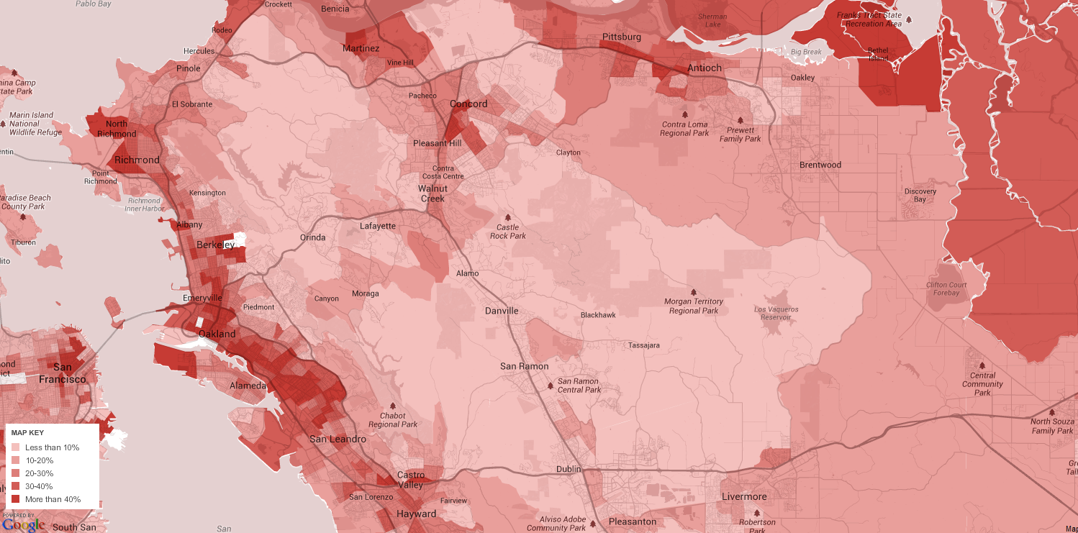
Distribution of Households Earning Under $30K Contra Costa and Alameda Counties
Maps were taken from the New York Times online resource titled: Mapping America: Every City, Every Block
(link: http://projects.nytimes.com/census/2010/explorer?ref=us).
Map source data come from the Census Bureau's American Community Survey, based on samples from 2005 to 2009. Because these figures are based on samples, they are subject to a margin of error, particularly in places with a low population, and are best regarded as estimates.

Slide 21
Contra Costa County
Workforce & Income Profile
West County
Pockets of lingering unemployment & high poverty
At 8.6% the unemployment rate is 1.6 percentage points above the county average
The poverty rate is the highest in the county at 13.6%
Low but growing income and strengthening housing market
Household incomes are lowest in the county ($64K) but growing the fastest.
Median house values are also growing the fastest and are now second highest in the county
East County
Weak job growth & growing poverty
Unemployment rates are highest in the county at 9.2%
At 7.9% the poverty rate remains below the county average but the rate of growth is fastest in the county
Slowing income growth & tepid housing market
Household incomes ($83K) remain slightly above the county average but have experienced the slowest growth in the county.
Likewise, housing values sit below the county average and price gains have not kept pace with the rest of the county
Central County
Strong labor market & low levels of poverty
The unemployment rate (4.4%) and poverty rates (6.5%) remain well below the county average
High income & high home valuations
At $91K Household incomes are the highest in the county and growing on par with the county average.
Housing values are the highest in the county ($636K) though returns over the last decade dropped below the county average
Data sources: U.S. Census Bureau; American Community Survey; EMSI Data reports.

Slide 22
West County
Central County
East County
Pg 8
Third largest region; slow growth
Largest region; modest growth
Second largest region; rapid growth
Overall population
Pg 12
Most diverse by age; aging by decline in youth
Deepest age pool; aging by growth in elderly
Youngest age pool; U-shaped growth
Age Distribution
Pg 15
Ethnically diverse; rapid decline of African-Americans
Least diverse; growing more diverse
Bimodal ethnicity; rapid minority growth
Ethnicity
Pg 17
High & growing density of foreign born
Low density but fast growth in foreign born
Rapid growth of foreign born residents
Origin of Birth
Pg 19
English speakers soon to be minority
High density of English speakers but changing
Fastest growth among non-English speakers
Language Spoken
Pg 24
Slightly less educated but growing more so
Most educated and growing more so
Least educated; strong growth in AA degrees
Education Attainment
Pg 26
Weak growth; stable capture rates
Moderate growth; stable capture rates
Booming growth; rising capture rates
HS Graduate Market
Pg 32
Feeder HS API Profile
Lowest performing
Highest performing
Midlevel performance
Pg 47
Pockets of unemployment; high poverty
Strong labor market; low levels of poverty
Weak job growth; growing poverty
Labor Market
Pg 46
Low but improving income; strengthening housing market
Income & Housing Market
High income and high home valuations
Slow income growth & tepid housing market

Slide 23
Environmental Scan
The full report and all documentation can be found at:
http://www.4cd.edu/research/default.aspx

Slide 24
Internal Trends

Slide 25
Broad overview of our recent performance in terms of access, equity and success
Domain of this Review
Data we will examine
Access
Enrollment by age, gender, ethnicity and method of instruction
Equity
Classroom performance by age, gender, ethnicity and method of instruction
Success
Degree, certificate and transfer completion

Slide 26
Los Medanos Fall Headcount since 1978
Brentwood Campus opens
In the next few slides we’re going to focus on the last six years
(Fall 2007 – Fall 2012)
LMC

Slide 27
ACCESS
(in terms of enrollments)

Slide 28
Percentage growth since Fall 2007 by student gender
Peak of Recession
Male
Female

Slide 29
Percentage growth since Fall 2007 by student age
Peak of Recession
20 – 24 Yrs Old
< 20 Yrs Old
25 – 49 Yrs Old
50+ Yrs Old

Slide 30
Percentage growth since Fall 2007 by student ethnicity
Peak of Recession
Hispanic
Asian
Afr American
Filipino
Multi-Race = +217%
Undeclared = - 38%
White
Note: trends for students identified as Native American or Pacific Islander were not included here due to small sample sizes. Data for those populations are included in the full report

Slide 31
Percentage growth in enrollments by instructional delivery method
Peak of Recession
On-line
Traditional
Note: Hybrid courses are included in the Traditional category for this analysis

Slide 32
EQUITY
(in course success rates)

Slide 33
Five year success rates by student gender
Quick take away: gender doesn’t appear to be associated with divergence in course success
Female
Male
Next line of inquiry: might there be separation by gender in terms of other measures of success like completion?

Slide 34
Five year success rates by student age
Quick take away: there appears to be some indication of convergence in success by student age
50+ Yrs Old
25 – 49 Yrs Old
< 20 Yrs Old
20 – 24 Yrs Old
Next line of inquiry: the convergence is a result of a mild decline in two older age groups and a rise in two younger ones. What might be the explanation?

Slide 35
Five year success rates by student ethnicity
Quick take away: trends have some directional similarities but no strong evidence of convergence
Asian
Filipino
White
Hispanic
Afr American
Next line of inquiry: We saw evidence of convergence by age and none by ethnicity. Are the age distributions different for each ethnicity cohort?
Note: trends for students identified as Native American or Pacific Islander were not included here due to small sample sizes. Data for those populations are included in the full report

Slide 36
Five year success rates by instructional delivery method
Quick take away: both trends are mildly upward, and while a gap remains, there is some evidence that it is closing.
Traditional
On-line
Next line of inquiry: if the recent growth in on-line enrollments continues how might that impact the success rates of various cohorts?
Note: Hybrid courses are included in the Traditional category for this analysis

Slide 37
SUCCESS
(in college completion rates)
< this data is extracted from the State Chancellor’s ScoreCard >
Completion is defined as achieving any of the following: a certificate, an AA/AS degree, or becoming transfer ready (60+ transferable units earned and completion of college level English & math)

Slide 38
Five Year Trend in Overall Completion Rates
State Community College Average
Definition: The % of students earning 6 units within six years, attempting any math or English course within three years and then “completing” within six years. These figures are for students whose first term was in 2006/07.
Los Medanos College

Slide 39
Five year completion rates by student gender
(derived from the State Chancellor’s ScoreCard)
Male
Female

Slide 40
Five year completion rates by student age
(derived from the State Chancellor’s ScoreCard)
< 20 Yrs Old
20 – 24 Yrs Old
25 – 49 Yrs Old

Slide 41
Five year completion rates by student ethnicity
(derived from the State Chancellor’s ScoreCard)
Asian
White
Filipino
Hispanic
Afr American
Note: trends for students identified as Native American or Pacific Islander were not included here due to small sample sizes. Data for those populations are included in the full report

Slide 42
Possible next steps to consider
As you review both the Environmental Scan and the Accreditation data packets in search of the next step consider:
        the direction of the trends
        the size of any gaps
        evidence of convergence or divergence
        the crosstabs
2. Data don’t provide meaning; we make meaning from data. Consider venues for discussing this information and reflecting on its meaning with an eye toward identifying the next step.
3. Capture any questions that arise in the conversations and let’s pursue them.

Slide 43
Overview of LMC Accreditation Report

Slide 44
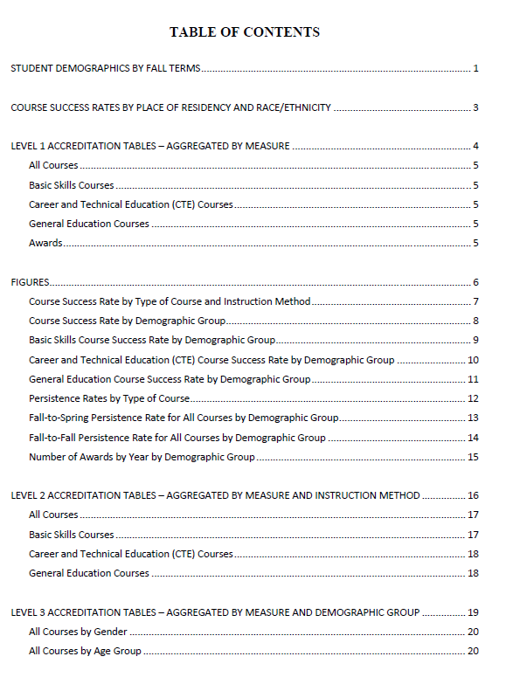
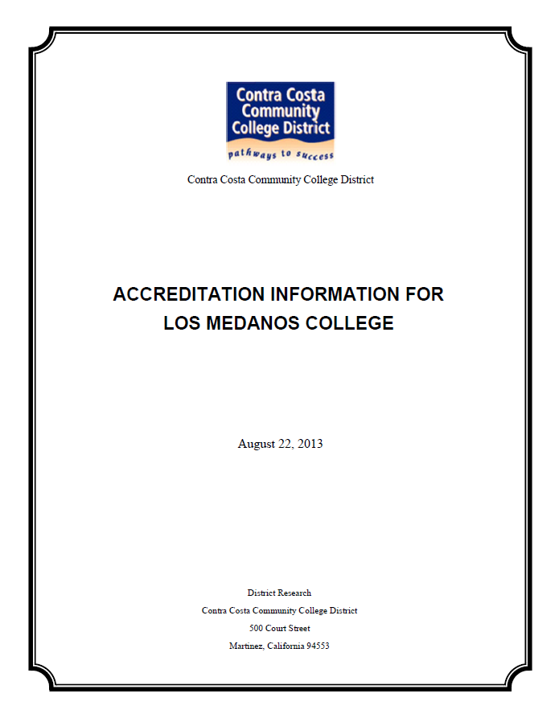

Slide 45
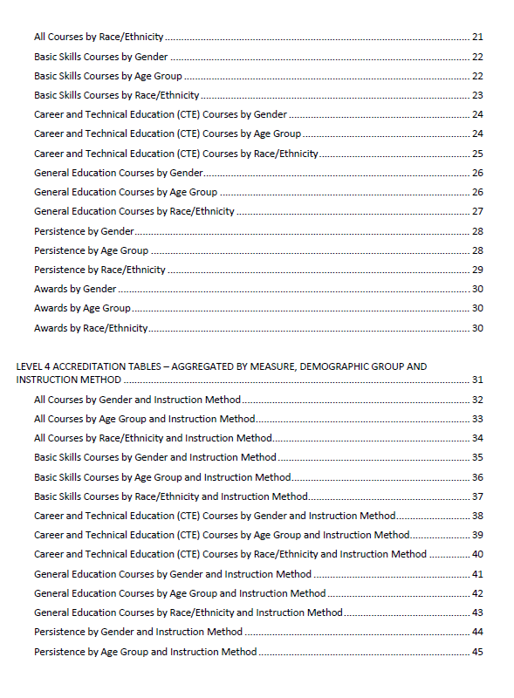
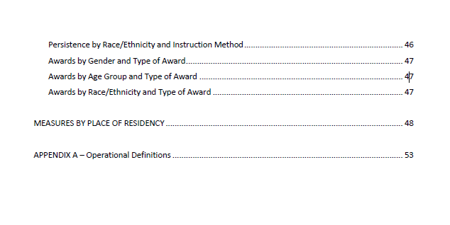

Slide 46
1. Review of the contents of LMC’s Accreditation Data Report
58 pages of tables and graphs
Keep in mind
This report was designed to meet a specific reporting mandate by our accreditors. Other questions are certain to arise as you review the document. Capture them and consider them candidates for future lines of inquiry outside of the accreditation process.
Contains over 10,000 data points
Includes a current demographic profile
Five year trend analysis
Success measures with multiple crosstabs
Includes a socioeconomic status proxy
Companion document for Brentwood Campus

Slide 47
1. Review of the contents of LMC’s Accreditation Data Report
All definitions are provided in the appendix of the report
Success Measures Reported
Success rate
Retention rate
Persistence rate (2 measures)
Number of awards (certificates & degrees)
Crosstabs Reported
Course type (GE, CTE, Basic Skills)
Instructional delivery method (on-line vs F-2-F)
Student demographics (gender, age, ethnicity)
Place of residence (a crude SES proxy)

Slide 48
2. The context for interpreting the data
Review the summary of the environmental scan
Demographic trends drive most of the change
Compare your self to your past not to other colleges
This is high-level data; aggregate change is usually slow
Be cautious in identifying causal relationships

Slide 49
3. Finding the story amid the noise
Focus on the trends and gaps. Look for evidence of convergence or divergence, volatility or stability.
Don’t try to explaining everything about a trend or gap; pick a perspective and offer an interpretation.
Reference occasions where there was collaborative, reflective dialogue on evidence. Suggest how you will have more of that going forward.

Slide 50
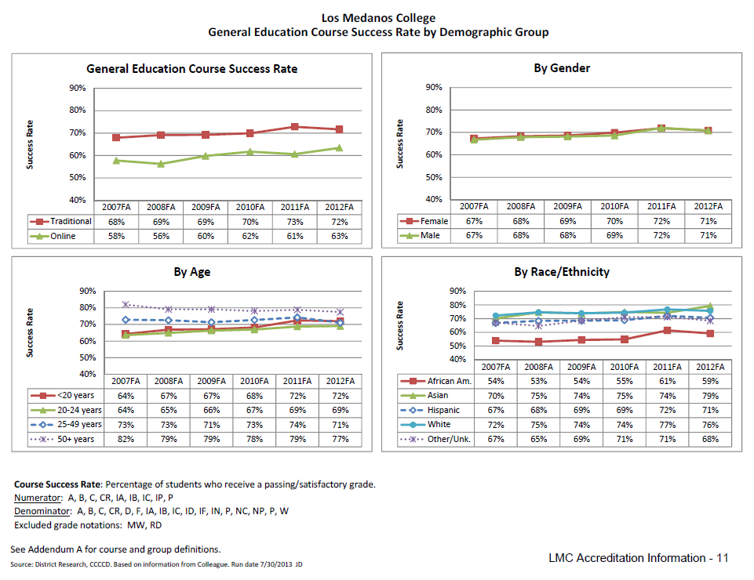
3. Finding the story amid the noise
Evidence suggests a smaller performance gap for Hispanic students than African American students.
Evidence of an improving overall trend and convergence in performance by age

Slide 51
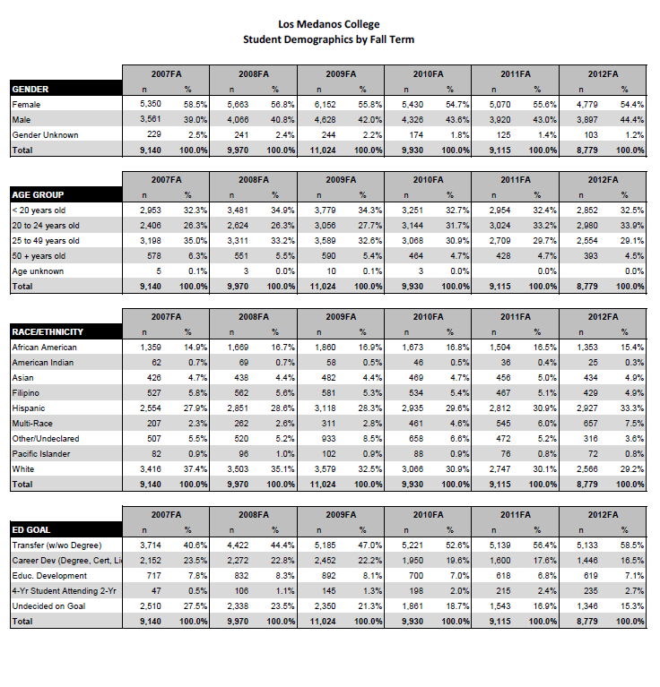
3. Finding the story amid the noise
The fastest growing age group is 20-24 year old group.
From the graph on the previous page we saw that 20-24 years olds tend to be the lowest performing age group. If that trend continues might we expect overall success rates to decline? If so, how might we best plan for that?

Slide 52
4. General rules for writing to the standard
Generally, you are not going to be assessed as to whether your data tells a good news story.
You are going to be assessed based on whether you conducted thoughtful review of the evidence (that you can document) and took appropriate action based on that review.
When referencing data, don’t simply describe what’s in the table/graph. Provide an interpretation and where possible demonstrate actions taken or to be taken.

Slide 53
4. General rules for writing to the standard
If you get stuck, consider saying something like …
“a review of this evidence prompted a request for a more detailed analysis to better identify appropriate interventions”
“while the cause of the change is indeterminate we will continue to monitor going forward with an eye toward identifying possible interventions”
“ while the emerging trend is promising, there remains opportunities for future improvements”

Slide 54
5. Next steps
Make note of where additional evidence would be helpful. Frame your thinking in terms of the question you would like to be able to answer and why it is important.
This report, the environmental scan and other data will be made available on the new District research page
Consider venues for routine discussion about evidence.

Slide 55
Thoughts?
Comments?

Slide 56
THANK YOU!
And special thanks to the Contra Costa District research staff who demonstrated outstanding data collection and research in support of the findings included in this report
Francisco Balderas
Rolando Valdez
Joy Hakola-Dardin
Helen Wu

