Slide 1
All-Faculty Meeting
Thursday, August 18, 2022
10:00-11:30

Slide 2
Enrollment Trends & Highlighted Efforts
Fall 2022

Slide 3
College Enrollment Trend: Headcount
 | Fall 2019 |  | Fall 2020 | Fall 2021 | Fall 2022*
New | 2,338 |  | 1,753 | 1,727 | 1,847
Continuing | 5,596 |  | 5,226 | 4,564 | 4,246
Returning | 1,785 |  | 1,704 | 1,766 | 1,679
Total | 9,719 |  | 8,683 | 8,057 | 7,772
 | Spring 2020 |  | Spring 2021 | Spring 2022
New | 756 |  | 516 | 554
Continuing | 6,631 |  | 6,075 | 5,614
Returning | 1,270 |  | 1,203 | 1,027
Total | 8,657 |  | 7,794 | 7,195

Slide 4
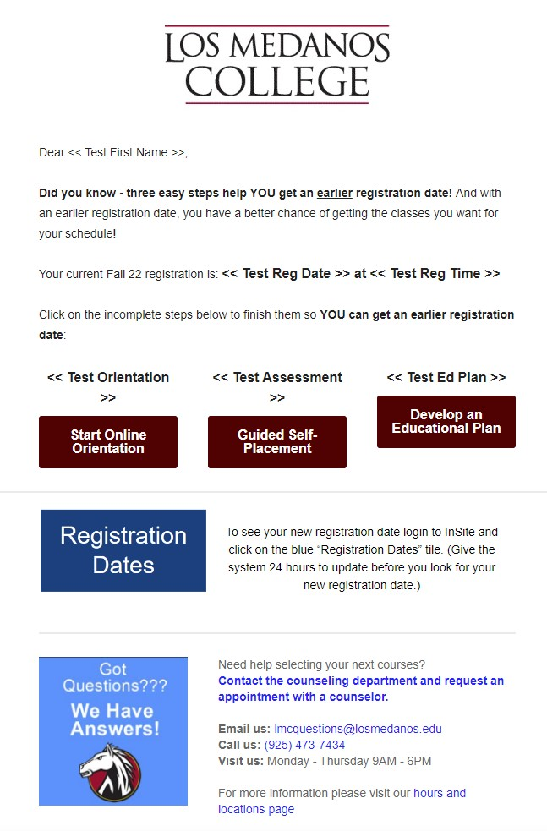
Continuing Students: Early Registration

Slide 5
Continuing Students: Calling Campaigns
1,898 Continuing Students who were:
Enrolled in classes in Spring 2022
Did not graduate in 2021-2022
Between 6 – 70 Cumulative Units
Not yet registered for Fall 2022
Phone calls by Student Ambassadors with a Counselor “Standing By”
August 8 – 17
CTE In-reach
For low-enrolled CTE courses there have been a mix of email, text, and calling campaigns to students that have CTE majors listed and are missing courses for completion

Slide 6
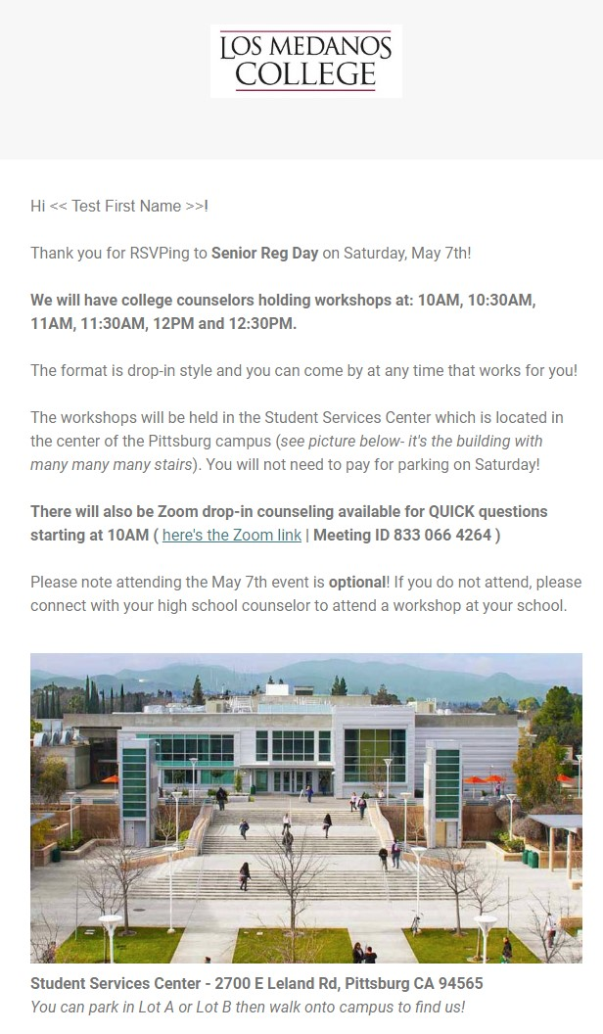
High School Graduating Seniors

Slide 7
Digital Advertising

Slide 8
Digital Advertising

Slide 9
Digital Advertising

Slide 10
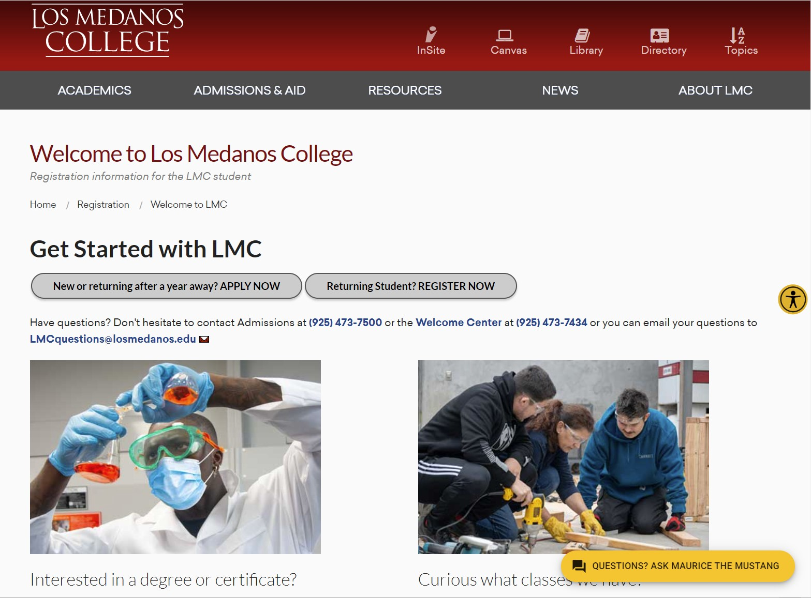
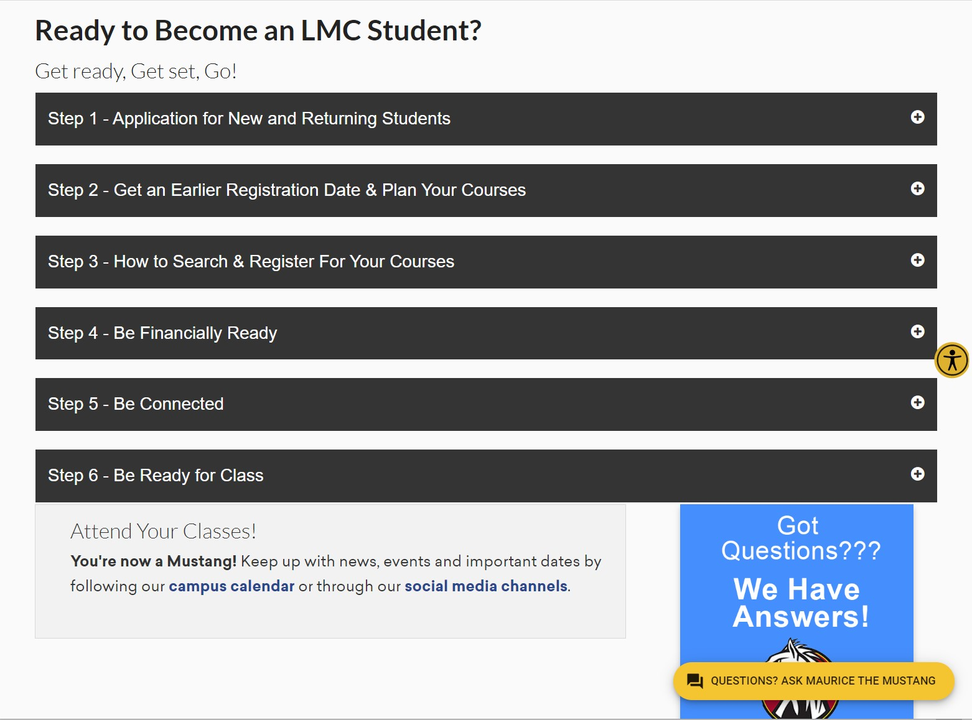
Directed: Registration Webpage

Slide 11
Directed: Virtual Information Sessions

Slide 12
Shout Outs!

Slide 17
Rikki Hall- A&R Tips & Waitlists

Slide 18
Nexus Update- Nexus Coordinators Jen Saito & Edward Haven
Welcome new faculty
Nexus overview and goals
Dr. Hollis Extended Series:
"What to Say and How to Say It: Bringing Civility and Honesty to Tough Conversations"

Slide 19
Office of Instruction
Introductions- OoI Team
Webpage
Administrivia

Slide 22
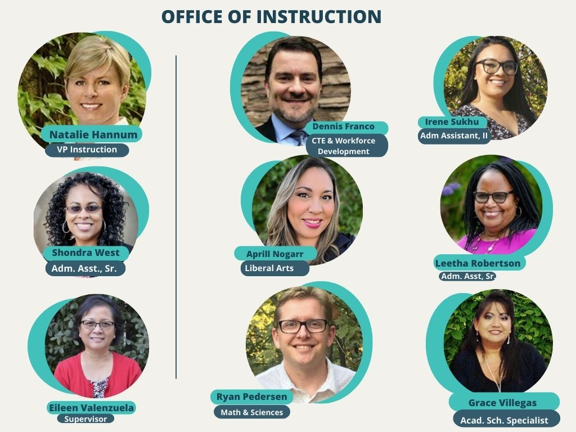

Slide 23
https://www.losmedanos.edu/intra-out/oi/

Slide 24
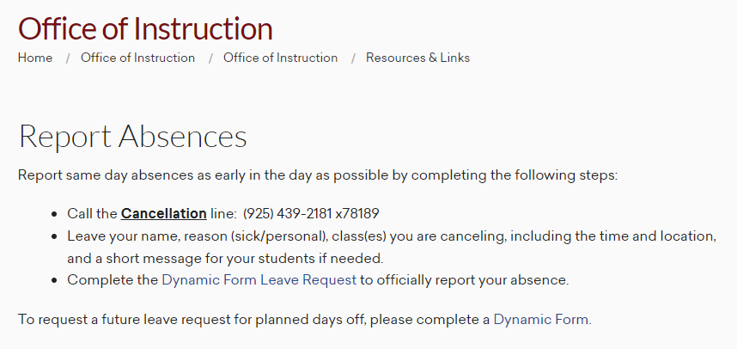
Dynamic Form Leave Request

Slide 25
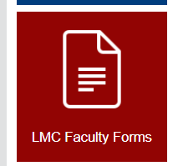
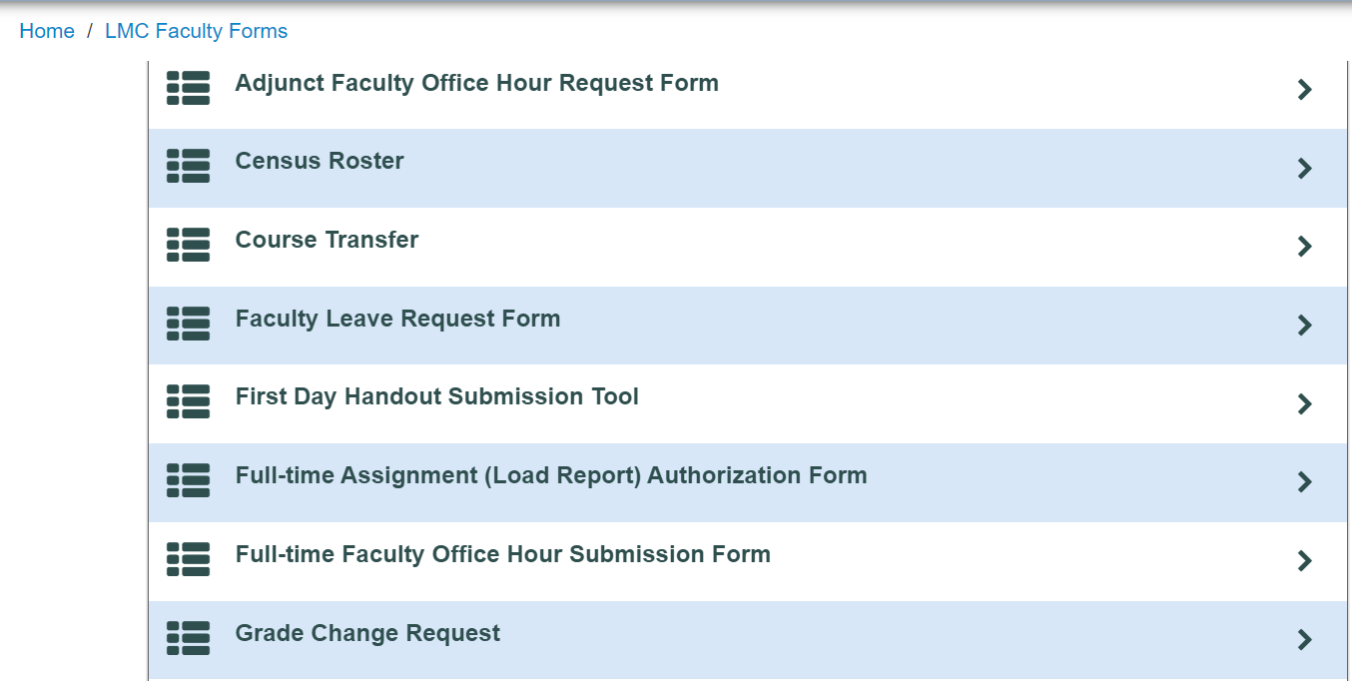

Slide 26
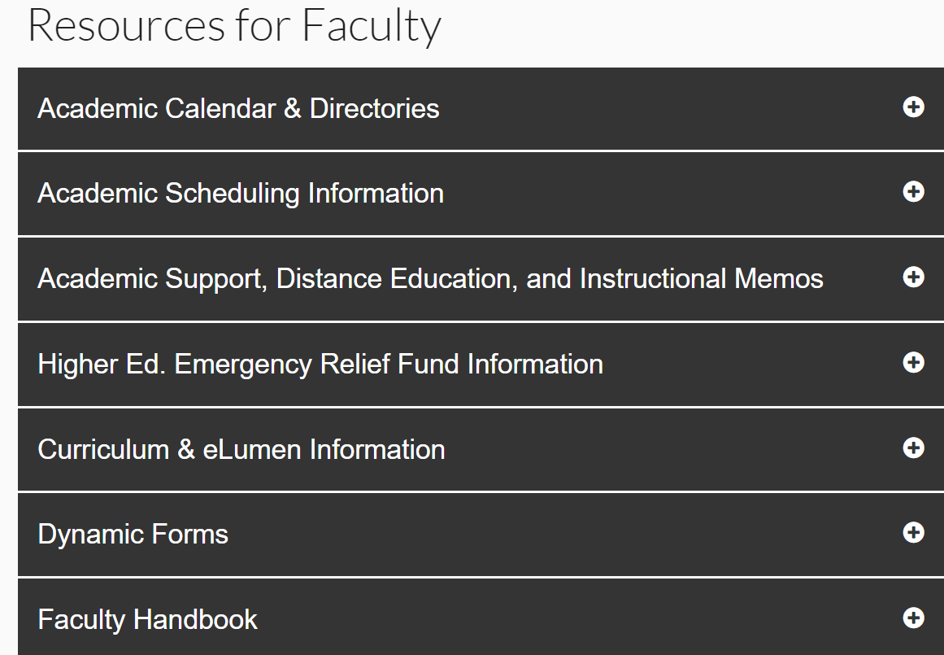
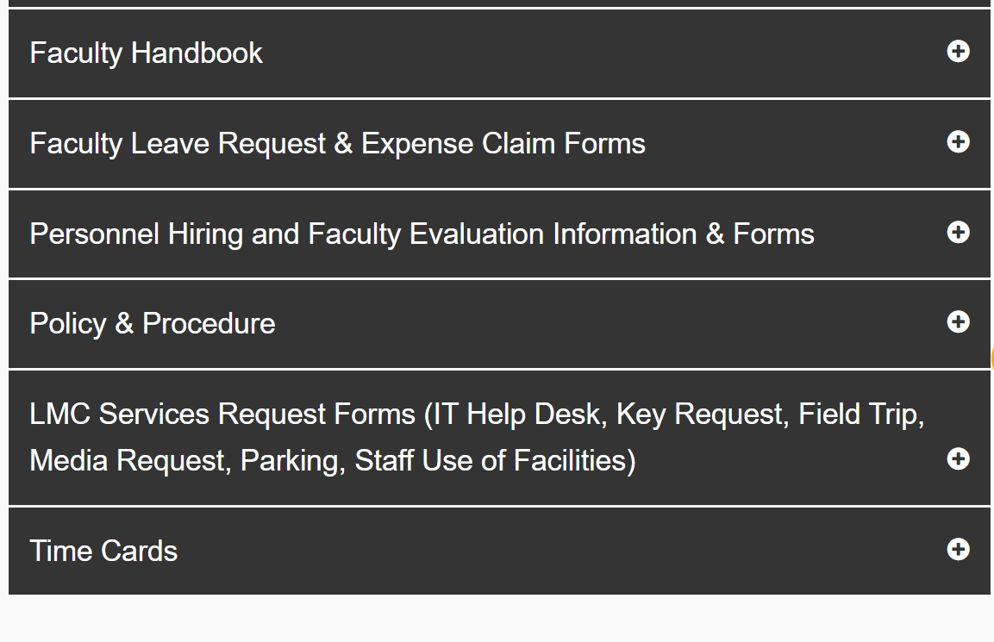

Slide 28
Distance Education Reminders & Resources
Districtwide Guidance on Online Attendance
Canvas New Analytics
PopeTech Integration – Accessibility Dashboard
Regular Substantive Interaction (RSI) - PlayPosit & Pronto
POMP, BEHI, Equity & Inclusion PD

Slide 29
Curriculum & Assessments: Back to Basics Morgan Lynn, Curriculum Chair Eileen Valenzuela Marci Lapriore Adrianna Simone

Slide 30
Your Curriculum Team:
14 Voting Members Thalia Bobadilla – Arts, Humanities, Communication Star Louis Steers - Arts, Humanities, Communication Von Wolf - Brentwood Center Penny Wilkins - Business and Management Vacant - Career Technical Education Vacant-Counseling Scott Hubbard - Distance Education George Olgin - English Syed Hussain - Health, Behavioral and Social Sciences Randi Osburn - Health, Behavioral and Social Sciences Christina Goff - Librarian Sepideh Daroogheha - Mathematics Tess Shideler - Science, Technology, Engineering and Math Girlie Sison - Science, Technology, Engineering and Math | Resource Members Natalie Hannum - Vice President of Instruction Dennis Franco - Dean, Instruction, Interim Ryan Pedersen - Dean, Instruction Aprill Nogarr - Dean, Instruction Rikki Hall - Director of Admissions and Records Nidia Gonzalinajec - PSLO/CSLO Coordinator David Reyes - Transfer Representative Adrianna Simone - General Education Committee Representative Rachel Anicetti - Transfer Representative Eileen Valenzuela - Articulation Officer Grace Villegas - Academic Scheduling Specialist Shondra West - Note taker, Administrative Assistant, Senior TBD- Student Representative

Slide 31
Open Seats!
Curriculum Chair position
One curriculum committee representative in Arts, Humanities, and Communication
One curriculum committee representative in CTE

Slide 32
Tech Review:
The tech review team reviews COR and Program submissions prior to full committee review and provides feedback on any areas of concern related to their expertise
Standing tech review meetings: (Date/Time TBA) via Zoom
Drop in or schedule a week to come in
An all-faculty email will come shortly with time and Zoom info
Opportunities for feedback and collaboration to solve curricular issues
Tech Review Team: Morgan Lynn, Christina Goff (Library), Rachel Anicetti (Transfer), Rikki Hall (A&R), Scott Hubbard (DE), Eileen Valenzuela (Articulation), Adrianna Simone (GE), Nidia Gonzalinajec (PSLO/CSLO Coordinator)

Slide 34
Deadlines
September 7, 2022: Catalog deadline!
Why this early? Curriculum requires approval by the District Board of Governors, and we are bound by their meeting schedule to then meet state deadlines
We know this is early, and particularly those of you proposing new courses will need more time. But we need all submissions by the third week of September PLEASE!

Slide 35
Know where to start:
Title 5
The Program and Course Approval Handbook
The LMC Curriculum Committee COR Guide
Your CSLO assessment results
Student feedback
ASCCC COR Guide
LMC’s Transfer Exploration Tool
Assist.org
DEI in Curriculum: Model Principles and Practices
Your colleagues at LMC!

Slide 36
Curriculum Development: IDEAA
9.01 F21 Adding Culturally Responsive Curriculum, Equity Mindedness and Anti-Racism to Course Outline of Record (COR) Requirements in Title 5
9.05 S21 Developing an Anti-Racism, Diversity, Equity, and Inclusion Curriculum Audit Process
Anti-Racism in Education Paper (Fall 2020)
Recommendation #5: Enact culturally responsive curricular redesign within disciplines, courses, and programs and with curriculum committees.
3.02 S22 Adopt the DEI in Curriculum Model Principles and Practices Framework
Resolved, That the Academic Senate for California Community Colleges adopts the DEI In Curriculum Model Principles and Practices and encourages local senates to use the model to review their curriculum practices; and
Resolved, That the Academic Senate for California Community Colleges works with system partners to support the implementation of the DEI in Curriculum Model Principles and Practices through collaborative professional learning. DEI in Curriculum Model Principles and Practices

Slide 37
From 5C:
As colleges design curricula to meet the needs of our diverse student populations, it is recommended that colleges address innovative ways to approach curricular design and the curricular impacts on student success as an opportunity to eliminate equity gaps. The California Community College Curriculum Committee (5C) recommends framing dialogue and decision-making for reimagining curriculum through an equity lens using the following principles:
Principle 1: Commitment to curricular diversity, culturally responsive content, and anti-racism
Principle 2: Commitment to change policies to remove systemic barriers to student success and equity
Principle 3: Commitment to building system resiliency

Slide 38
Get your voice heard!
Faculty advocacy groups (ASCCC)
Join listservs on different issues and disciplines
Pending changes in regulation
Adhoc groups for faculty feedback
Your LMC Academic senator and Academic President

Slide 39
PSLO Validation/Redesign SP22: Program-level Student Learning Outcomes
PSLOs
What do you want students to learn & be skilled in by the end of your program?
How will you know they have gotten there?
How will you help to get them there in courses/ experiences in a program?
(Tyler, 1949)

Slide 40
PSLO final products
Demonstrate the ability to properly diagnose, adjust and repair all major automotive systems, meeting or exceeding all manufacture specifications (Automotive)
Pursue discovery by creating and performing experiments, interpreting and communicating the results (Physical Science)
Approach texts through a critical, creative lens to support construction of knowledge and expression (English)
Choose 1 PSLO above: What are the knowledge, skills, & behaviors you see reflected here? How might you use these to inspire & motivate students?

Slide 41
Use other parts of your PSLO design plan to enhance, align, & tighten pedagogy & curriculum
Essential Questions – as thinking or assessment tools:
How is English used differently in various contexts to create the meaning we intend? (ESL)
How does what we want to make influence what materials we should use? (3D Design)
How can I transform my thinking to deeper long-term learning? (Vocational Nursing)
Why not? (Philosophy)
Enduring Understandings – as unit/ module objectives or assessment prompts:
A successful travel advisor is a professional that has in-depth knowledge of both travel products and client needs. (Travel Marketing)
Messages have real-world consequences for people and society. (Speech)
Organisms have surprising and often unpredictable connections in the ecosystems in which they live, and those connections shift when an ecosystem changes. (Bio)

Slide 42
Don’t forget – now you have a rockin’, intentional assessment plan
Collect evidence from courses in your program USING YOUR PLAN
Collect this evidence now or in 2026-27 year (next PSLO assessment year)
You’ve done the work! Now, use it to help prep learners for their futures ☺

Slide 43
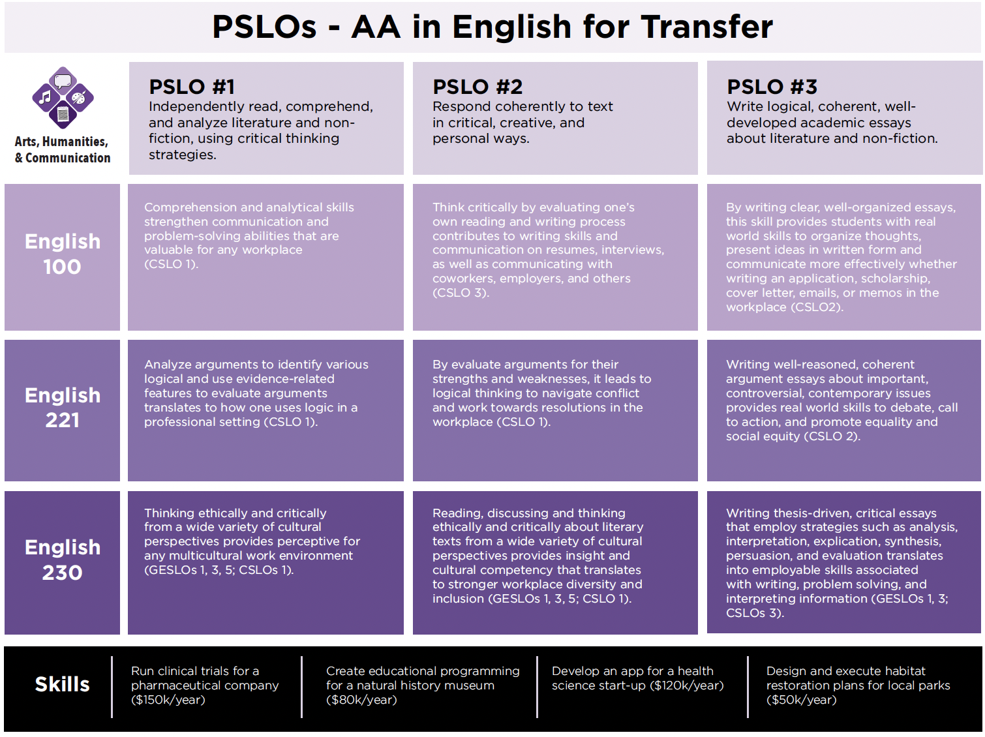
What’s next?
Get your new/validated PSLOs in eLumen and align to CSLOs (with guidance of TLC)
Use your plan to inform curriculum, including assessment, and pedagogy across your program
Get students hyped about those skills!
Stay tuned for these cool learning progression maps we’re working on!

Slide 44
Local GE Overview
6 GE SLOs
Aligns with Discipline Categories
1.Human Communication
2.Information Literacy
3.Ethical Insights
4.Diverse Perspectives
5.Quantitative Reasoning
6.Scientific Inquiry
1.Arts and Humanities
2.Language and Rationality (LR 2B)
3.Social and Behavioral Sciences
4.Ethnic and Multicultural Studies
5.Language and Rationality (LR 2A)
6.Natural Sciences
If your COOR transfers as a UC or CSU GE class, it will be automatically added to the GE LMC pattern if there is a comparable LMC GE requirement. At the next regular COOR revision, you will be required to integrate the assigned GE SLO.

Slide 45
Ethnic Studies and Social Justice Studies Update
ETHN courses:
ETHN 045: Introduction to Black Studies
ETHN 101: Introduction to Ethnic Studies
ETHN 102: Critical Thinking in Ethnic Studies
ETHN 103: Racial and Ethnic Justice Movements
ETHN 110: Introduction to Native American/Indigenous Studies

Slide 46
Department Updates
Art, Humanities & Philosophy
Ethnic Studies

Slide 47
Ethnic Studies
Additional five classes going through Curriculum Committee this Fall
One re-submission for Area F, ETHN 120: Immigrant Experiences in the U.S.
New faculty hired
1 full time ETHN/SJS faculty member
6 part-time in ETHN or/and SJS

Slide 48
Ethnic Studies and Social Justice Studies Department
Program approval from CCCCO's office- September/October (awaiting their memo)
Box 2A for F/T faculty position for Ethnic Studies (October)
Alignment of remaining courses to the proposed department sign MOU (September)
Budget and GL development with Business Services (October/November)
Final review by College President (November)
New Department effective January 1,
2022

Slide 49
Questions & Dicussion

