Slide 1
IDEAA and DEI and Curriculum Model Principles and Practices
General Session 1: Thursday, July 7 at 9:00 am - 10:15 am
Notes:
Welcome:Stephanie

Slide 2
Presenters
Michelle Velasquez Bean, ASCCC Treasurer
Stephanie Curry, ASCCC Area A Representative
Kelly Fowler, Vice President of Instruction, Mt. San Antonio College, 5C co-chair
Marshall T. Fulbright III, Vice President of Academic Affairs, Grossmont College
Notes:
Stephanie

Slide 3
General Session Description
The California Community College Curriculum Committee (5Cs) in 2020 created a set of recommended priorities focusing on championing equity-minded curriculum and practices for credit and noncredit instruction. Join us for this general session where we will share the new DEI in Curriculum Model Principles and Practices created in response to the 5C priorities. The session will provide a safe space for participants to reflect and hear real-life examples to take back to college campuses championing curricular diversity and culturally responsive content with an anti-racism focus. Join us to learn how to support these promising practices and begin conversations with curriculum committees on how to redesign practices within an equity-minded framework in support of our students. Although there may be challenging conversations in beginning transformative work, these discussions are essential steps to removing systemic barriers to student success and improving equity in curriculum.
Notes:
Stephanie

Slide 4
Concentric Circles Activity
Concentric Circles: Where are you?
DISCOMFORT
RISK
COMFORT
Notes:
Michelle (5 min)
Concentric Circles Self-reflection
Using your pen, mark with an X inside ONE of the circles--what are you feeling after reading the scenario?
Are you feeling . . .
COMFORT--is a place where you feel at EASE, with no tension. The environment you can imagine in this scenario is okay--you feel comfortable navigating the things occurring. Or maybe you are placing yourself in that zone to feel safe?
RISK ZONE--this is where you feel most willing to take some risks--a place that is most ready for learning and openness to others with curiosity and earnest interest.
DISCOMFORT--this is the DANGER zone. This is when one feels tense or fearful or defenses go up. Sometimes you get angry or may even want to escape and get to a safe space.
Staying in the Danger Zone takes a lot of energy and emotional toll. It’s where we go to a less rational state.
So, if you feel yourself go to the Discomfort/Danger Zone, then recognize and label it, so you can move into the RISK zone to consider ideas and perspectives you have not thought of before.

Slide 5
Many Acronyms - Shared Goal
DEI- Diversity, Equity and Inclusion
DEIA- Diversity, Equity, Inclusion and Accessibility (used by CCCCO)
IDEAA- Inclusion, Diversity, Equity, Antiracism and Accessibility (used by ASCCC)
Notes:
Kelly

Slide 6
Let’s Get On The Same Page:
Tool Terminology
Equity-minded - a schema that provides an alternative framework for understanding the causes of equity gaps in outcomes and the action needed to close them. Rather than attribute inequities in outcomes to student deficits, being equity-minded involves interpreting inequitable outcomes as a signal that practices are not working as intended. Inequities are eliminated through changes in institutional practices, policies, culture, and routines. Equity-mindedness encompasses being (l) race conscious, (2) institutionally focused, (3) evidence based, (4) systematically aware, and (5) action oriented (CCCCO Diversity, Equity, and Inclusion Glossary of Terms).
Culturally responsive teaching - an educator’s ability to recognize students’ cultural displays of learning and meaning making and respond positively and constructively with teaching moves that use cultural knowledge as a scaffold to connect what the student knows to new concepts and content in order to promote effective information processing . . . to create a safe space for learning. (Hammond, Z., 2015).
Euro-centric - privileging European or Westernized values and ways of knowing as the norm or “default” while marginalizing alternative perspectives, histories and knowledge.
Collectivism - an individual's sense of connection to and responsibility for members of their group/community (Hofstede, 1984; Triandis, 1995)
Individualism - the valuing of the individual over the value of groups or society as a whole (Griffiths, 2015).
Notes:
Marshall
Use culturally responsive teaching and learning. The scholarly term is “culturally responsive pedagogy.” Came from the book of Culturally Responsive Teaching & The Brain by Zaretta Hammond
Culturally Responsive Teaching and The Brain: Promoting Authentic Engagement and Rigor Among Culturally and Linguistically Diverse Students: Hammond, Zaretta L.: 9781483308012: Amazon.com: Books

Slide 7
Terminology Continued
Student-centered - refers to a wide variety of educational programs, learning experiences, instructional approaches, and academic-support strategies that are intended to address the distinct learning needs, interests, aspirations, or cultural backgrounds of individual students and groups of students.
Watering up - instructional practices with the science of learning that we can apprentice students to be active agents in their own learning, instead of watering them down with the compliance-oriented deficit views. This process requires students to build and braid together multiple neural, relational, and experiential processes to produce their own unique learning acceleration process (Hammond, Z., 2021).
Warm demander - a teacher who communicates personal warmth toward students while at the same time demands they work toward high standards. The teacher provides concrete guidance and support for meeting the standards, particularly corrective feedback, opportunities for information processing, and culturally relevant meaning making (Hammond, Z., 2015).
Warm handoffs - directly connecting students to campus resources and services; a transfer of care between two members of a care team; teachers providing direct contact names and information to connect students with service representatives such as in syllabi and course materials or directly introducing students to student service representatives with an intentional introduction.
Critical race theory - a way of seeing, attending to, accounting for, tracing and analyzing the ways that race is produced; the ways that racial inequality is facilitated, and the ways that our history has created these inequalities that now can be almost effortlessly reproduced unless we attend to the existence of these inequalities (Crenshaw, 2021 as cited in Fortin).
Notes:
Share Chancellor’s Office terminology page as resource: https://www.cccco.edu/-/media/CCCCO-Website/Files/Communications/vision-for-success/8-dei-glossary-of-terms.pdf

Slide 8
Acknowledging Power and Race: The Why
We need to come with INTENTIONALITY–to dig deeper and go beyond compliance
IMPACT is acknowledging
  the baseline–we have minimum requirements for serving our diverse students
  we need to start somewhere–with no shame or blame
  sustainable practice is cultivating cultural humility–self-reflection and accountability
Why do we discuss race and race neutrality?
  social constructs–color blindness does not acknowledge racial inequities
  systemic barriers—we need to disrupt the systems that creates barriers
What does the social justice journey entail?
  the struggle is part of the path
  the work requires intentionality to level the playing field
  we all win when we have equity
Notes:
Michelle
racism is not a thing of the past; it’s dangerous to think so, as there are still significant impacts of racism
remember we are speaking of collective action and impacts; not individual intention (that’s an equity detour when we try to blame individuals instead of address the impact of the behavior)
we need to actively and intentionally address race-neutrality in policy and procedures that actually uphold status quo, dominant power in decision-making
who did the development of those policies and procedures rely on primarily? it may be difficult to hear–we evolve as a society in ways that we may not be comfortable with–but that is the journey!
Race and races are social and political constructs, categories that society invents and manipulates when convenient. (https://neaedjustice.org/social-justice-issues/racial-justice/seven-harmful-racial-discourse-practices-to-avoid/; http://www.miller3group.com/Articles/What_Does_It_Really_Mean.pdf)

Slide 9

Framing Courageous Conversations
Ask the WHY
  Is it the right thing to do?
  Whom does it benefit? Whom does it harm?
  Does it align to our goal(s) or vision?
  Is there a negative impact? On whom?
Focus on policy not people
  Focus less on the personal issue and more on the problem solving
  Aim to change behavior--we cannot change beliefs
  Let’s acknowledge this is sensitive terminology (back to concentric circles)
Invest in community
  Keep the focus on building a collective team instead of emboldening individualism
  Allow for the organic community foundation--don’t get stuck in the idea of “perfection” before you start
Notes:
Kelly
Address triggers. Sensitive Terms. not moral binary. Call out the feeling. (around focusing on policy not people)
“Liberation is the creation of relationships, societies, communities, organizations and collective spaces characterized by equity, fairness, and the implementation of systems for the allocation of goods, services, benefits and rewards that support the full participation of each human and the promotion of their full humanness.” (Love, Dejong, Hughbanks 2013)
Who does it benefit? Who does it harm?
Return back to your FRAMING--ask the WHY? (goal, vision, passion, centering)
PEOPLE--often will want to go to the moral binary-- the focus on “good intent”
But avoid making space for an excuse for bad behavior
Ask if it is a reasonable request vs. making an accusation
Feelings may be that uncomfortable zone when addressing bias, racism, and sexism.
But SELF-REFLECTION is the key--that is the courage. The weakness is living off and decision-making based on our bias. The narrative and lived experiences of whole human beings is just the beginning of the conversation. It is needed.
REMEMBER COMMUNITY!

Slide 10
DEI Leadership as Heart Work
DEI work is hard work and heart work
  Approach diversity, equity, inclusion, accessibility, and antiracism work with a lens of empathy and humanity
  Self-awareness is a skill and involves emotion
  We are all responsible for our own growth
  No judgement or blame–rather, open mindedness and care
Need to build relationships (need to work together)
  Create intentional space and time for relationships and trust building
  Have the courageous conversations in order to move the work
May encounter frustrations but keep moving forward
  We are imperfect people who will make mistakes
  Embrace “fallure” vs. failure
  Seek positive “feedforward” vs. shaming feedback
Notes:
Michelle and Marshall
Building relationships- Intentional space for relationships and trust.
Focus on leadership and supporting curricular conversations.
Fallure story–means missing the hold in the rock and falling back–yet you keep going up the rock to get to the summit.

Slide 11
What ASCCC Says about IDEAA in Curriculum
9.01 F21 Adding Culturally Responsive Curriculum, Equity Mindedness and Anti-Racism to Course Outline of Record (COR) Requirements in Title 5
9.05 S21 Developing an Anti-Racism, Diversity, Equity, and Inclusion Curriculum Audit Process
Anti-Racism in Education Paper (Fall 2020)
  Recommendation #5: Enact culturally responsive curricular redesign within disciplines, courses, and programs and with curriculum committees.
3.02 S22 Adopt the DEI in Curriculum Model Principles and Practices Framework
  Resolved, That the Academic Senate for California Community Colleges adopts the DEI In Curriculum Model Principles and Practices and encourages local senates to use the model to review their curriculum practices; and
  Resolved, That the Academic Senate for California Community Colleges works with system partners to support the implementation of the DEI in Curriculum Model Principles and Practices through collaborative professional learning. DEI in Curriculum Model Principles and Practices
Notes:
Stephanie

Slide 12

The Student Ask
2020 Student Senate for California Community Colleges Anti-Racism: A Student Plan of Action
  Curriculum changes
  Ensure that the community college curriculum is responsive to all cultures in an effort to foster cultural appreciation, awareness, acceptance, and value
Notes:
Stephanie

Slide 13
5C: Collective Work on DEI and Curriculum
As colleges design curricula to meet the needs of our diverse student populations, it is recommended that colleges address innovative ways to approach curricular design and the curricular impacts on student success as an opportunity to eliminate equity gaps. The California Community College Curriculum Committee (5C) recommends framing dialogue and decision-making for reimagining curriculum through an equity lens using the following principles:
Principle 1: Commitment to curricular diversity, culturally responsive content, and anti-racism
Principle 2: Commitment to change policies to remove systemic barriers to student success and equity
Principle 3: Commitment to building system resiliency
Notes:
Stephanie and Kelly

Slide 14
Introducing: DEI in Curriculum Model Principles and Practices
The intention of the DEI in Curriculum Principles and Practices chart is to focus on acknowledging the inequities of historically marginalized racial and ethnic groups (Black, Indigenous, Latinx/a/o, Asian Pacific Islander).
Provide a tool and support structure to have conversations at your campus on looking at current practices and supporting analysis and change.
The tool is not exhaustive, it provides multiple topics but is designed to be expanded as need to support local questions or concerns.
While acknowledgement of intersectional identities is important and valued, the aim of designing the chart was not necessarily addressing accessibility tools, as the California Virtual Campus and Accessibility Center have robust training and support for inclusion and accessibility requirements.
Notes:
Stephanie

Slide 15
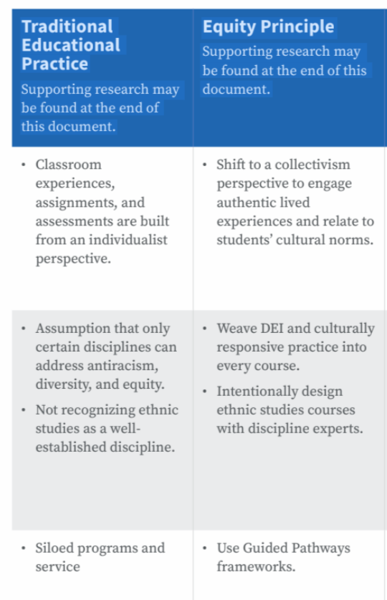
Acknowledging and Identifying Traditional Educational Processes and Equity Framework
Traditional Educational Practice
Supporting research may be found at the end of this document.
Equity Principle
Supporting research may be found at the end of this document.
Notes:
Kelly
(page 6 of tool: classroom experiences)
Marshall
Framing why DEI? Gro
Keeping inclusive, diverse with centered opposed to punitive concerns.e and equitable educational experience for our students at the heart of our work.

Slide 16
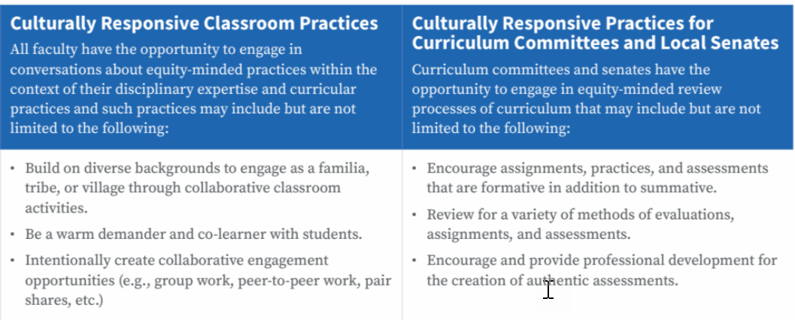
Models and Practices for Classrooms & Committees
Engaging with the fourth column:
Curriculum committees and academic senates have the opportunity to engage in equity-minded review processes of curriculum.
This column shows ways that local curriculum committees and academic senates may support equity work in reviewing credit and noncredit curriculum, course outlines of record, and curriculum documents and processes in culturally responsive ways.
Engaging with the third column:
All faculty have the opportunity to engage in conversations about equity-minded practices within the context of their disciplinary expertise.
This column provides promising practices that faculty can begin implementing at the classroom level.
Classroom level and curricular practices may include but are not limited to those listed in the chart.
Notes:
Stephanie
Again, just suggestions to begin your courageous conversations
These promising practices are not exhaustive nor limited to those on the chart.
Create and discuss what works for your campus.
The focus and aim should be open-mindedness with disrupting traditional mindsets and embracing diversity of thought and critical inquiry in processes and policies for credit and noncredit.

Slide 17
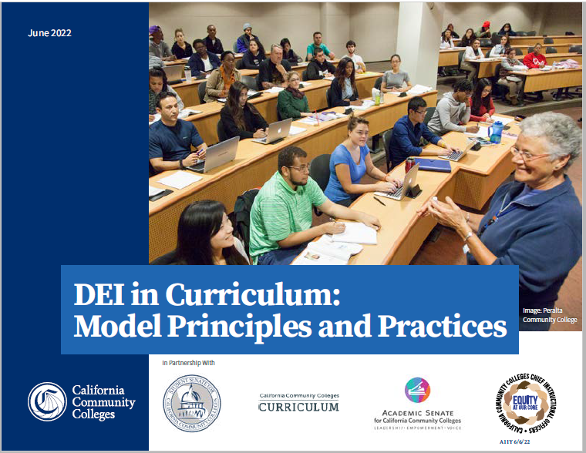
Areas identified in the tool…your college can locally add more
Textbooks
Student-facing documents
Role of discipline faculty
Course syllabus
Classroom assignments/assessments
DEI in all disciplines
Ethnic Studies as a discipline
Siloed programs and services
Your college can add more!
Notes:
Michelle

Slide 18
Curriculum Change needs Collaboration (Faculty and Administrators)
Need partnership to support curriculum between faculty and administrators
To make change–collaborate in creating policies, practices, and implementation
It’s about championing! Supporting the work and shift of mindset
Need trust, relationships, and collaboration
Resource: The Value of Partnership in Moving Systems: CIOs and Faculty Team Up for Good- Michelle Bean and Don Miller
Notes:
Kelly and Michelle
THINGS YOU CAN DO TODAY:
Make an appointment to talk to your CIO about needed resources and support for the IDEAA work.
Agendize IDEAA at every meeting.
Collaborate with other campus constituents to make major IDEAA principles part of your annual institutional goals. Put those goals on your agendas, on your website, and post them EVERYWHERE on campus.
Create a Cultural Humility Journey Map together.
Return to the 2020 promises and antiracist pledge you may have written and passed and measure what progress you have made.
Empower BIPOC leaders and create a succession plan to include more voices.
Give yourself grace and space to be imperfect but keep going! Social justice work is ongoing, and you are needed.

Slide 19
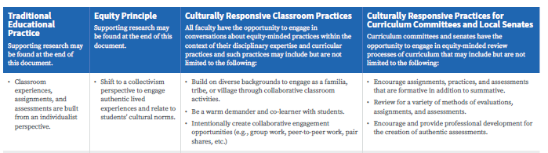
Using the Tool: Let’s walk through one of the sections
TRADITIONAL: Classroom experiences, assignments, and assessments are built from an individualist perspective.
EQUITY PRINCIPLE: Shift to a collectivism perspective to engage authentic lived experiences and relate to students’ cultural norms.
CLASSROOM PRACTICES:
  Build on diverse backgrounds to engage as a familia, tribe, or village through collaborative classroom activities.
  Be a warm demander and co-learner with students.
  Intentionally create collaborative engagement opportunities (e.g., group work, peer-to-peer work, pair shares, etc.)
CURRICULUM COMMITTEES/SENATES:
  Encourage assignments, practices, and assessments that are formative in addition to summative.
  Review for a variety of methods of evaluations, assignments, and assessments.
  Encourage and provide professional development for the creation of authentic assessments.
Notes:
All/Michelle/Kelly
Traditional Eurocentric Practice: Classroom experiences, assignments, and assessments are built from an individualist perspective
Equity Principle: Shift to a collectivism perspective to engage authentic lived experiences and relate to students cultural norms
Culturally Responsive Classroom Practice:
● Build on diverse backgrounds to engage as a familia, tribe, village through collaborative classroom activities.
● Be a warm demander and co-learner with students.
● Intentionally create collaborative engagement opportunities (e.g., group work, peer to peer work, pair shares, etc.)
Culturally Responsive Practices for Curriculum Committees and Local Senates:
● Encourage assignments, practices, and assessments that are formative in addition to summative.
● Review for a variety of methods of evaluations, assignments, and assessments.
● Encourage and provide professional development for the creation of authentic assessments.

Slide 20
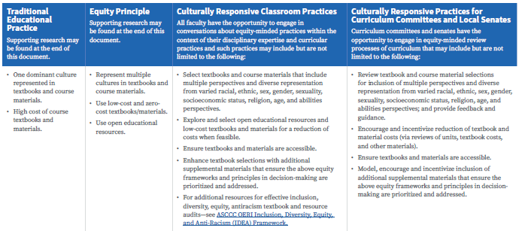
Using the Tool: Walking through another section
TRADITIONAL:
  One dominant culture represented in textbooks and course materials.
  High cost of course textbooks and materials.
EQUITY PRINCIPLES:
  Represent multiple cultures in textbooks and course materials.
  Use low-cost and zero-cost textbooks/materials.
  Use open educational resources.
CLASSROOM PRACTICES:
  Select textbooks and course materials that include multiple perspectives and diverse representation from varied racial, ethnic, sex, gender, sexuality, socioeconomic status, religion, age, and abilities perspectives.
  Explore and select open educational resources and low-cost textbooks and materials for a reduction of costs when feasible.
  Ensure textbooks and materials are accessible.
  Enhance textbook selections with additional supplemental materials that ensure the above equity frameworks and principles in decision-making are prioritized and addressed. For additional resources for effective inclusion, diversity, equity, antiracism textbook and resource audits—see ASCCC OERI Inclusion, Diversity, Equity, and Anti-Racism (IDEA) Framework.
CURRICULUM COMMITTEES/SENATES:
  Review textbook and course material selections for inclusion of multiple perspectives and diverse representation from varied racial, ethnic, sex, gender, sexuality, socioeconomic status, religion, age, and abilities perspectives; and provide feedback and guidance.
  Encourage and incentivize reduction of textbook and material costs (via reviews of units, textbook costs,and other materials).
  Ensure textbooks and materials are accessible.
  Model, encourage, and incentivize inclusion of additional supplemental materials that ensure the above equity frameworks and principles in decision-making are prioritized and addressed.
Notes:
Michelle, Kelly, Marshall

Slide 21
How To Use The Tool Locally
Not going to solve all problems but tool to move the conversations and work forward
Take this back to your local senates and curriculum committees
Meant to be shared in cross functional conversations (faculty, staff, students, and administrators)
Dedicate time to working through the tool, conversations may need to take multiple meetings.
  There is no shortcut to this work.
  Be willing to be vulnerable and uncomfortable in these conversations.
Notes:
Stephanie

Slide 22

R. A. V. E. N.
(Dr. Luke Wood and Dr. Frank Harris)
Redirect
  Intervene, correct, pull aside
Ask probing questions for clarity
  I think I heard you say . . . What do you mean by that?
  I want to make sure I understand what you were saying. Were you saying that . . . ?
Values clarification
  You know, at our college, we work hard to create space that is safe and welcoming for all. What you just said is not in alignment and/or inconsistent with our institutional values that prioritize equity and inclusion.
  What you just said is not socially acceptable, let’s reframe that to a positive.
Emphasize your own thoughts and feelings
  When I hear you comment, I think/feel . . .
  Many people might take that to mean . . .
  In my experience, . . .
Next steps
  The next time you encounter this situation, you may want to consider doing . . .
Notes:
Effective TOOLS to use for RESPONSE: (Michelle intro; Kelly–do eagle and hawks)
RAVEN method
REDIRECT: Decide calling in vs. calling out: What’s effective? Do I know this person well?
ASK: If you feel it, ask for CLARIFICATION.
Listen for microaggressions and racialized microassaults: “THOSE” students. “She’s so touchy feely.” “I can’t even understand him with his accent.” “She’s so lazy.” “Here comes trouble”
Microinvalidations and microinsults: “Oh, you have a Ph.D.?” “You didn’t answer my question.” “Girls don’t do well in STEM usually” “You speak really good English” “I don’t see color” “I understand what you’re going through, I grew up poor”
VALUES CLARIFICATION:
Ask what they mean?
Remind them of the established COMMUNITY NORMS and COMMITTEE GOALS.
EMPHASIZE OWN FEELINGS:
Use HUDDLE TEAM--cultivate and consult your team and ask for support ahead of time!
GIVE what they can DO NEXT instead of flipping to a dominant culture lens
Remember that SELF-REFLECTION is the key--coded language is deep seeded in the “discourse of collegiality”

Slide 23

The Huddle
“Huddle” with those who will help and give feedback on identifying the issue and strategizing how to deal with it with empathy and love.
Holding each other up does not always mean agreeing with each other, but does mean calling in behaviors not aligned with your goals and vision.
“The main goal [of allies] is to develop relationships of solidarity, mutuality and trust, rooted in a praxis of intentional anti-racist thought, action and reflection.” --Raible qtd in Goodman
Notes:
Put your energy into those in your HUDDLE of EMPATHY.
“We need to start safeguarding each other to start healing each other’s pain.” (Dr. Ramani: https://www.youtube.com/watch?v=4aZKNck6LDE&feature=youtu.be)

Slide 24

The Teamwork
Am I intellectualizing or actualizing a safe space for diverse voices?
Am I “going along to get along” or are I am going to speak up when something is off?
Will I speak up when I see exclusionary behavior or hear unwarranted comments?
Will I celebrate the discomfort? Am I willing to grow, listen, engage, and acknowledge others for their diverse perspectives?
Am I engaging in liberation and healing and not self-loathing or denial?
Self-Reflection Questions
Notes:
BYSTANDER INTERVENTION:
Speak up--DON’T give bullies hiding behind archaic ideas of “collegiality” a FREE PASS!
Be willing to hear what others are saying is not working--see something say something!
Be a witness to the exclusionary behavior--the aim is not to change that person but to show observers that there is another alternative.
Strategize with president/CEO and your team to . . .
STOP embolding the patterns of toxic behavior couched in “discourse of collegiality.”
STOP FEEDING those who oppress and invalidate.
TAKE away the audience and the oppressors will collapse.
CELEBRATE DISCOMFORT: We should all be exercising this muscle! And remember that DEFENSIVENESS doesn’t help anyone. That doesn’t help anyone feel safe.
If you have the power and privilege to change something, a system that creates barriers to diverse voices, then do something to change it. That’s CIVIL--that’s common HUMANITY! That’s empathy and equity.

Slide 25
From Discussion to Action
Once you have the conversations, be willing to act on your findings.
Don’t just talk about changing policies, processes, and procedures, do it.
It does not have to be perfect before you make changes (first pancake).
Discuss how you are going to evaluate the change and its impact.
Share what is working and what is not with fellow colleagues: let’s learn together.
Notes:
Stephanie

Slide 26
Follow Up Breakout Sessions
Breakout Session 1 Today at 10:30 a.m. - 11:45 a.m.
Serving the Students We Have: How IDEAA in the COR Can Encourage Inclusive Instruction (I)
Breakout Session 2 Today at 2:15 p.m. - 3:30 p.m.
Walking the IDEAA Talk: Reimaging Your Curriculum Processes and Classroom Practices (O)
Breakout Session 6 Saturday at 9:00 a.m. - 10:15 a.m.
How to Use Equity Tools to Have Equity Conversations (I)
Notes:
Michelle

Slide 27
Support and Resources
Email: info@asccc.org
Local Senate Visit on using DEI in Curriculum Model Policies and Practices or Generally on IDEAA in Curriculum
CCCCO Glossary of Terms
OERI curricular audit tool to share with your colleagues (link is in the DEI Model Policies and Practices Document)
Notes:
Stephanie
Glossary: https://www.cccco.edu/About-Us/Vision-for-Success/diversity-equity-inclusion

Slide 28

QUESTIONS?
Notes:
All

