Slide 1

LMC Food Pantry

Slide 2
Where and how did it start?
Started as an idea from Tito Ramos (former LMC student)
Took the idea to the Office of Student Life
Housed under the Office of Student Life

Slide 3
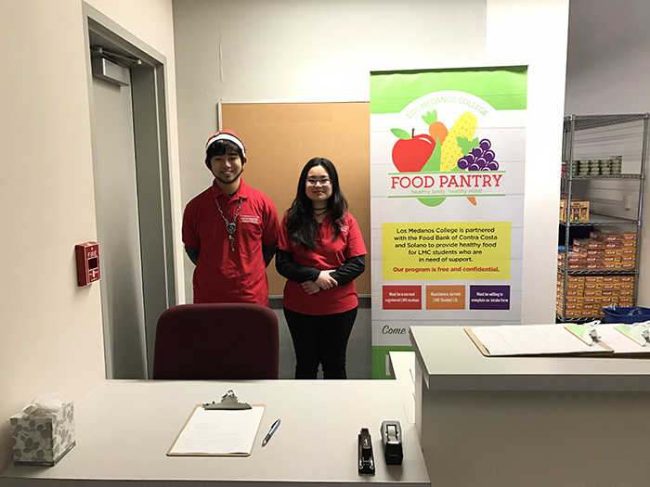
Student Employees
6 work-study students
All have a passion for alleviating food insecurity on campus

Slide 4
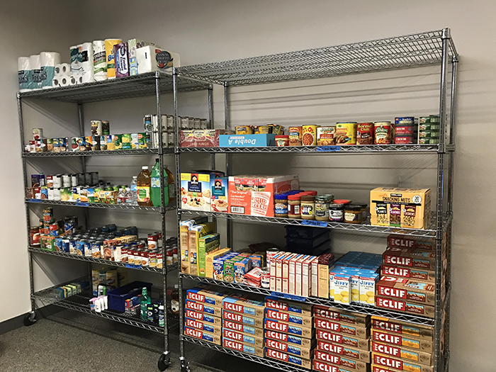
Funding
Food Donations
Grants

Slide 5
Who is eligible?
Current registered LMC students

Slide 6
Process
What is the process to receive food?
  Students will need to first fill out an intake form in order to be verified as a student.
  After the intake form has been approved, the Student Life Coordinator will notify the student that they have been accepted.
  After they have been accepted, they can start picking up items from the Food Pantry.
  Students will line up and swipe their cards in order to receive food.
An updated menu will be available weekly.

Slide 7

Hours of Operation
Monday - 10:00AM - 3:00PM & 5:00PM - 7:00PM
Thursday - 10:00AM - 3:00PM & 5:00PM - 7:00PM
Friday - 1:00PM - 3:00PM

Slide 8
Contact Us
Location: SS3-817 (by Cafeteria and Veteran's Center)
Phone: (925) 473-7758
For more information, please contact John Nguyen at knguyen@losmedanos.edu or call (925) 473-7553.

