Slide 1
BIO
Roderick Jefferson is an internationally recognized, business focused speaker. Having given keynote presentations nationally and seven countries throughout the world, he understands the power of sharing real life strategies that work.
Over the past two decades, Roderick has shared his dynamic and energetic voice globally in variety of events including keynotes, guest lectures, and domain expertise panels, with companies including Oracle, Salesforce.com, 3PAR/HP, Business Objects, NetApp, PayPal, Siebel Systems, and AT&T.
In addition to a highly successful speaking career, Roderick is an acknowledged thought leader in the sales enablement space. For over twenty years he has built award-winning sales enablement organizations within some of the world's most successful Fortune 1,000 companies. Roderick has won numerous awards including being selected as the 2015 Sales On-boarding Program of the Year by SiriusDecisions.

Slide 2


“Diversity in leadership”
#Hopeisnotastrategy

Slide 3
Diversity in leadership
Why is diversity important?
What is the responsibility of the college/university?
  How is college an extension of family diversity ideals?
What is the responsibility of Corporate America?

Slide 4
Why is diversity important?

Slide 5
What is Diversity?
di·ver·si·ty (dəˈvərsədē,dīˈvərsədē)
noun
noun: Diversity; plural noun: Diversities
“the state of being diverse; A range of different things”.
synonyms: Variety, Assortment, Mixture, Multiplicity

Slide 6
What is the Value of Diversity in the workplace?
agility
Innovation
culture
Notes:
Corporate employees represent a variety of cultures, span four generations, practice many religions, and live in large cities and small towns. This diversity allows companies to examine our business from a range of perspectives.

Slide 7
What is the responsibility of the college/university?

Slide 8
Preparation to enter a diverse workforce
LOOK
LISTEN
LEARN

Slide 9
YOUR NETWORTH IS DETERMINED BY YOUR NETWORK
Increased enrollment
Improved Retention
Decreased Default

Slide 10
Courage to Connect
(STEPPING OUTSIDE YOUR COMFORT ZONE)

Slide 11
How is college an extension of family diversity ideals?

Slide 12
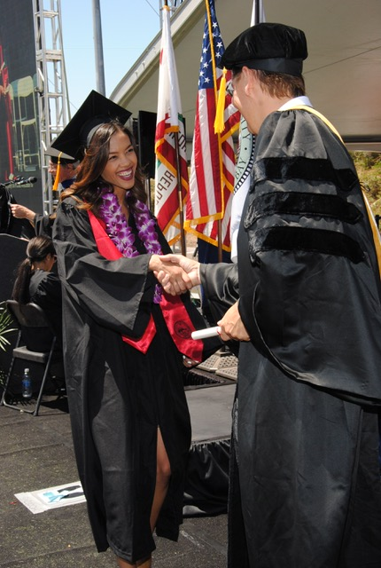


SUCCESS IS ACHIEVED THROUGH PARTNERSHIP

Slide 13
What is the responsibility of Corporate America?

Slide 14
Driving diversity through thought leadership
Diversity recruiting
COMPANY VISION & VALUES
Mentorship programs
COMMUNITY OUTREACH programs
Supplier diversity programs

Slide 15
Why is diversity & inclusion critical to success?
“Diversity is the mix… inclusion is making the mix work”
- Andres tapia
“Diversity is a seat at the table, inclusion is the ability to order off of the menu”
- Barb hardy

Slide 16
info@roderickjefferson.com facebook.com/@thevoiceofrod
@thevoiceofrod

