Slide 1



Brothers of Excellence
Program
Welcome to
Present By
Richard C Hanzy, MA, LMFT
Los Medanos EOPS Adjunct Counselor

Slide 2
WHY BOEP
In 2014, the Minority Male Community College Collaborative (M2C3) of California released a report that highlighted the negative outcomes for men of color in the California Community College system.
The study found that African American men in particular had the lowest overall persistence rates and credit course completion rate; and third lowest graduation/transfer rates with only a 2% difference from being the lowest.
In an effort to combat this educational epidemic, Los Medanos College’s EOPS (Extended Opportunity Program and Services) Department has taken an innovative approach to decreasing the achievement gap between minority male students and their counterparts by creating the Brothers of Excellence Program (BOEP) in 2015.

Slide 3
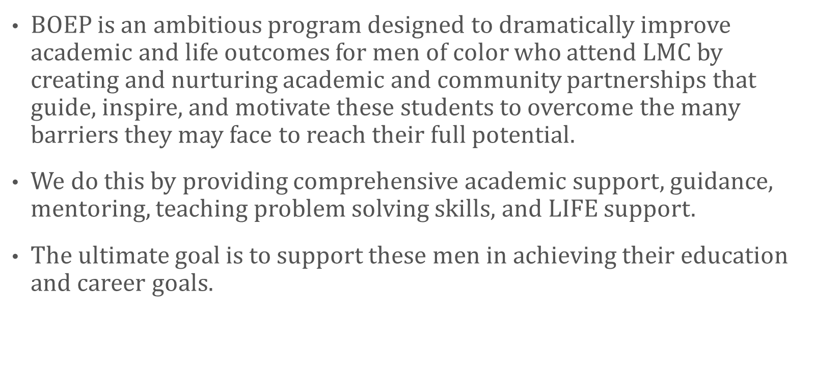
ABOUT BOEP

Slide 4
6 Success Factors
DIRECTION: BOEP students will be encouraged and supported in setting an academic goal and creating an education plan to achieve it.
FOCUS: BOEP students will meet bi-weekly as a group (weekly if needed) with BOEP coordinators to track their progress and get support in overcoming barriers to their goals.
NURTURE: BOEP will embody LMC‘s “family” atmosphere, by creating an environment where students feel supported and are connect throughout the college with additional support services.

Slide 5
6 Success Factors
ENGAGE: BOEP will actively involve students in meaningful and authentic educational experiences and activities inside and outside the classroom
CONNECT: BOEP students will assisted in connecting various campus academic programs, campus events and meetings to become a vital part of the LMC community.
VALUE: Through personal development activities, BOEP students will use their skills, talents, abilities and experiences to contribute to and enrich the LMC culture and community

Slide 6

STUDY LOUNGE OVERVIEW
The Los Medanos College's Study Lounge offers students a comfortable learning environment that allows students to develop their academic skills.
TIME: Fridays at 4:00PM-6:00PM
LOCATION: LMC’s English Department
GUIDED LOUNGE ACTIVITY: Some of LMC’s instructors will be present during lounge hours to help you with their course work.
COUNSELING - PRIORITY FOR TRANSFER TRIPS -A FREE T-SHIRT -TRIPS - WORKSHOPS – FOOD PROVIDED

Slide 7
STUDY LOUNGE OVERVIEW
PARTICIPATION REQUIREMENTS:
To access the Study Lounge, students must:
1. Take the Academic Success Pledge (ASP), committing to successfully completing all of the courses that they are enrolled in throughout the semester.
2. Regularly attend The Study Lounge and workshops throughout the academic year.
3. Abide by the Study Lounge Code designed by the students.
All students are welcome!

Slide 8


BOEP IS ABOUT MAKING BETTER CHOICES

Slide 9

QUESTIONS

Slide 10

James Noel, PhD
Coordinator and English Professor
925-473-7863 jnoel@losmedanos.edu
Richard C Hanzy, LMFT, PhD
Coordinator and EOPS Counselor
925-473-7480 rhanzy@losmedanos.edu
Please Support Us!
Los Medanos College
SS4-400 (upper level of the Student Services Center)
2700 East Leland Road
Pittsburg, CA 94565
www.losmedanos.edu /studentservices/eops

