Slide 1

Notes:
The open space on the bottom right of this slide is where a partner college/organization can add their logo when providing a presentation authorized by New World of Work.

Slide 2
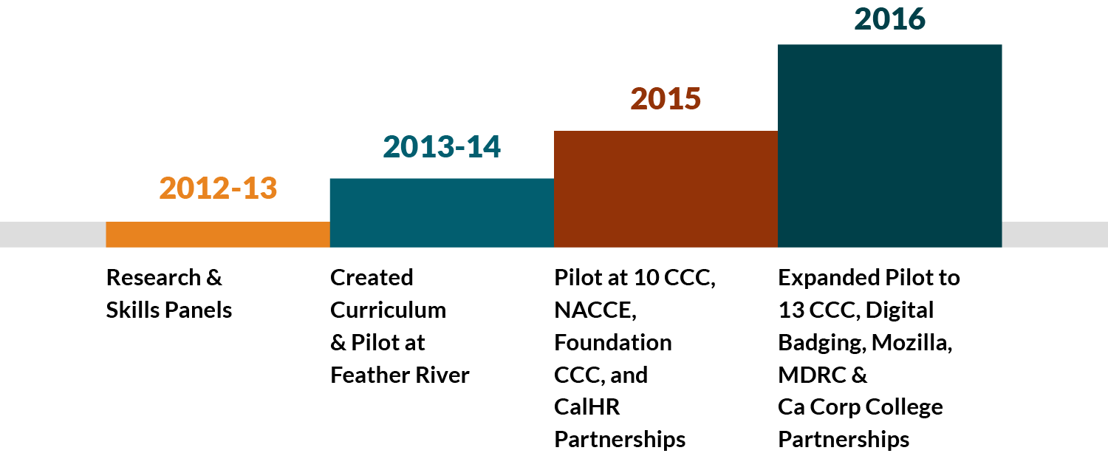
NEW WORLD OF WORK: HISTORY
Notes:
New World of Work began in 2012 at Feather River College in Quincy, CA. The following slides give more detail about key developments and achievements from inception up through 2016, with the transition in 2017 to the new headquarters at Shasta College.

Slide 3
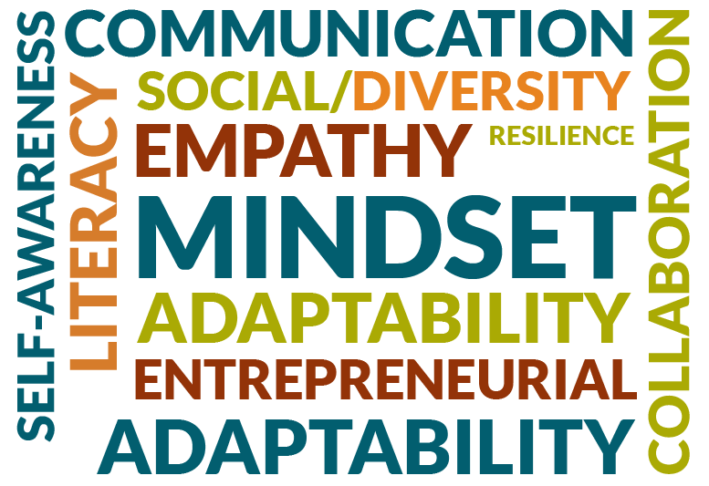
“Top 10” 21st Century Skills
Adaptability
Analysis/Solution Mindset
Collaboration
Communication
Digital Fluency
Empathy
Entrepreneurial Mindset
Resilience
Self-Awareness
Social/Diversity Awareness
Notes:
Read out all the skills.

Slide 4

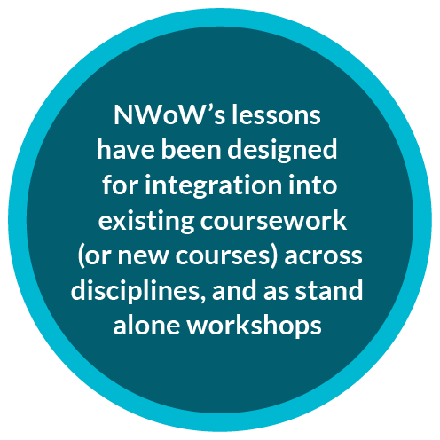


HOW TO INTEGRATE 21st CENTURY SKILLS?
Notes:
Important to note here that with the streamlining process for curriculum approval that began in the summer of 2016, colleges in our Community of Practice are not only integrating the lessons into existing frameworks on their campus, but also starting new stand-alone courses for 21st Century Skills. For example, Shasta College is creating a course that will cover all ten essential employability skills as a prerequisite to students conducting internship placements.
Workshops are also a great way to focus on a particular skill and can be hosted in tandem with partner organizations/groups such as TRiO, Career/College Advising, Workforce Development Boards, and Community organizations.

Slide 5




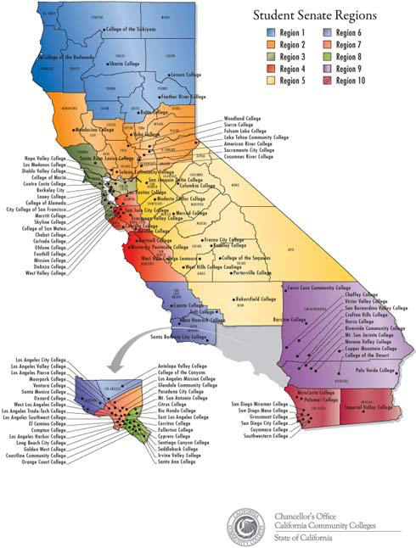









INITIAL CURRICULUM & DATA PILOT
IN CALIFORNIA
Notes:
The thirteen colleges that participated in the IDRC grant to pilot the curriculum and badges. Colleges are located throughout the state in each region.

Slide 6









NEW PARTNER COLLEGES IN CALIFORNIA: 2017
Notes:
New colleges adding to the partner group after each training: need to send 2-3 faculty/staff participants who will implement the curriculum on their campus. The NWoW team then offers ongoing support with the most up to date curriculum and data resources, as well as hosts Community of Practice calls to showcase best practices across the colleges in 21st Century Skills education.

Slide 7
EXAMPLE COURSES IMPLEMENTING 21st CENTURY SKILLS CURRICULUM
Folsom Lake College
Pasadena
Shasta College
Work Experience (WEX)
Integrated with college/career counseling offerings
Civic and Community
Engagement
Sociology
Workshops in conjunction with career services dept.
Feather River College
Business
SCBC at Miramar
College
Hartnell
Electrical and Electronic Systems
Biotechnology
West Hills Coalinga
Santa Barbara City College
Health Sciences/Nursing
Lassen
Human Services
Career/Employment Strategies
WEX
Skyline College
Entrepreneurship
Part of training offerings through the Business & E-ship Center
Santa Rosa Junior College
Columbia College
American River College
Workshops
Ag, Enviro. Tech, & Transportation
Soft Skills for Business
IT/Tech Courses
Notes:
New World of Work curriculum was implemented in a variety of courses as well as through workshops throughout the pilot. The curriculum is adaptable in that it can be contextualized across industries and tailored for various course settings. NWoW team is happy to provide peer-to-peer introductions for new colleges interested in finding out more about how early adopter colleges have been using the content.

Slide 8
Spring 2018
Los Medanos College Thursday, March 1
Friday, March 2
Contra Costa College Thursday, April 12
Friday, April 13
Diablo Valley College Thursday, May 3
Friday, May 4
www.newworldofwork.org > COLLEGE > ACCESS FREE LESSONS

Slide 9





QUESTIONS?

