Slide 1

Guided Pathways to Success (GPS)

Slide 2
GPS Essentials
Whole programs of study.
Informed choice and meta majors.
Default pathways.
Guaranteed milestone courses.
Intrusive, just-in-time advising.
Math alignment to majors.

Slide 3




Students are …
Why GPS?
Taking too much time
Taking too many credits
Spending too much money
Not graduating

Slide 4
Too Much Time to Degree
Of those who graduate…
2-year
Associate
4-year
Bachelor’s
(Non-Flagship)
^{Full-time students take}
^{3.9 years}
^{Full-time students take}
^{4.9 years}

Slide 5
Too Many Credits
2-year
Associate
4-year
Bachelor’s
(Non-Flagship)
78.8
credits accumulated
136.2
credits accumulated
60
credits standard
120
credits standard
Does NOT count remediation

Slide 6

Very Few Graduate on Time …
On-Time Graduation Rates
(Full-time students)
4-year Bachelor’s
(Non-Flagship)
2-year Associate
^{5.0%}
^{18.1%}

Slide 7

Too Few Graduate at All
4-year Bachelor’s
(Non-Flagship)
2-year Associate
^{12.9%}
^{43.2%}
150% time = 3 years for associate, 6 years for bachelor’s

Slide 8

Part-Time Students Rarely Graduate
2-year Associate
4-year Bachelor’s
(Non-Flagship)
^{6.9%}
^{15.9%}
200% time = 4 years for associate, 8 years for bachelor’s

Slide 9
Why So Many Excess Credits?
Causes
(in semester credit hours)
Academic challenges:
“F” grades
Poor student choices
GPS directly addresses these problems
Transfer problems
Academic problems:
“W/R” grades
Unavailable courses
Degree requirements

Slide 10
Too Many Choices and
Too Little Guidance
Why GPS?
Most colleges have more than 100 majors and hundreds of courses
Most students are uncertain about their career interests
45% of students haven’t seen a counselor by the third week of class

Slide 11

1 counselor : 400 students
Why GPS?

Slide 12
Behavioral Economics: Choice
Too much choice — especially uninformed choice — leads to indecision or poor decisions.

Slide 13

Behavioral Economics: Choice
Overwhelmed by Choice
2 Plans Offered
59 Plans Offered
75% Participation
60% Participation

Slide 14
Behavioral Economics: Default
A substantial number of people accept — even welcome — a default choice designed by informed professionals.

Slide 15

Behavioral Economics: Default
Organ Donation Rates
Austria (OPT-OUT)
99%
Germany (OPT-IN)
12%

Slide 16
Behavioral Economics: Structure
Structure optimizes design elements for success and minimizes mistakes.

Slide 17
GPS:
The Solution

Slide 18
GPS: Choice Architecture
A design that leads people to make more informed, deliberate decisions. Provides “default choices” that are in the person’s best interest given his or her educational goals

Slide 19






GPS: Essential Components
DO THIS
Default pathways
Informed Choice
Meta-Majors
Academic Maps
Milestone courses
Intrusive advising

Slide 20

1. Structured, Default Pathways Built for On-Time Graduation
Students don’t “discover” the right path; the academic map is the default schedule.
  Students do not need permission to register for courses on their schedule.
  They do need permission to take courses not on their schedule.
Notes:
Examples of defaults: 90% organ donation

Slide 21

2. Informed Choice
Provides information on careers
Uses high school performance and other measures to recommend broad academic pathways — “meta-majors”
Presents default pathways

Slide 22

3. Meta-Majors
Students must choose a meta-major — broad clusters of majors
No student is “unclassified” — those who can’t decide are defaulted into Liberal Arts
STEM
Health Sciences
Social Sciences
Liberal Arts
Education
Business

Slide 23
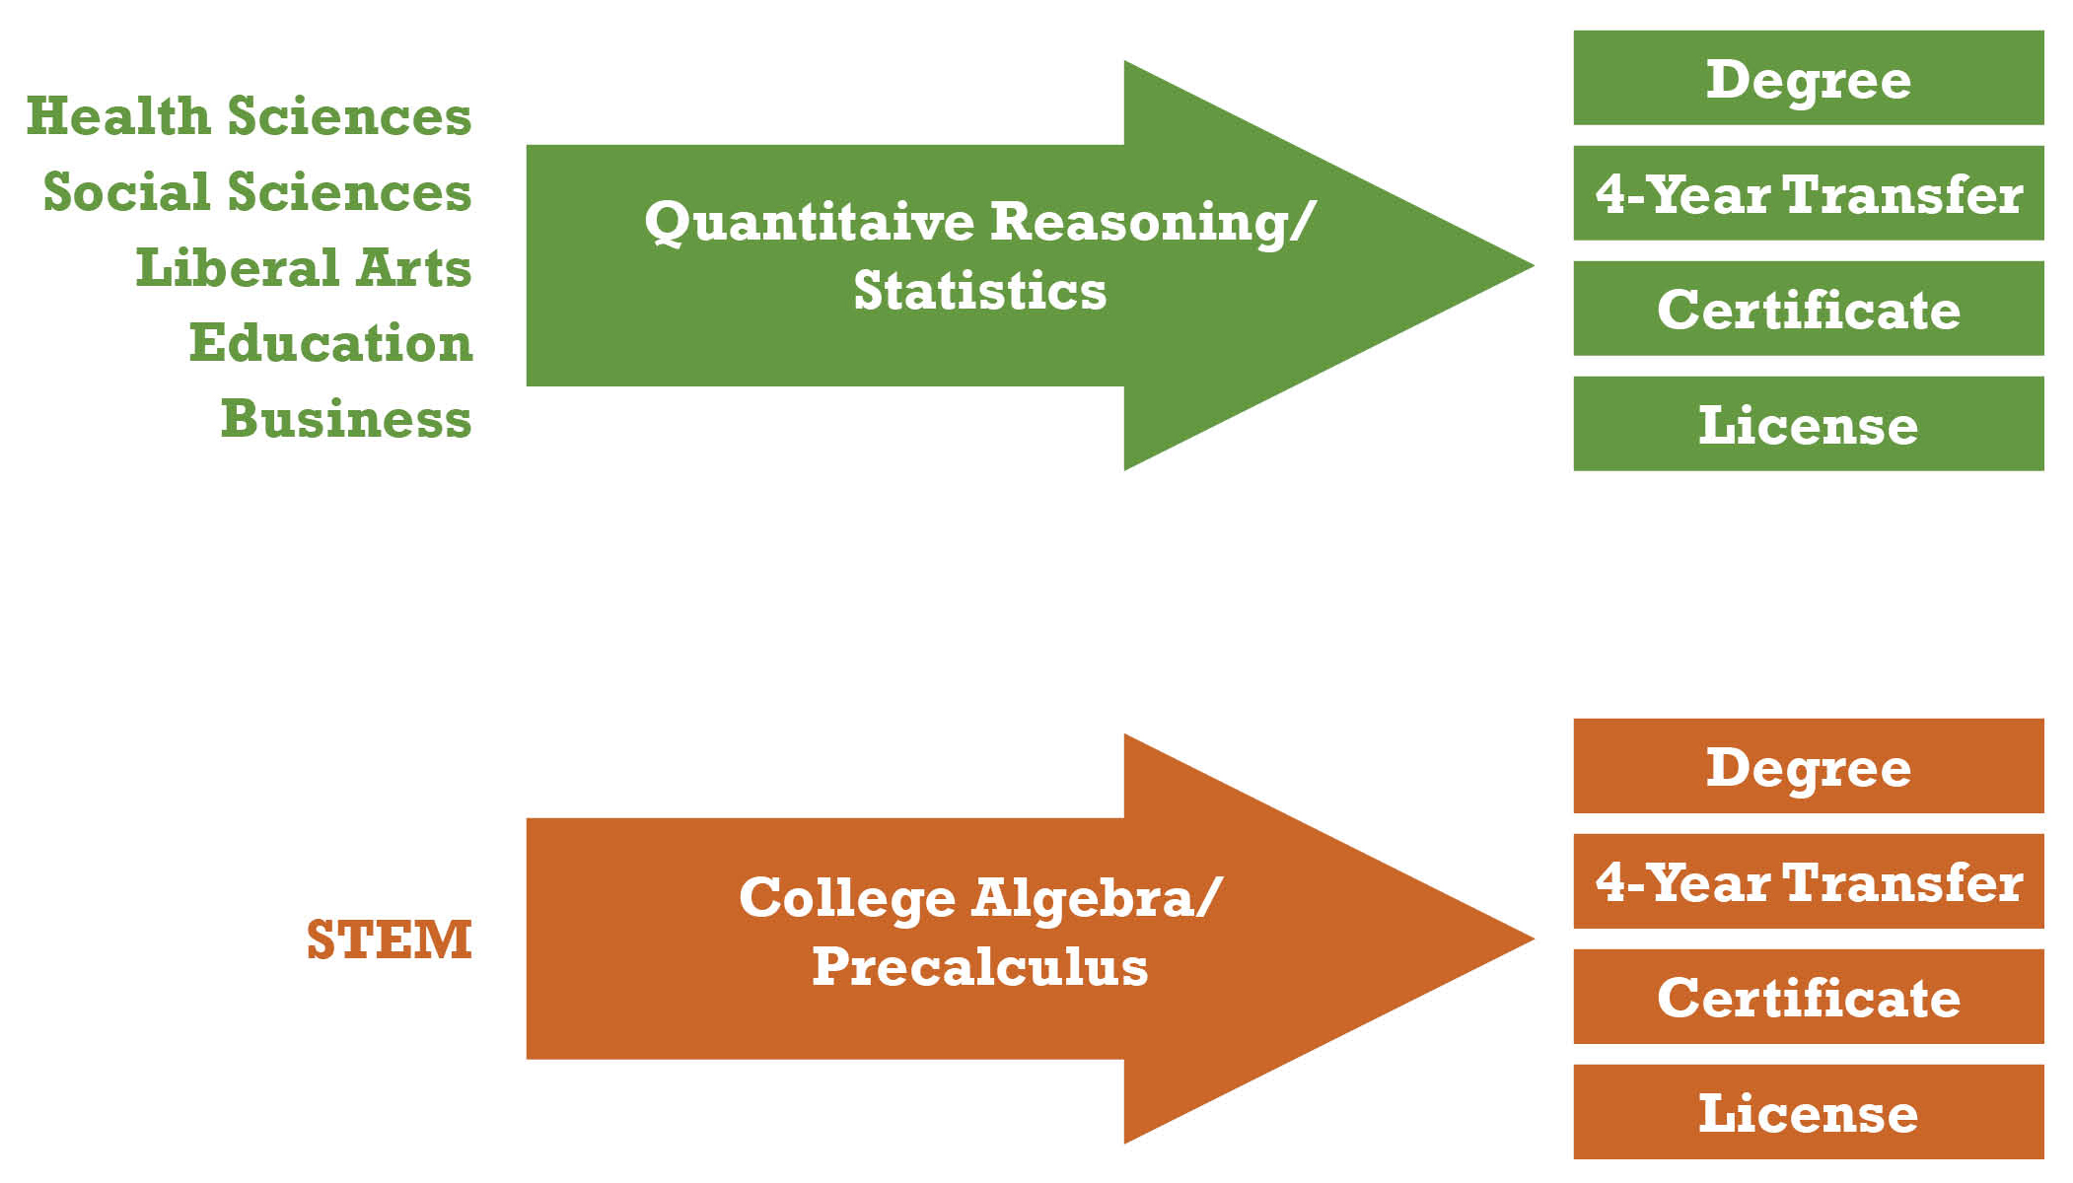
Math Is Aligned with Meta-Majors

Slide 24
Meta-Major to Majors
Help students make the big choices
Once in a meta-major, help students narrow their study to a major
A semester-by-semester academic map is the sequential, prescriptive schedule of classes for the meta-major and the major

Slide 25

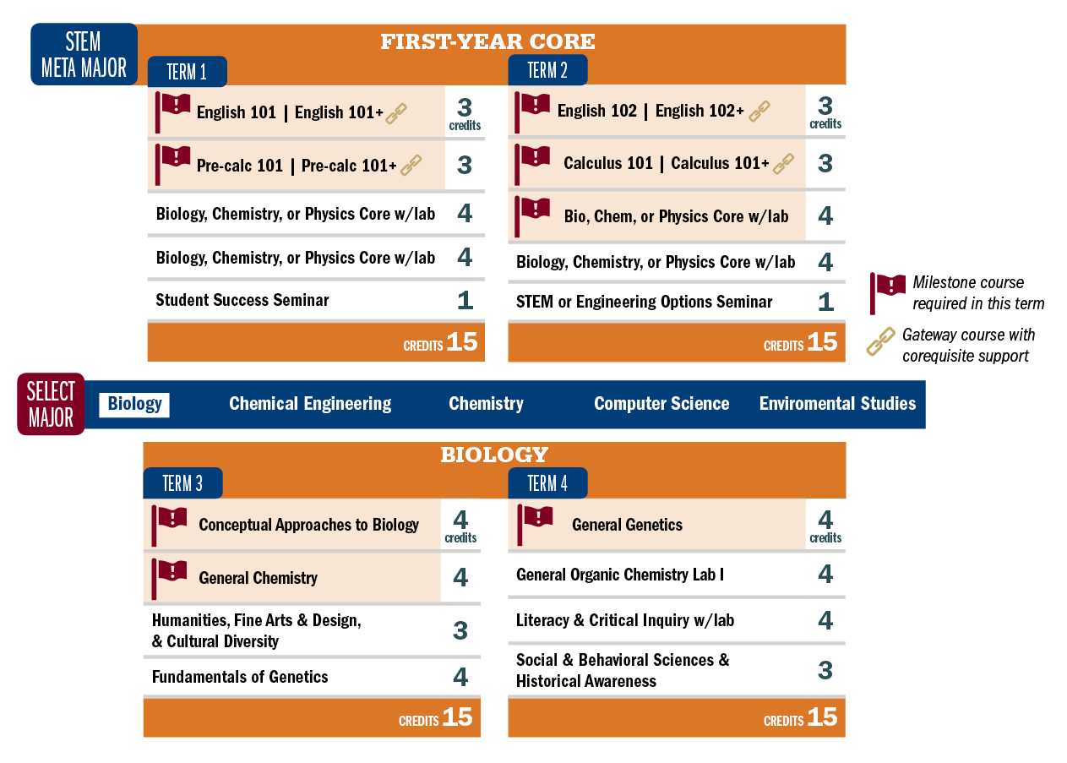
4. Academic Maps

Slide 26
5. Milestone Courses
Prerequisite courses are designated for each semester
They must be taken in the recommended sequence
The college must guarantee the courses are available in the sequence and terms designed in the academic maps

Slide 27
6. Intrusive Advising
Students must see their advisors before registering for classes if:
  they do not complete the milestone course on schedule
  they fall 2 or more courses behind on their academic map
  they have a 2.0 GPA or less for the semester

Slide 28




Highly Structured Option
Block schedules of classes
Cohorts of students
Students choose programs or majors not courses
Attendance required

Slide 29
Additional Considerations
Remediation is embedded or corequisite
15 credit hours is the default load
Degree requirements should not exceed 120 credits for a 4-year degree and 60 credits for 2-year degree

Slide 30
GPS:
The Results

Slide 31
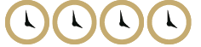

Results
Higher graduation rates
More on-time graduates
Closing the achievement gap
Fewer lost credits — saving time and money

Slide 32
Georgia State University
GPS SUCCESS
Degree maps and intrusive advising
Graduation rates up 20% in past 10 years
Graduation rates higher for:
  Pell students, at 52.5%
  African American students, at 57.4%
  Hispanic students students, at 66.4%
More bachelor’s degrees to African-Americans than any other U.S. university

Slide 33
Florida State University
GPS SUCCESS
Since starting degree maps, FSU has cut the number of students graduating with excess credits in half
Graduation rate increased to 74%
  African Americans to 77%
  First-generation Pell students to 72%
  Hispanic students to more than 70%

Slide 34
Arizona State University
GPS SUCCESS
eAdvisor system boosting retention and success
First-time, full-time freshman retention rates climbed to 84%
91% of all students deemed “on track,” up from 22% three years before

Slide 35
CUNY ASAP Program
GPS SUCCESS
Students grouped into cohorts with consolidated block schedules
Doubled graduation rates for associate degrees
55% of fall 2007 cohort earned associate degrees in 3 years

Slide 36
TN Colleges of Applied Technology
GPS SUCCESS
Highly structured, block schedule program
More than 75% of students graduate, at rate 3x higher than peers, even though slightly poorer and older
Center has certificate programs have job placement rates of 80% or higher

Slide 37
MAPS, META-MAJORS AND MILESTONES

Slide 38

ACADEMIC MAPS: A CORE ELEMENT OF GUIDED PATHWAYS
Guided Pathways to Success: Boosting College Completion. Indianapolis: Complete College America, 2013. Print.

Slide 39
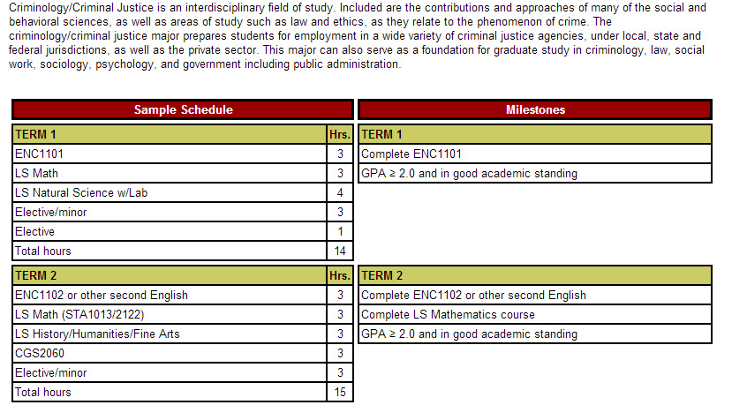
Academic maps: four essential components – the narrative, sample schedule, milestones and employment opportunities
The narrative explains the use of academic maps and any specific information about degree requirements, including admissions requirements
The sample schedule outlines which courses should be taken in which specific term in order to satisfy all requirements
The milestones identify critical courses for timely progress and the last semester in which they can be completed for on-time graduation. May include the grade as a critical indicator.
List of Representative Job Titles and Potential Employers
Notes:
Everything needed for the student to understand the four-year map to graduation should be clearly presented.
The inclusion of employment information often assists the student in selecting a major.

Slide 40
KEY ACADEMIC POLICIES
  Require early declaration of interest area (a meta-major) or major.
  Require every student without a major to attend a “choosing a major” workshop and have a major selected by 30 hours.
  Establish Milestones for each term (key courses, factors, or events that must be completed by a specific time in order to stay on track). These courses must be offered when needed.
  Rationalize general education requirements.
Notes:
It is important for a student to either have an area of interest with an accompanying “metamajor” map to avoid unnecessary general education or prerequisite courses.
The university must offer “Chose Your Major’ workshops at the start of each semester with mandatory attendance.
Institutions must rationalize their general education requirements to avoid the common chaos surrounding the need to choose from literally hundreds of general education courses.

Slide 41
KEY ADVISING POLICIES
Assist students with choosing a major through workshops, the Career Center and web resources, e.g., http://www.bls.gov/ooh/ and http://www.onetonline.org/.
Monitor student registration and grades for milestone courses.
Every student “off-map” must be mandated to meet with an advisor in person (or electronically).
Students must change majors if they are “off-map” two consecutive terms.
Notes:
There must be a mechanism to alert both the student and the institution that the student did not complete a Milestone course or action.
That alert would result in a face to face meeting with an advisor to discuss the situation. Don’t focus on the cost of adding advisors since the improvement in retention will generate the funds needed to add advisors.
The student and advisor will need information on which majors will result in the fewest excess credits at graduation if a change is necessary.

Slide 42
KEY COMMUNICATION POLICIES
EARNING A DEGREE IS A TWO (OR FOUR) YEAR PROCESS.
MAPS MUST BE PART OF EVERY COMMUNICATION WITH STUDENTS, PARENTS AND FACULTY.
THEY MUST BE EASY TO FIND ON THE WEBSITE AND EASY TO UNDERSTAND.
MAPS MUST BE INTEGRATED INTO EVERY ASPECT OF THE ACADEMIC EXPERIENCE.
Notes:
Many institutions have maps that are difficult to locate and that are not communicated to students, advisors, faculty and parents.
Every interaction with students should emphasize the academic map and the four-year degree.
Every advisor and faculty member should be familiar with the academic maps in their discipline.

Slide 43
Providing Students with a clear Path to
Graduation Reduces Excess Hours, Significantly Reduces Costs and Improves Time to Graduation
Year | Students with Excess Hours | 4-year Graduation Rate
2000 | 7,382 | 44.2%
2006 | 3,011 | -------
2009 | 1,540 | 61.1%*
Source: Florida State University
*2008 cohort 4 year graduation rate
Notes:
Larry – From College Results Online, I have different grad rates for the years mentioned in this slide. I don’t have grad rates going back to 2000 in CRO, but in 2002 the 6-year overall rate was 63.3. In 2003, the year maps were instituted based on your later slide, it was 62.9. In 2006, it was 68.3 and in 2009 it was 71.4. Most recent from CRO is 2010, which is 73.6. The trend holds graduation rate wise if we use the CRO data, although I can’t go back to 2000 to match the students with excess hours data point. How would you like to address?

Slide 44
MAPS, META-MAJORS AND MILESTONES

Slide 45


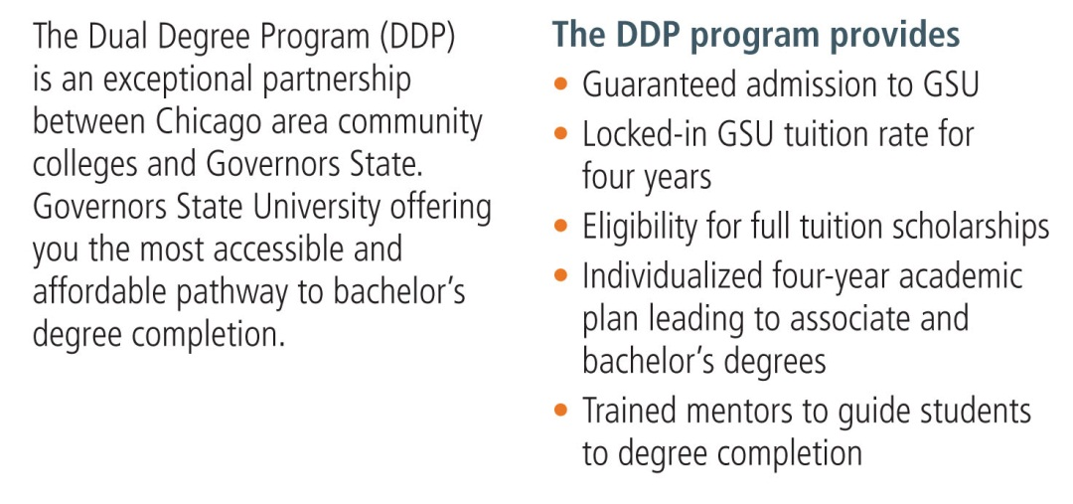













Slide 46

GSU’s Freshman Program
Limited choices for students
Core courses incorporate writing across the
curriculum, civic engagement, critical thinking, etc.
Learning communities
Classes with their cohort classmates
Small classes
Intrusive advising
Highly trained peer mentors

Slide 47

Early Start at GSU
Students in need of remediation are required to start the fall semester
two weeks early.
During regular fall semester, their classes are extended from three to
four hours.
Those who do not need remediation have
opportunity to participate in a voluntary, enrichment
Early Start, a two week immersion into the cultural
life of Chicagoland.
Lots of writing!

Slide 48
INTRUSIVE ADVISING

Slide 49
Intentional Advising,
Proactive Tools and Approaches
Dr. Jennifer Joslin
Associate Director for Content Development
NACADA: The Global Community for Academic Advising

Slide 50

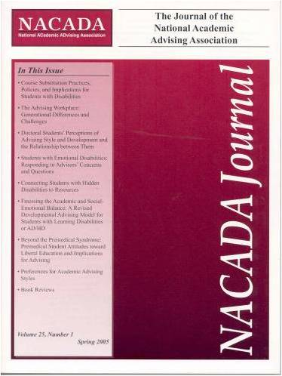
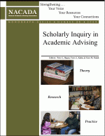

Effective Academic Advising is
A field of study with a body of research;
A profession with theory-based approaches;

Slide 51

Effective Academic Advising is
An intentional learning process that contributes to the academic mission;
Built into the culture of an institution and reinforced structurally;
Utilized by successful institutions serious about student success.

Slide 52
Effective Advising is Not:
Accidental or serendipitous
Course-scheduling or registration
Separate from the teaching mission
Isolated from institutional culture
Performed well without technology tools

Slide 53
Successful Institutions:
Merge effective and strong advising with innovative technology;
Address decentralization to promote system-wide strategies;
Ensure that everyone understands common goals and pathways to success;
Understand that structural change is critical to meet education and legislative goals.

Slide 54

NACADA: The GlobalCommunity for Academic Advising
Works with institutions throughout North America and the world to:
Support research and scholarship that furthers understanding of student behavior and proven strategies that lead to high-quality degree attainment;
Offer year-round Institutes and professional development opportunities that helps institutions meet state and national educational standards.

Slide 55


