Slide 1

Introducing Student Retention and Support Services (SRSS)

Slide 2
The Team
Teresea Archaga,
Director of Student Retention and Support Services
Letta Green,
Minority Retention Specialist
Robert Delgado,
Office Assistant II
2 Designated Counselors
Fall 2015
Lauren Beliew
Mark Yamamoto
Student Office Support:
Veronica Greenhouse
Roman Smith

Slide 3
SERVICES FROM THE BEGINNING
Application
Student obtains ID #
Retention Team
Schedule appts.
Assessment
Student will obtain assessment results upon completion
Confirmation Email
Makes Referrals
Follow Up with Students at later date
Orientation
They get confirmation email of completion if done online.
Education Plan
Student will obtain two or more semesters education plan made in collaboration with Counselor
Retention Team
“Touch” students that do online orientation to schedule appt. with counselor to do Ed Plan.
Week or two after application
Verify goal and major
Look at Educational Goal and Major
Group Orientation may come out with two semester Ed Plan
-----------------------
Retention Team
Confirms student took all necessary steps
Schedule appts.
Makes Referrals
Follow Up with Students at later date
Week or two after application
We lose students in this process: Target students missing steps and Target undeclared/undecided students

Slide 4
Students We Are Targeting to Engage With
Students who are undecided upon an active major or career goal
Students who are academically underprepared
Students who have been placed on Academic and/or Progress Probation and/or Dismissal

Slide 5
SPRING 2015
1100 Students In Academic Distress @ LMC
Probation I students are not currently “touched” aside from email (ISSUE)
Probation II students are contacted via email to participate in workshop and take additional steps
Dismissed students are contacted via email to participate in workshop and take additional steps

Slide 6
Activities We Have For Students in Academic Distress
All Students in academic distress receive a letter regarding their status from our office
Probation and Reinstatement Workshops
One on One Counseling
Unit limitation and/or course recommendation forms
Time Management and other workshops
Required Mid Semester Progress Reports
Intrusive case management services- STARFISH

Slide 7

STARFISH
F.L.A.G.S.
Fostering* Learning*Achievement*and Graduation* Success*

Slide 8

COMING SPRING 2016
STARFISH EARLY ALERT SYSTEM
Los Medanos College is 1 of 9 community colleges in California to pilot the Starfish Early Alert System.
Implementation of this software will assist students while offering opportunities for instruction and student services to effectively work together in identifying and assisting students who are at risk.

Slide 9
Can you predict students’ final course grades based on their early performance in your course(s)?
If so, how early are you able to make an accurate prediction?

Slide 10

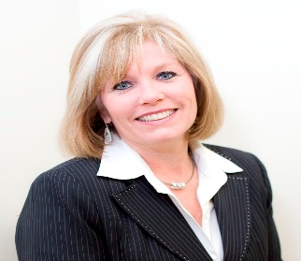
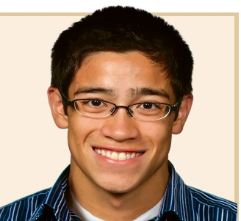
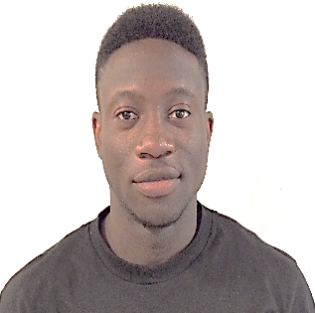


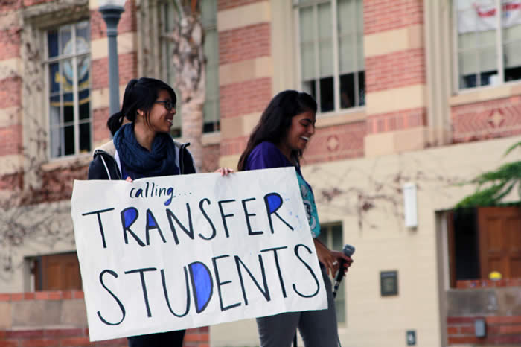

Life-long
Learner, 81
Refresh
Skills, 49
Concurrent
Enrollment, 14
Just
graduated, 18
Mid-adult
Re-entry, 56
Certificate
Transfer
Source: Dean Benford
Degree

Slide 11
GOALS of STARFISH
Supports a “team approach” in student retention among instruction and student services-
Successful course completion (C or higher)
Assess “TOUCH” we provide students to see if it makes a positive impact on retention and academic status
You will now know what happens when a referral is made
Notes:
Improve communication within and between faculty and support offices
Information flow
Improve coordination of response
Close the reporting loop
What was done/what happened

Slide 12
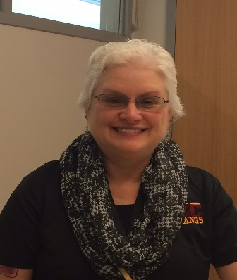
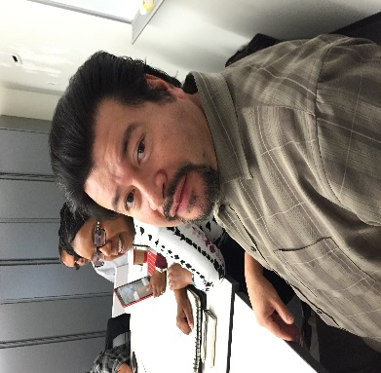
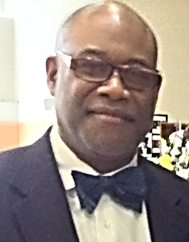
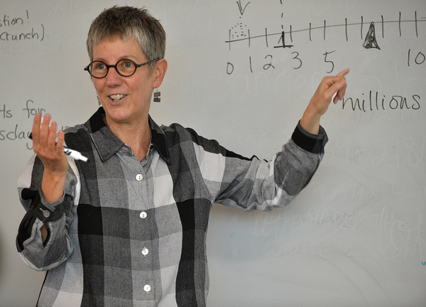
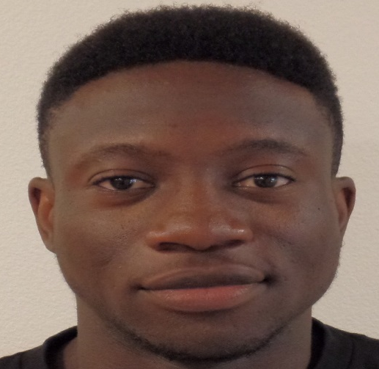
A&R
Outreach
Faculty
Dean
Outcomes?
Source: Dean Benford

Slide 13
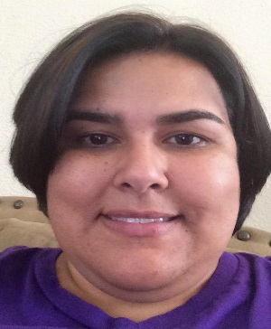
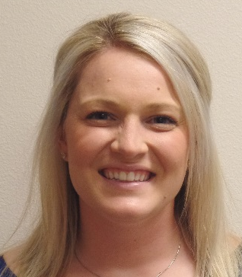
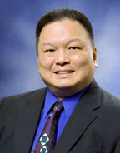

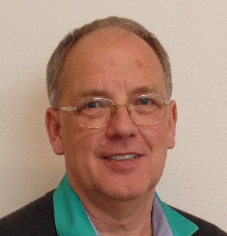
Dynamic Intrusive Contacts Weeks 3, 8, & 13
Source: Dean Benford

Slide 14
OPPORTUNITY
Date | Time | Location
Tuesday Nov. 17 | 230-400 PM | SS4- 412
Thursday Nov. 19 | 230-400 PM | SS4-412
Monday Nov. 30 | 1130-100 PM | Brentwood- Room 14
Wednesday Dec. 2 | 100-300 PM | SS4-412
Tuesday Dec. 8 | 230-400 PM | SS4-412
Thursday Dec. 10 | 230-400 PM | SS4-412

