Slide 1
CTE Data Unlocked: Finding data on students, progress, and economic outcomes
(in brief)

Slide 2
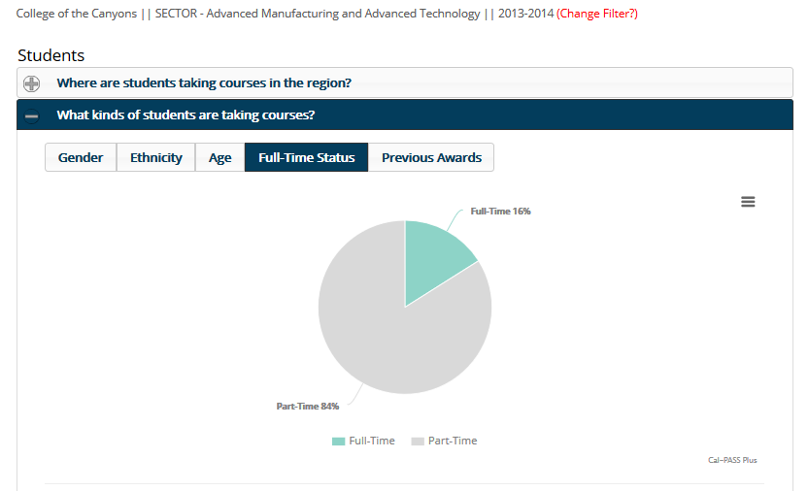
Identify your current market

Slide 3
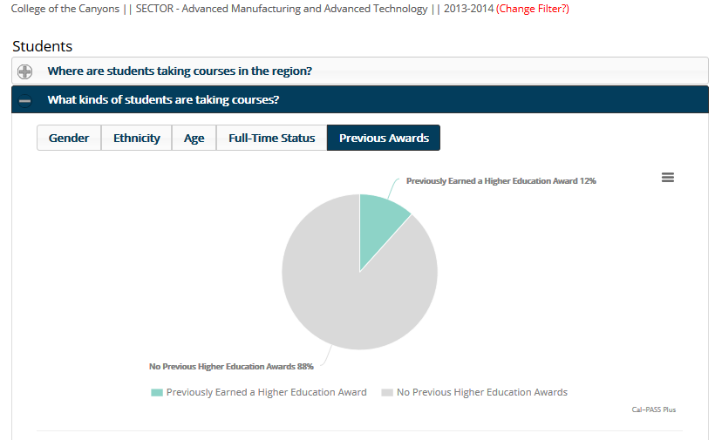
Identify your current market

Slide 4
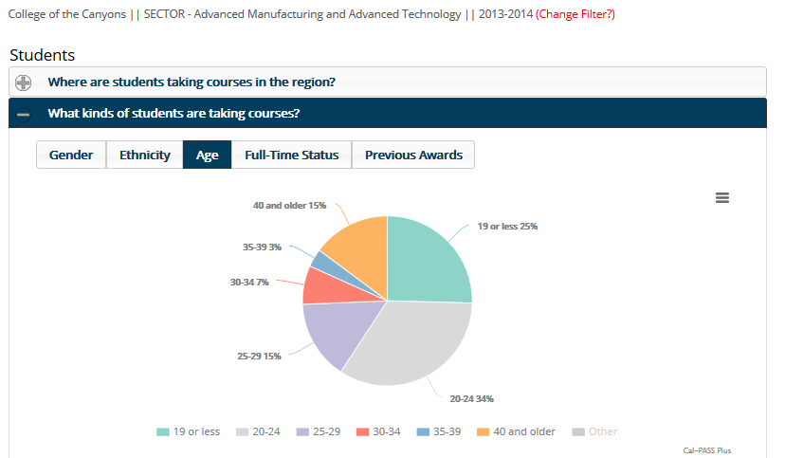
Identify your current market

Slide 5
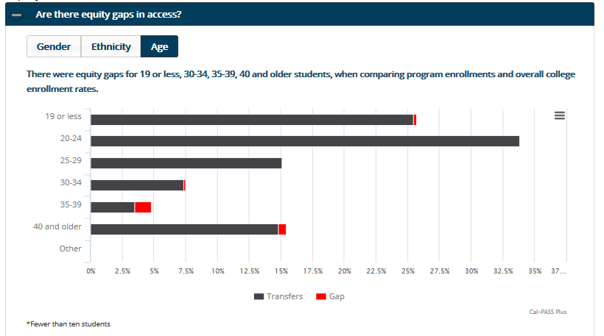
Identify your current market

Slide 6
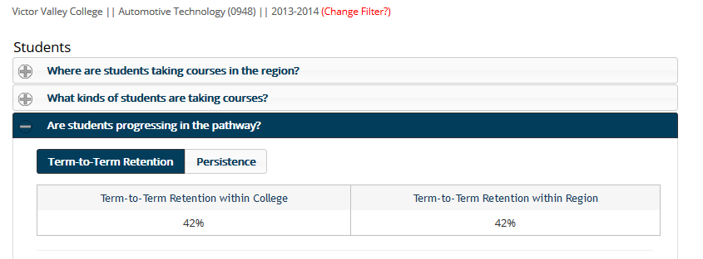
Determine students pathway progress

Slide 7
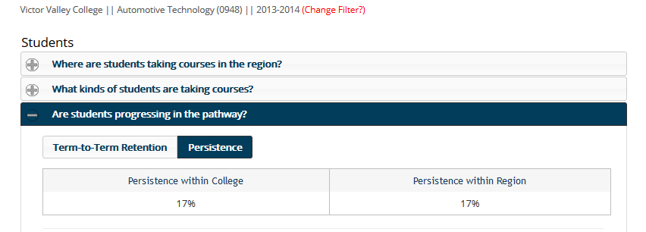
Determine students pathway progress

Slide 8
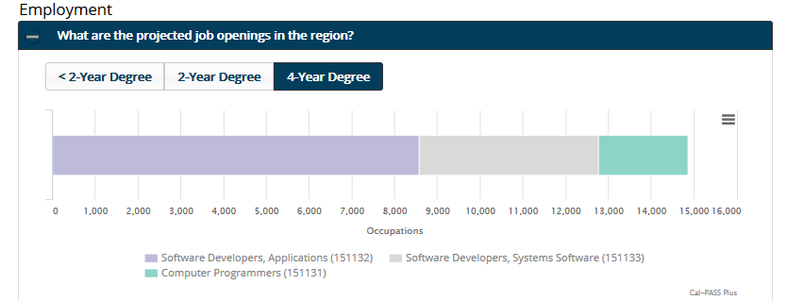
Identify long-term educational options

Slide 9
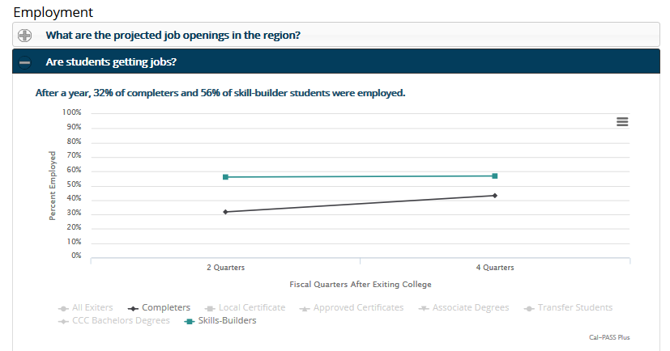
Understand economic outcomes

Slide 10
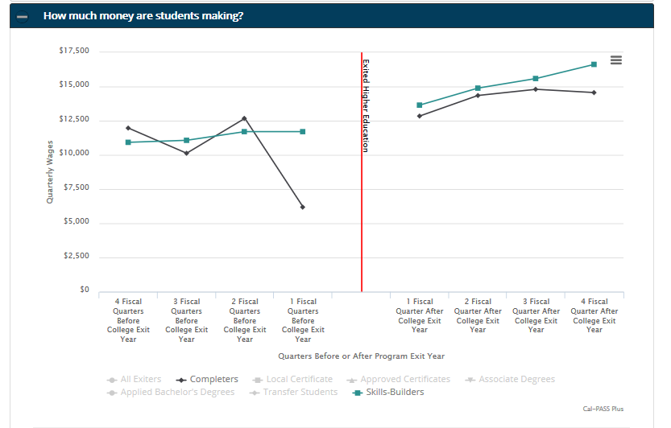
Understand economic outcomes

Slide 11
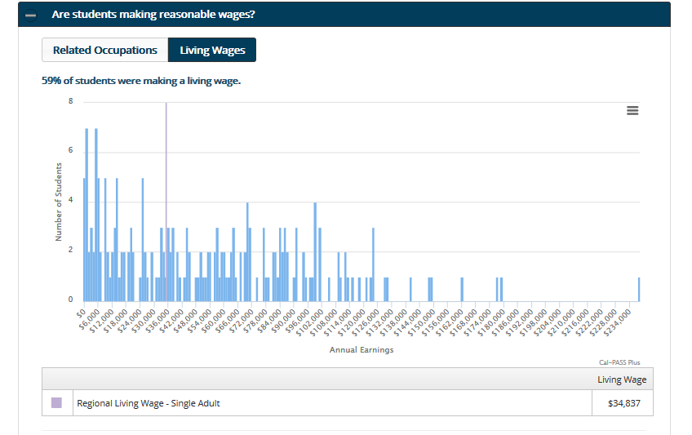
Understand economic outcomes

Slide 12
Simulation Ground Rules
You can only use your smartphone to access the college’s website. Connect to LMC wifi if your carrier isn’t L-109 friendly.
Counselors – we love you, but you can’t play this game. Watch the other faculty squirm!
You have 8 minutes to answer the prompt, briefly report on your progress vis discussion.

Slide 13
Top 4 Bay Area Projected Middle Skills Jobs
Occupation Type | Number of Jobs | 5 Year Change | Median Wages | Wages Will Support
Office & Admin Support (customer service reps) | 48,395 | +15% | $20.71 | 1 adult
Personal Care & Services (childcare) | 37,660 | +6% | $10.89 | Below living wage
Sales (sales reps) | 38,915 | +12% | $33.06 | 1 adult, 2 kids
Healthcare Support (home health aids) | 12,840 | +49% | $11.74 | Below living wage
Centers of Excellence, 2016 Bay Area Regional Labor Market Assessment + Living Insight Center for Community Economic Development

Slide 14
Simulation
Identify the specific courses you would take each term to earn a CTE certificate or degree that would prepare you for one of these high-demand occupations.
Assume that you had been placed into:
  Basic skills math at one-level below transfer level
  Basic skills English at one-level below transfer level
You have 8 minutes, briefly report on your progress.
Customer Service, Childcare, Sales, Home Health Aide

Slide 15

What was it like?
What made it hard? Easy?
What do you want to do?

