Slide 1
Multi Purpose Roster & Authorization Codes
2019 Spring

Slide 2
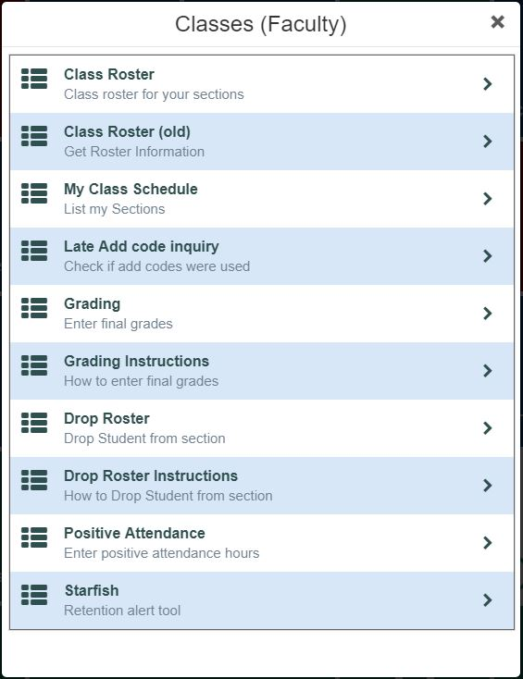
Multi-Purpose Roster & Authorization Codes
The multi-purpose roster will replace almost everything on this menu
(from the InSite Classes tile)
Notes:
The new multi-purpose roster is a product from our Student Information System vendor. It replaces several of their previous separate products, and our custom versions.
Every option on our current Classes menu for faculty will be replaced with the new roster (except the Starfish retention alert tool).

Slide 3
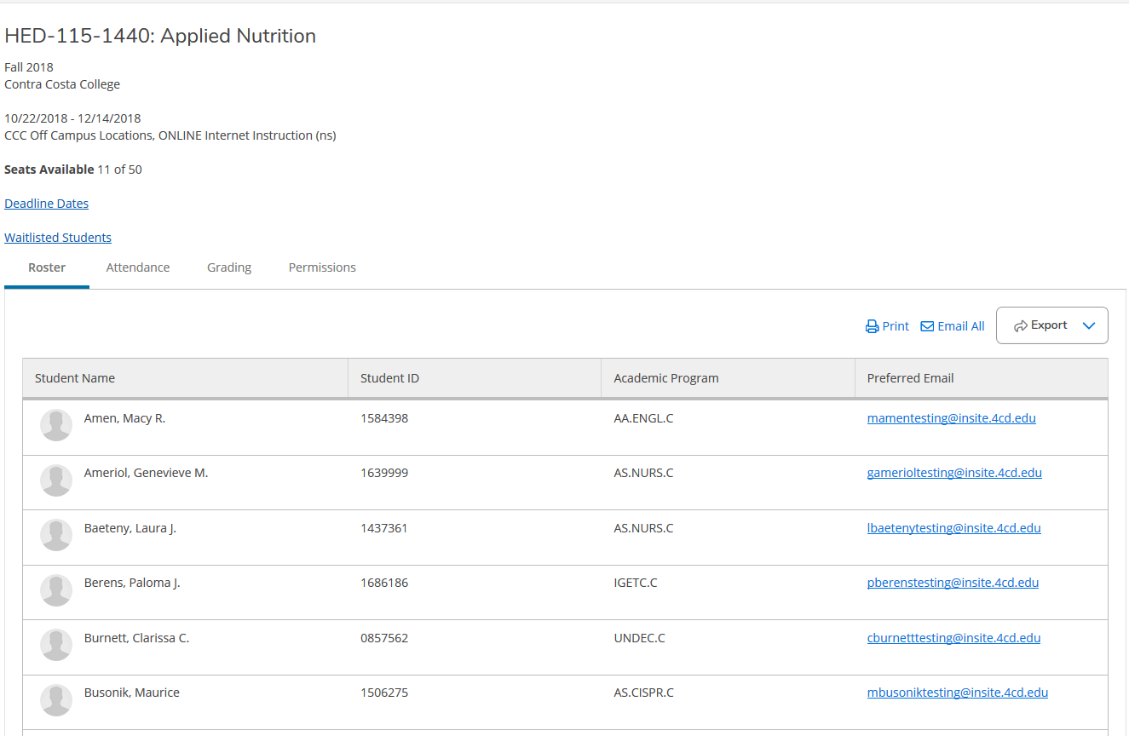
Multi-Purpose Roster
Notes:
This is a view of the new multi-purpose roster.

Slide 4
Multi-Purpose Roster
Tabs for each function Roster, Attendance, Grading, Permissions
Notes:
There are tabs for each of the multiple functions.
Roster
Attendance
Grading
Permissions
Note: this presentation doesn’t show the Attendance function, but this is where Positive Attendance will be recorded.

Slide 5
Multi-Purpose Roster
Deadline Dates and Waitlisted Students
Notes:
We have added links for our custom Deadline Dates and Waitlist Students functions.

Slide 6
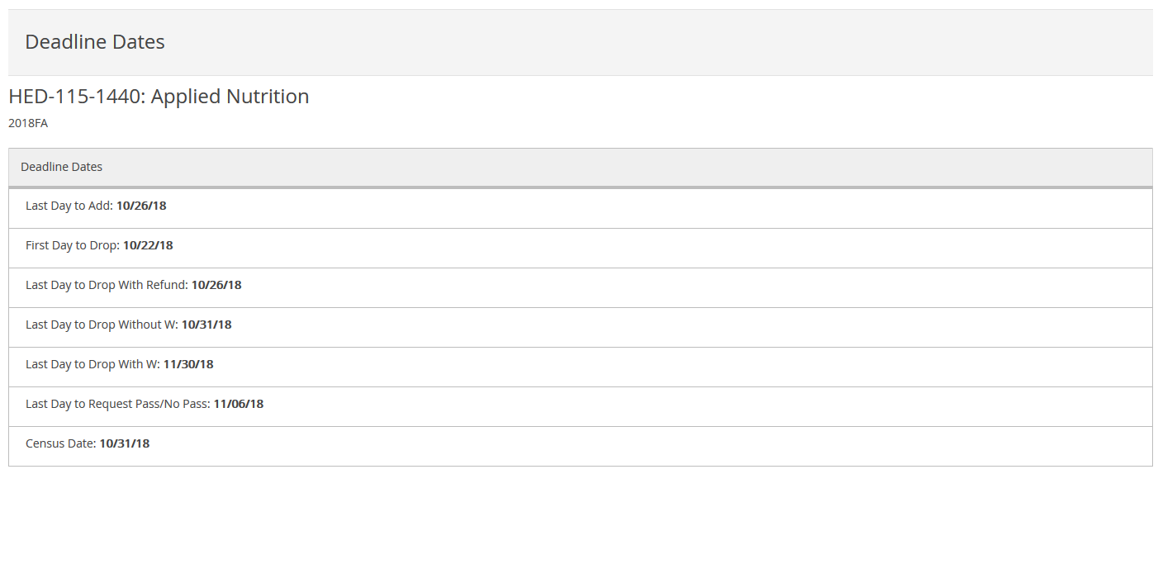
Multi-Purpose Roster – Deadline Dates
Notes:
This is our custom Deadline Dates.

Slide 7
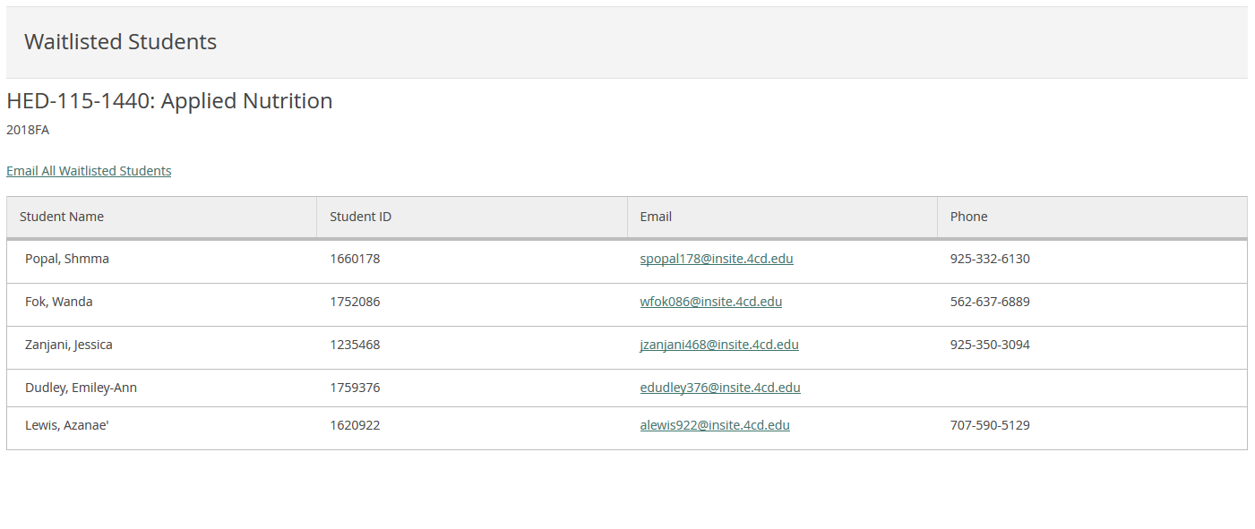
Multi-Purpose Roster – Waitlisted Students
Notes:
Our custom Waitlisted Students view includes student contact information and an “Email All” function.

Slide 8
Multi-Purpose Roster
Print, Email All and Export to Excel
Notes:
The roster includes a Print function, Email All and the ability to export to Excel (creates a CSV file).

Slide 9
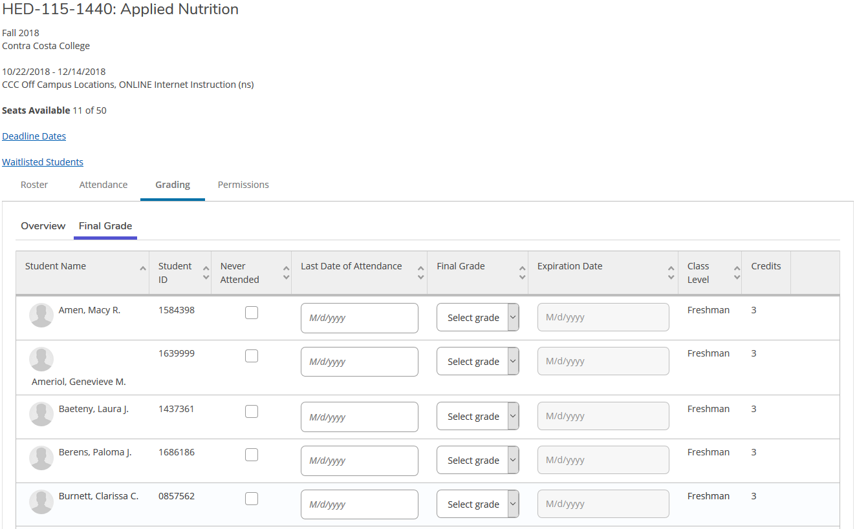
Multi-Purpose Roster – Grading and Drop Roster
Enter Final Grades or Select Never Attended or
Last Date of Attendance
Notes:
The Grading tab includes final grading, and you can drop students here before the appropriate deadline.

Slide 10
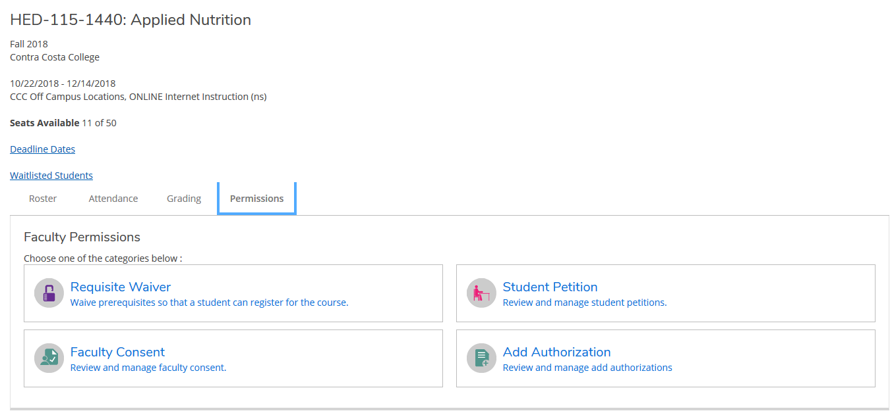
Multi-Purpose Roster – Add Authorizations
New Add Authorizations function replaces Late Add Codes
Notes:
The new Add Authorization function is part of the Permissions tab. This will replace our current Late Add Codes for late registration.

Slide 11
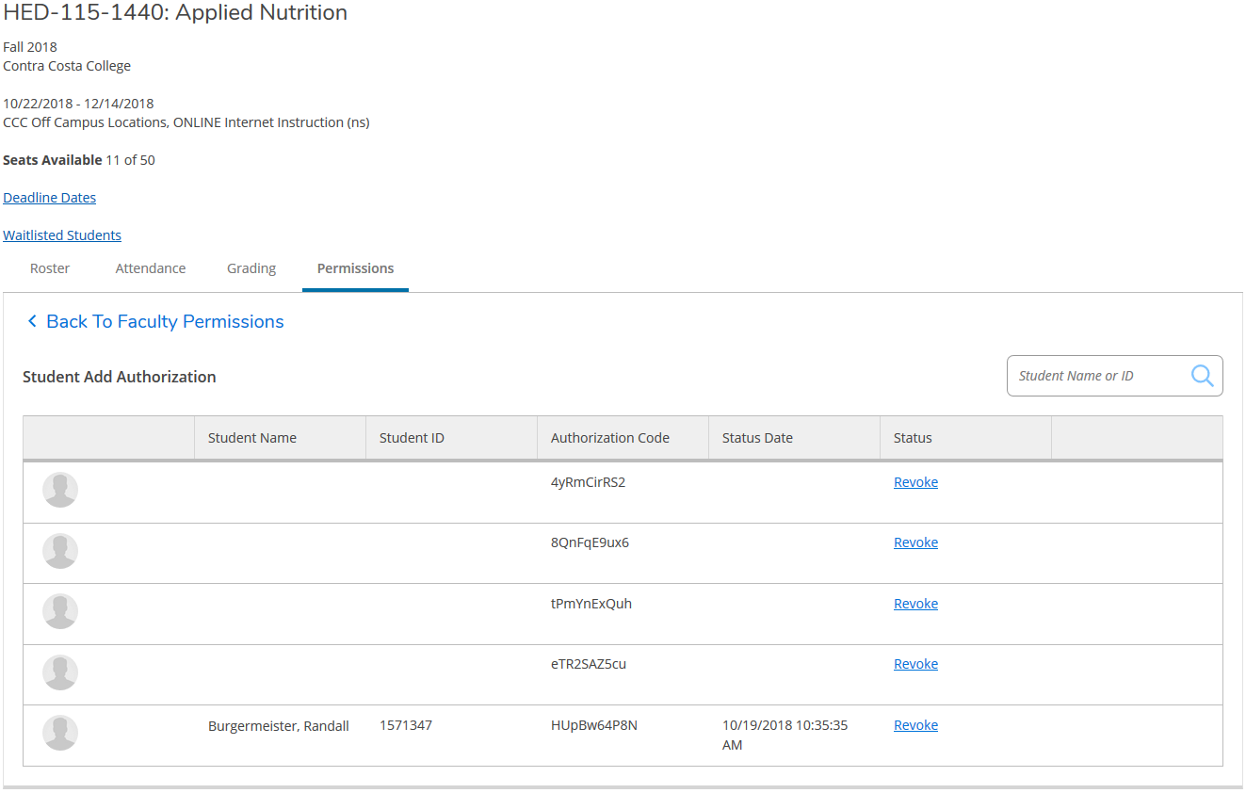
Multi-Purpose Roster – Add Authorizations
New Secure Authorization Codes (10 chars, upper & lower case letters and numbers)
Notes:
The new Add Authorization codes are more secure with 10 characters and a combination of numbers and upper & lower case letters.

Slide 12
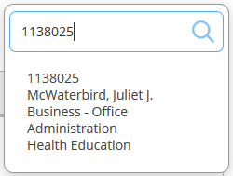
Multi-Purpose Roster – Add Authorizations
Enter Student ID to assign authorization code
Notes:
Add Authorization codes are assigned to the student here. Begin by entering the student ID in the search box.

Slide 13
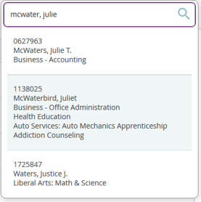
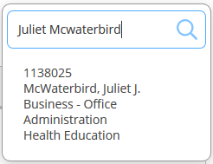
Multi-Purpose Roster – Add Authorizations
Or Search by Student Name
Notes:
If you don’t know the student ID, you can search by name.

Slide 14
Multi-Purpose Roster – Add Authorizations
Select Student and Confirm
Notes:
After selecting the student, confirm the Add Authorization.

Slide 15
Multi-Purpose Roster – Add Authorizations
Add Authorization Code is Assigned
Notes:
Authorized students are added to the bottom of the list. Unused codes are at the top.

Slide 16
Multi-Purpose Roster – Add Authorizations
Authorized Students are not prompted for code at registration. Registered Students appear on your roster, and are noted here.
Notes:
Authorized students can register from their online education plan called Student Planning. They are not prompted to enter a code.
Once registered, the status is updated here (and the student will appear on the Roster tab).

Slide 17
Multi-Purpose Roster – Add Authorizations
Add Authorization codes can also be revoked. Revoked codes are unable to be used.
Notes:
Add Authorization codes can also be revoked. You might decide to revoke a code if several days have passed after you have authorized a student and they have not registered.
Revoked codes are deleted from the system, and the authorization is cancelled.

Slide 18
Multi-Purpose Roster
Benefits
Several functions in one place
Secure Late Registration Process
Student never sees Add Authorization code
Codes cannot be shared
Late registration is part of Student Planning
(Our electronic Education Plan)

Slide 19
Thank You
2019 Spring

