Slide 1


Credit for Prior Learning (CLP)
The Basics
Title V Updates
Required Board Policy Updates (due 12/31/20)
Timeline
Next Steps

Slide 2
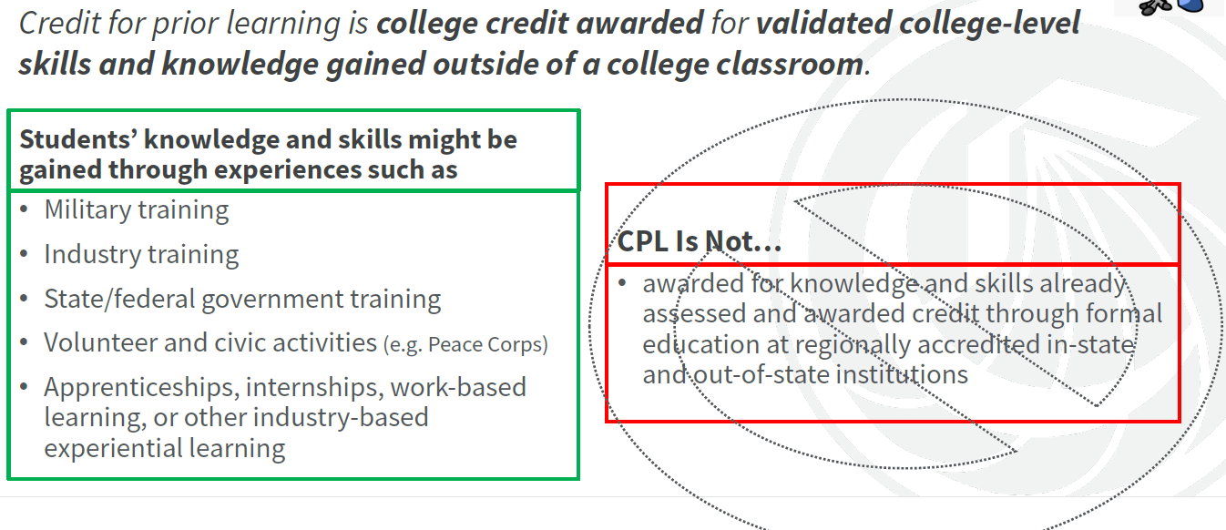
What is CPL?

Slide 3
Title V, Section 55050 Amendments
  Title Changed: “Credit by Examination” → “Credit for Prior Learning”
  Every district must adopt & publish CPL policies.
    Should incorporate all credit by exams and AP policies into a comprehensive CPL policy.
  Student must demonstrate “sufficient mastery” by passing an “assessment”.
    Nature of assessment is sole purview of faculty
    CPL can only be awarded for an individual course with subject matter similar to student’s prior learning
  Goal is for credit to be made to IGETC, CSU GE, and local GE
  Uses standard grading system, with P/NP offered if typically available

Slide 4
Title V, Section 55050 Amendments
  Veterans & active duty members should be automatically referred to CPL opportunities upon completion of educational plan, as well as any student who requests CPL.
  Students must have option to accept, decline, or appeal decisions related to award of credit.
  GB must review policy every 3 years, including disaggregated data, # of units awarded, retention/persistence, and completion data.

Slide 5

Required Board Policy Updates
  Governing Board must adopt CPL policies/procedures that address the following (§ 55050 [a]):
    credit by examination
    evaluation of joint services transcripts
    evaluation of student-created portfolios
    evaluation of industry-recognized credential documentation
    standardized examinations
  By December 31, 2020, districts must certify to the CCCCO that the required policies have been adopted and implemented. Submissions of the online form must include the following:
    Board-approved CPL policy language
    Confirmation that each college has posted its CPL policy in the college catalog and on its website

Slide 6
Timeline – Policy Approval
  August
    August 24 – VP Meeting
    August 27 – Informational email sent to academic senate presidents
  September
    September 8 – CLP presentation at Chancellor’s Cabinet
    September 23 – CLP presentation to Consultation Council. Draft policy language shared and feedback solicited.
    September 28 – CPL discussed at A&R Directors meeting

Slide 7
Timeline – Policy Approval
  October
    Draft policy language continues to be revised with input
    October 13 – 1st read of CLP policy at Chancellor’s Cabinet
    Late October (TBD) – Approval of Policy at Consultation Council
  November
    November 3 – District Governance Council (information only)
    November 10 – 2nd read at Chancellor’s Cabinet
    November 11 – 1st read by Governing Board
  December
    December 11 – Governing Board Approval

Slide 8
Additional Requirements by 12/31
  Add CPL policies to college catalogs and websites
  Develop a process by which students are automatically referred to CPL opportunities upon completing an education plan if they fall into one of the following categories
    Veterans or active duty members of armed forces
    Have an industry-recognized credential
    Requests CPL
  Be able to demonstrate that efforts to identify/develop prior learning “assessments” are underway by faculty members.

Slide 9
CCCCO Resources
  Information gleaned from CPL Implementation Pilots
    CPL Faculty Discipline Cross-Walks Pilot
      ASCCC convened 7 discipline faculty groups to develop model “cross-walks” – aligning curriculum SLOs to industry certifications and training to assess CPL
    Policy Implementation Pilots
      Colleges from north & south regions developed model local CPL policies & procedures.
  CPL Community on Vision Resource Center
    8/18 CPL Webinar Recording
    CLP Toolkit
    Existing CLP Cross-Walks & Rubrics Developed During Pilots
  Data: MIS data elements to track and report CPL outcomes

