Slide 1
LMC Technology Plan Process Update
College Assembly Update April 12, 2021

Slide 2
Why a new Technology Plan
Current Plans are aging
  CCCCD District-Wide Strategic Infrastructure/Telecommunication Plan, 2009
  Draft LMC Technology Plan, 2014-19 (not officially adopted)
New Education Master Plan adopted and calls for a Tech Plan
Accreditation – We are addressing the standard with a Tech Plan
COVID-19 demonstrated importance of the informed use of technology

Slide 3
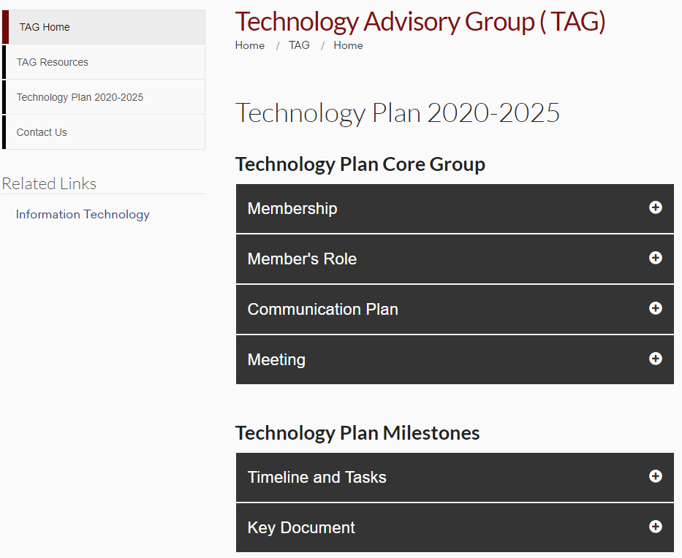
Technology Plan 2025 Process
Used a similar process to the EMP
Started with TAG, then created a Tech Plan Core Group
Built a website https://www.losmedanos.edu/tag/techplan20-25.aspx
Developed
  Members and Role
  Communication Plan
  Timeline and Tasks
  Library of Key Documents

Slide 4
Technology Plan 2025 Process
Started with…
Identified a list of documents important for the LMC Technology Plan
  Review EMP Goals/Objectives and implications related to Technology Plan
  Review old draft Tech Plan goals
  Review DE Strategic Plan
  Review Current IT works/projects
  Reviewed CCCCO Initiatives
Reviewed each document and identified relevant goals, topic areas, projects, and initiatives

Slide 5
Technology Plan 2025 Process
Then…
Used online mind map of all the goals, topic areas, projects, and initiatives to facilitate an easier review and discussion
All the information was then organized into major themes
  Hosted a theme conversation using an online whiteboard
  The themes were reviewed, validated, and missing ideas were discussed and added
A simple one-pager was developed that grew into the Draft Goals and Objectives
Goals and Objectives sent to committees with online tool for feedback

Slide 6
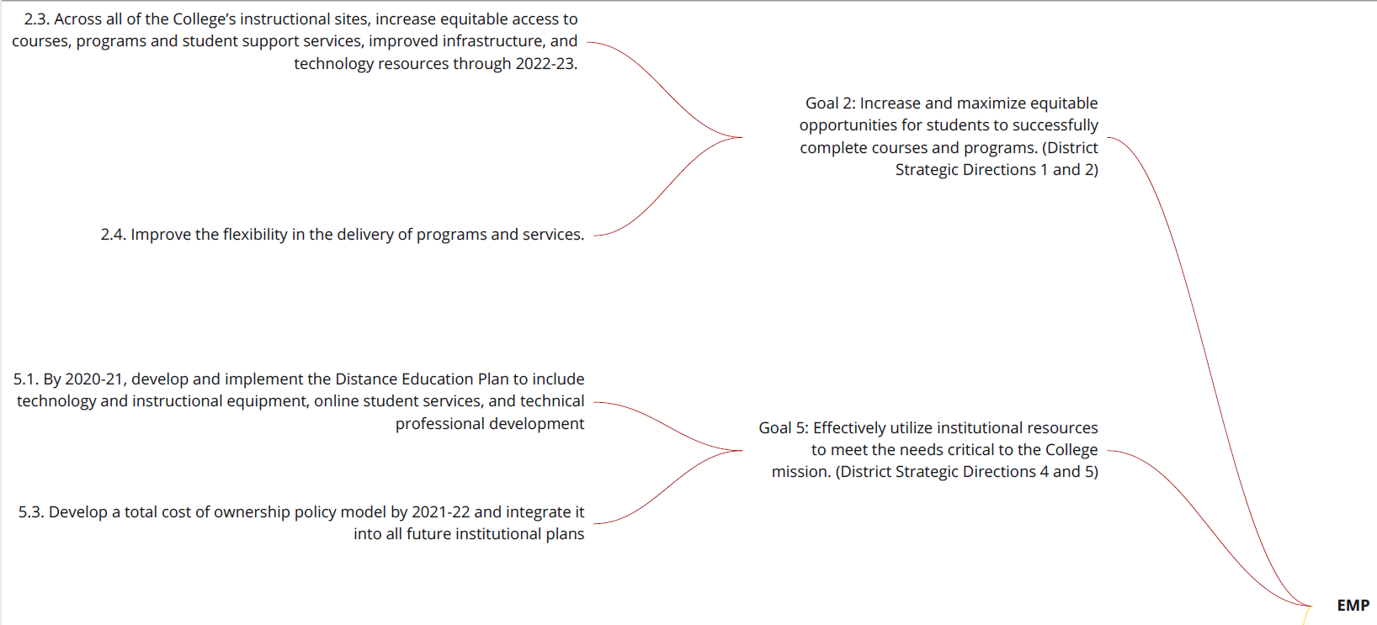
Mind Map Example

Slide 7
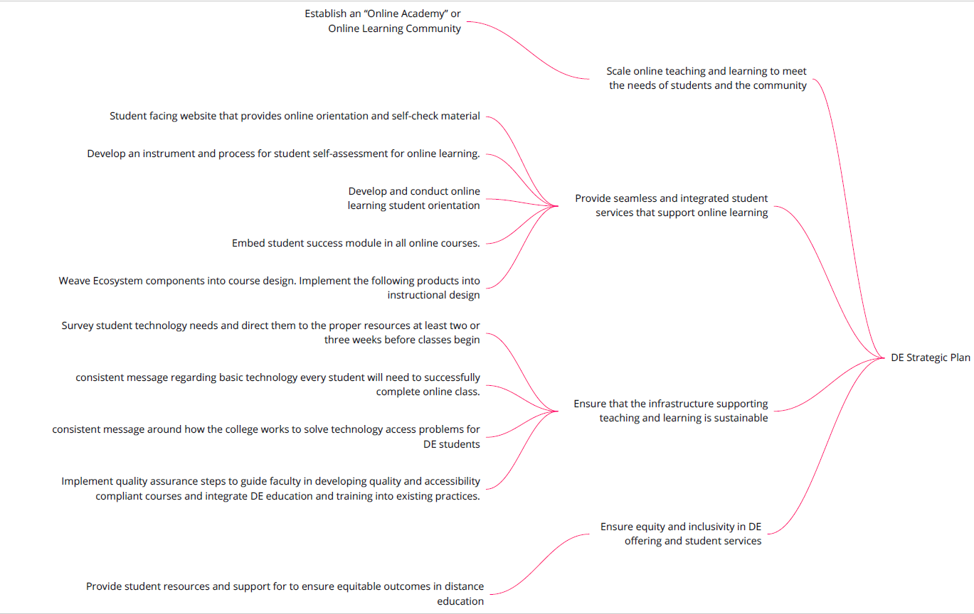
Mind Map Example

Slide 8
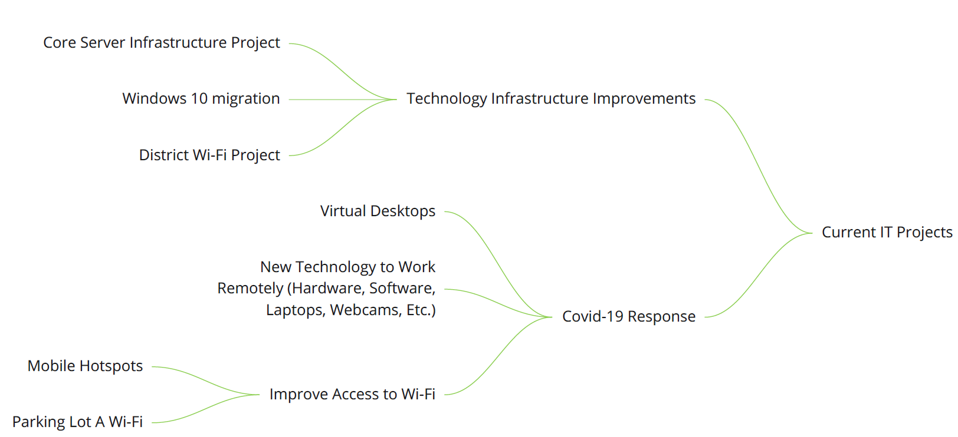
Mind Map Example

Slide 9
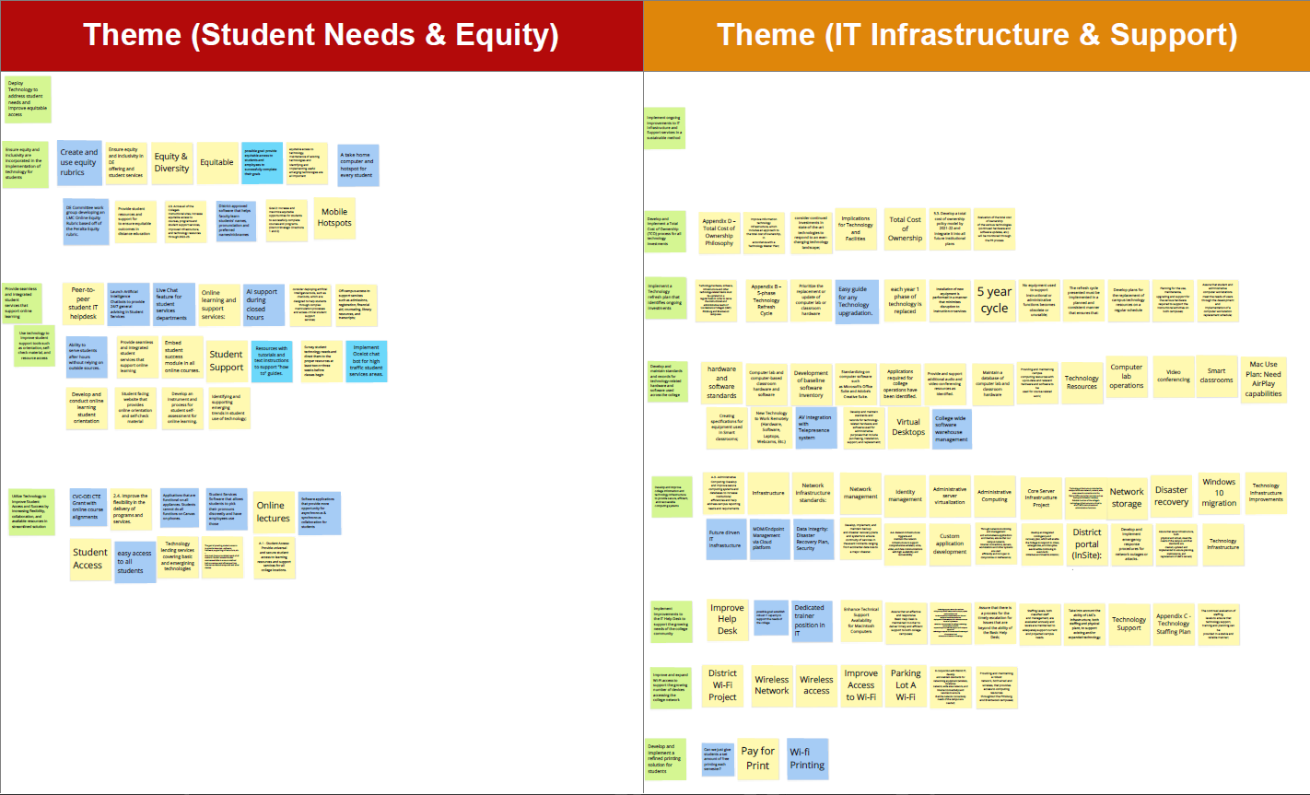
Theme Example

Slide 10
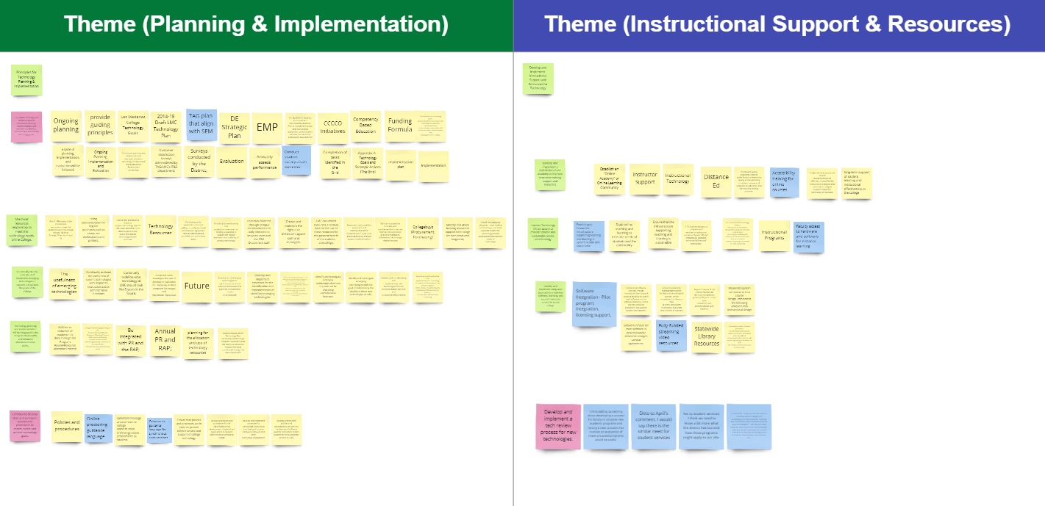
Theme Example

Slide 11
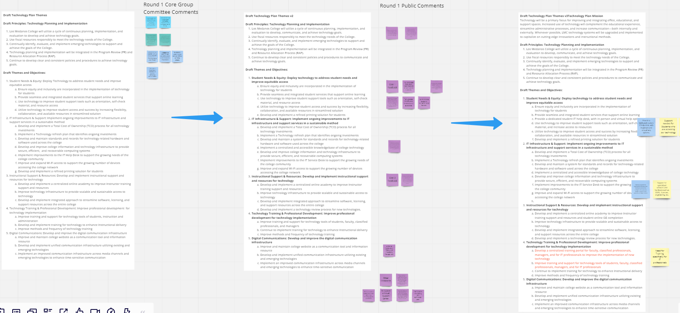
Goals and Objectives Discussion

Slide 12
Technology Plan
Mission and Planning Principles
Technology Plan Mission
  Technology is a primary focus in enhancing the educational experience, administrative processes, and communication strategies. To support the further the integration of technology across the college, Los Medanos will focus on upgrading the technology infrastructure to implement cutting-edge innovations and instructional methods to support our students.
Draft Principles: Technology Planning and Implementation
  Los Medanos College will utilize a cycle of continuous planning, implementation, and evaluation to develop, communicate, and achieve technology goals.
  Use fiscal resources responsibly to meet the technology needs of the College.
  Continually identify, evaluate, and implement emerging technologies to support and achieve the goals of the College.
  Technology planning and implementation will be integrated in the Program Review (PR) and Resource Allocation Process (RAP).
  Continue to develop clear and consistent policies and procedures to communicate and achieve technology goals.

Slide 13
Theme/Goal 1
Student Needs & Equity: Deploy technology to address student needs and improve equitable access
  Ensure equity and inclusivity are incorporated in the implementation of technology for students
  Provide seamless and integrated student services that support online learning
  Provide a dedicated student IT help desk, with in-person and virtual help options
  Use technology to improve student support tools such as orientation, self-check material, and resource access
  Utilize technology to improve student access and success by increasing flexibility, collaboration, and available resources in a streamlined solution
  Develop and implement a refined printing solution for students

Slide 14
Theme/Goal 2
IT Infrastructure & Support: Implement ongoing improvements to IT infrastructure and support services in a sustainable method
  Develop and implement a Total Cost of Ownership (TCO) process for all technology investments
  Implement a Technology refresh plan that identifies ongoing investments
  Develop and maintain a system for standards and records for technology-related hardware and software used across the college
  Implement a centralized and accessible knowledgebase of college technology
  Develop and improve college information and technology infrastructure to provide secure, efficient, and recoverable computing systems
  Implement improvements to the IT Service Desk to support the growing needs of the college community
  Improve and expand Wi-Fi access to support the growing number of devices accessing the college network
  Improve support for specialized software and hardware across the college's instructional, student support, and operational departments

Slide 15
Theme/Goal 3
Instructional Support & Resources: Develop and implement instructional support and resources for technology
  Develop and implement a centralized online academy to improve instructor training, resources, and student online GE completion
  Improve technology infrastructure to provide scalable and sustainable access to technology
  Develop and implement integrated approach to streamline software, licensing, and support resources across the entire college
  Develop and implement a technology review process for new technologies

Slide 16
Theme/Goal 4
Technology Training & Professional Development: Improve professional development for technology implementation
  Develop a centralized training portal for faculty, classified professionals, managers, and for IT professionals to improve the implementation of new technology
  Improve training and support for technology tools of students, faculty, classified professionals, managers, and for IT professionals
  Continue to implement training for technology to enhance Instructional delivery
  Improve methods and frequency of technology training

Slide 17
Theme/Goal 5
Digital Communications: Develop and improve the digital communication infrastructure
  Improve and maintain college website as a communication tool and information resource
  Develop and implement unified communication infrastructure utilizing existing and emerging technologies
  Implement an improved communication infrastructure across media channels and emerging technologies to enhance time-sensitive communication
  Enhance Technology Infrastructure to support Institutional Safety and Emergency Management and Communications

Slide 18
Feedback…

