Slide 1


Career Education Programs

Slide 2


Why Career Education?
Short Term programs
  Typically 1-4 semesters
Lead to Careers
Hands-on Training
Industry Partnerships
Good Pay

Slide 3
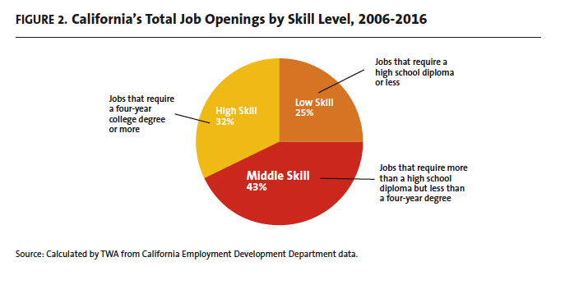
The “Middle Skills” Jobs

Slide 4



LMC
Career Edu
Programs
Industrial/Manufacturing Trades
Appliance Service Technology
Automotive Technology
Electrical & Instrumentation
HVAC
Technology
Process Technology
Welding Technology
Health & Education
Nursing
Child Development
Public Service
Administration of Justice
Emergency Medical Services
Fire Technology
Computers and Business
Business
Graphic Communications
Computer Science
Travel Marketing
Arts & Humanities
Journalism
Recording Arts
Notes:
Hand out CTE Booklets.

Slide 5






LMC Career Education Career Paths & Typical Level of Education Required
Appliance Repair Technology
Automotive Technology
Business Info. Worker
Child Development-Preschool
Electrical & Instrumentation
Technology
HVAC
Process Technology
Welding Technology
Travel Marketing
Recording Arts
Emergency Medical Services
Administration of Justice
Business
Child Development-Teaching
Computer Science
Journalism
Nursing
Fire Technology
Business
Computer Info. Systems/IT
Graphic Communications

Slide 6

New Program Coming Fall 2020
1 Semester program, Non-credit
Preparation to enter Union Apprenticeship
Notes:
Law Enforcement Academy: Career as a police officer, sheriff or correctional officer.
Emergency dispatcher, probation officer, positions in the FBI, the courts and other government agencies
Many students opt to transfer to a four-year school after completing required courses at LMC
1 Skills Certificate, 6 Certificate of Achievements and an Associate in Science Degree for Transfer

Slide 7
Top 12 High-Pay, Short-Term,
In-Demand Careers
Electrical Instrumentation Technician $75-95,000/yr (2 yr)
Process Technician $70,000/yr + Overtime (3 sem)
Welder $55,000/yr + Overtime (2 yr)
HVAC Mechanic/Installer $80,000/yr (2-3 sem)
Auto Mechanic (Dealership) $50-60,000/yr (2-3 sem)
Administrative Assistant $50,000/yr (1-2 sem)
Accounting Assistant $50,000/yr (2-3 sem)
Web Developer $70,000/yr (4 sem)
Licensed Vocational Nurse $60,000/yr (5 sem)
Sound Engineering Technician $52,000/yr (2-3 sem)
Computer Support Specialist $58,000/yr (2 yrs)
Graphic Designer $60,000/yr (2-3 sem)
+ Registered Nurse $120,000/yr (4 yrs)
Notes:
Law Enforcement Academy: Career as a police officer, sheriff or correctional officer.
Emergency dispatcher, probation officer, positions in the FBI, the courts and other government agencies
Many students opt to transfer to a four-year school after completing required courses at LMC
1 Skills Certificate, 6 Certificate of Achievements and an Associate in Science Degree for Transfer

Slide 8
Career Education Success Data
How satisfied are students with the career education and training received at LMC?

Slide 9
Career Education Success Data
How many students secured a job that is closely related to their program of study?

Slide 10
Career Education Success Data
How many hours per week are employed students working?

Slide 11
Career Education Success Data
How many months did it take for students to find a job?

Slide 12
Career Education Success Data
Key Results
After CE Training: 50% gain in hourly wages
84% of respondents reported being employed for pay
89% of respondents reported being very satisfied or satisfied with their training
32% of respondents reported transferring to another college or university

Slide 13
Short Term Programs that Lead to Better Part-time Jobs while in School
Computer Repair (1-3 classes)
EMT (1 class)
Preschool Assistant Teacher (2-4 classes)
Auto Repair Technician (4-6 classes)
Smog Technician (2 classes)
Graphic Design Intern (4 classes)
Sound Technician (4 classes)
Travel Agent (4 classes)

Slide 14






Supports for
Student Success
Learning Communities
Caring Professors
CTE Counselors
Internships

Slide 15



Industry Advisory Boards
Employer/Industry Connections
Inform Course Curriculum
Industry Trends
Workforce Needs: Employability Skills!
Work-Based Learning Opportunities
Internships
Job Shadowing
Company Tours
Job Fairs
Mock Interviews

Slide 16




“Top 10” 21st Century Employability Skills
Adaptability
Analysis/Solution Mindset
Collaboration
Communication
Digital Fluency
Empathy
Entrepreneurial Mindset
Resilience
Self-Awareness
Social/Diversity Awareness
Notes:
CAMILLE
Read out all the skills.

Slide 17


CBO Connections
Roadmap to College (18-24 yr)
Employment Support
“College Concierge”
Paid Internships
Employment Support

Slide 18


STEM= $$$
BELIEVE: You can build your skills in Math & Science
Tutoring, Math Lab, Great Math Professors, CTE Contextualized Courses

Slide 19
Electrical/Instrumentation & Process Technology
Notes:
Electrical and Instrumentation Technicians work closely with engineers to maintain the smooth operation of manufacturing plants and energy generation plants.
Starting salaries range between $75,000 - $90,000 and higher with overtime
42-45 unit Certificate of Achievement and Associate of Science Degree.

Slide 20


Electrical/Instrumentation Technology
Electrical and Instrumentation Technicians work closely with engineers to maintain the smooth operation of manufacturing plants and energy generation plants, also BART, Water Treatment companies.
Process Technicians understand how to safely turn on and turn off plant process, monitor plant process 24/7, and identify when repairs or calibration is needed. Water Treatment, Refineries, Food/Wine Prod.
Process Technology

Slide 21
Nursing Program Pre-requisites
Registered Nurse Licensed Vocational Nurse
Anatomy
Physiology
Microbiology
Engl 100
Alg 2 or Higher
Intro Psych
Intro Anat/Phys
Chem
Engl 95 or higher
Alg 1 or higher
Nutri 55: Nutrition
Medical Terminology
Drug Dosage

Slide 22



AVOID: For-Profit Technical Colleges
Insights to Share with Your Students
  Unitek, Carrington, Heald-type
ALSO AVOID: Phlebotomy Programs
REFER: Mt. Diablo Adult School
  Surgical Technologist, $11,000
  Medical Assistant
  Accepts Financial Aid
REFER: Kaiser Allied Health
  Sonography Program
  Radiology Technician
Contra Costa Medical Career College
  Sonography Program
  Surgical Technologist: Accepts Financial Aid, $23,000

Slide 23
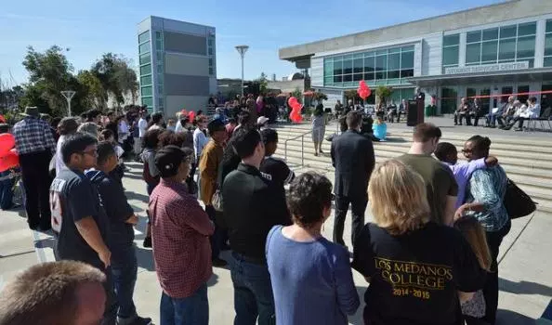
Intro to Industrial Trades Course: Summer 2019
INTRO TO INDUSTRIAL TRADES COURSE this summer:
June 17, 2019-July 26, 2019 Mon/Tue/Wed/Thur: 1:30-4:20pm

Slide 24

Thank You! Gracias! Salamat!
Camille Santana
Workforce Development Counselor csantana@losmedanos.edu
925-473-7484

