Slide 1
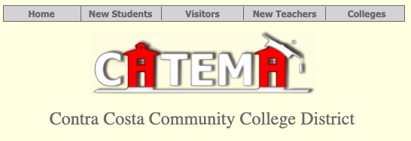
Los Medanos College
Articulated High School Classes & CATEMA Registration
How to Apply to LMC
How to Create Your CATEMA Account
Login to Your Existing CATEMA Account
Create a New Enrollment Record

Slide 2
Prepare to Register for CATEMA
In order to Create a CATEMA account and register into your articulated high school class, you will need to:
Apply to LMC
Obtain or retrieve a CCCID#
(3 letter/4 digit State ID# "ABC1234")
Obtain or retrieve an LMC Student ID#
(7 digit Community College ID# "1234567 ")
APPLICATION NOTES:
Already have a CATEMA Account? Go to “Sign In to CATEMA”
Already have an LMC ID#? You will need to retrieve BOTH your LMC ID# AND your CCCID# before you can create a CATEMA account.

Slide 3
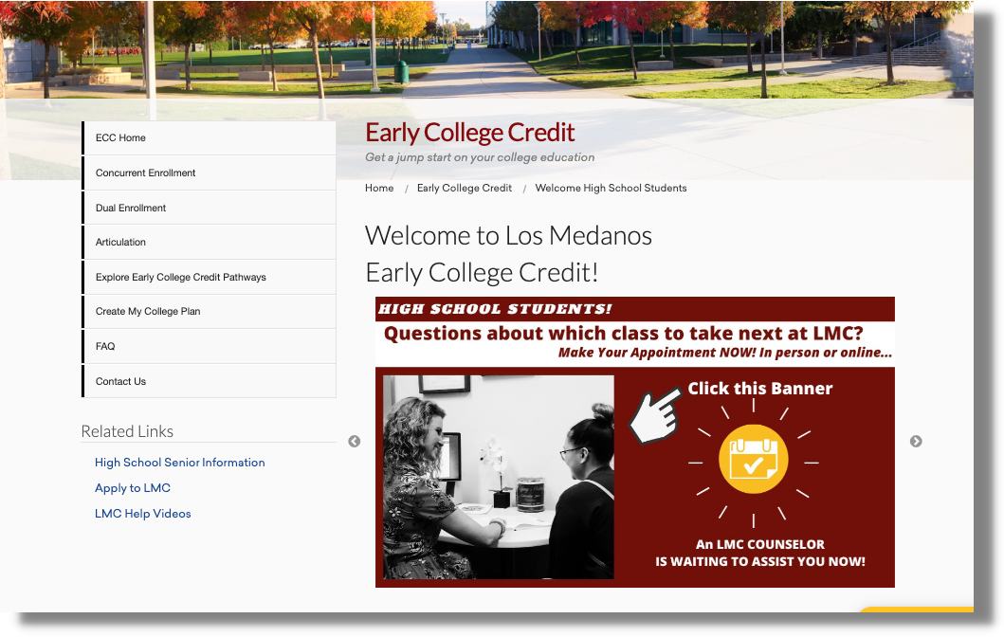
Apply to LMC
Begin on the LMC Early College Credit Homepage:
www.losmedanos.edu/earlycollegecredit
Click on “Apply to LMC” under Related Links on the Left Navigation Bar

Slide 4
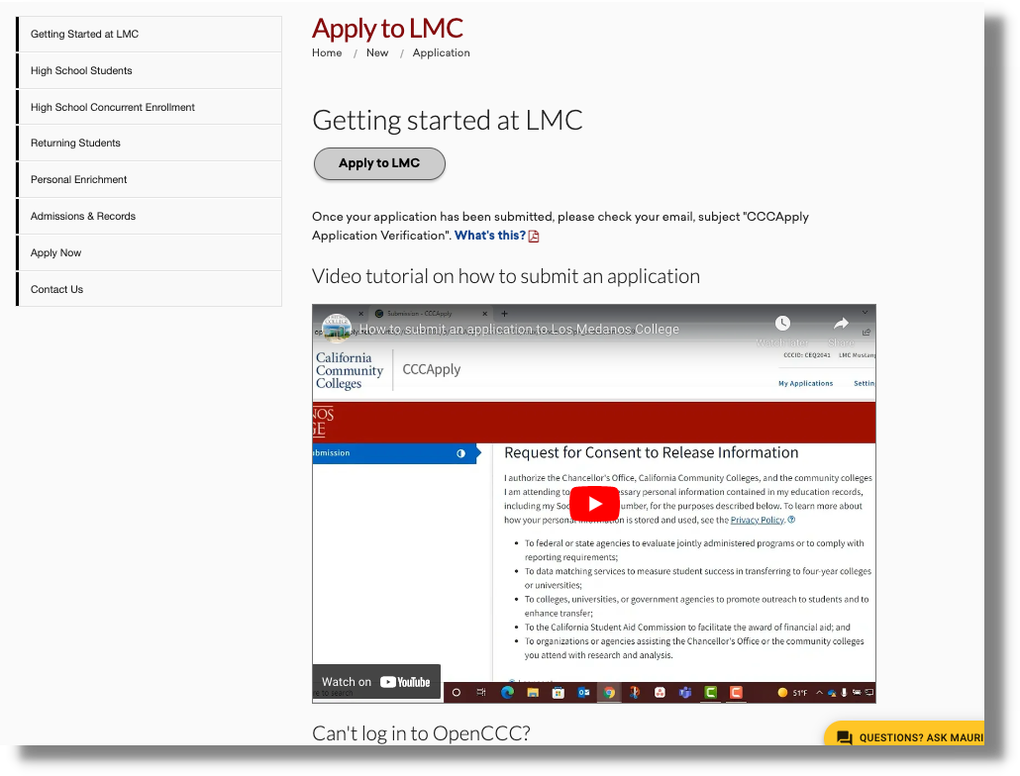
Apply to LMC
Click on “Apply to LMC” button
You may also want take time to watch the Video Tutorial first

Slide 5
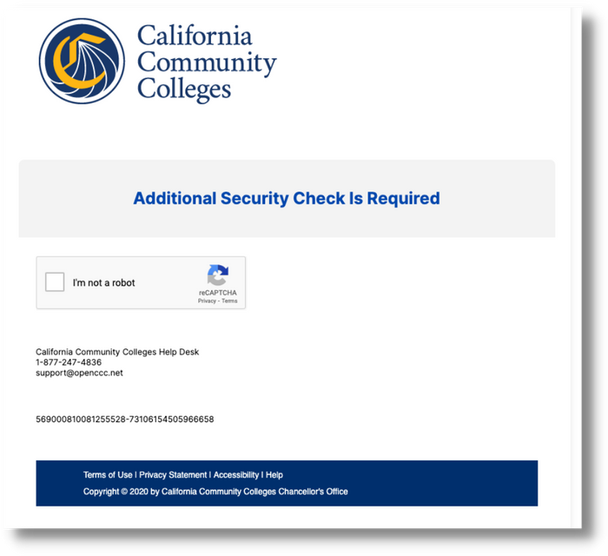
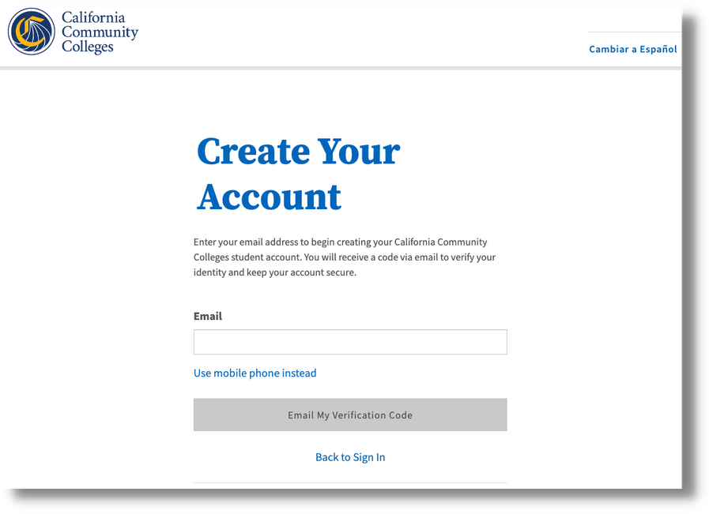
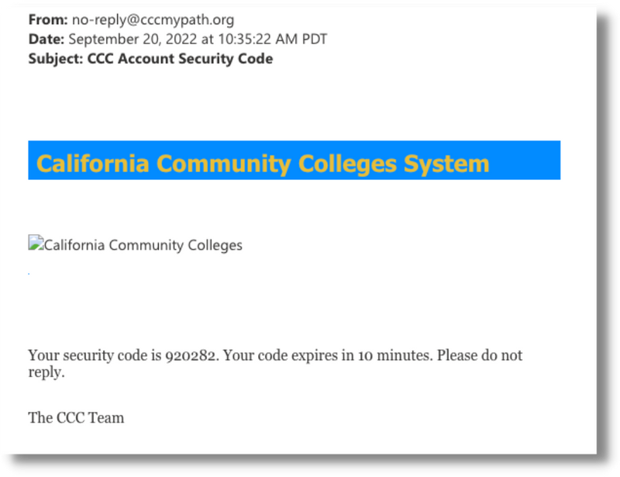
Apply to LMC
Follow the Security Prompts
Enter a valid PERSONAL email in order to verify yourself.
We highly recommend high school students use a PERSONAL email
(NOT a school email) rather than a phone number.
You will need immediate access to your email in order to enter the verification number that you receive and begin creating your OpenCCC account.

Slide 6
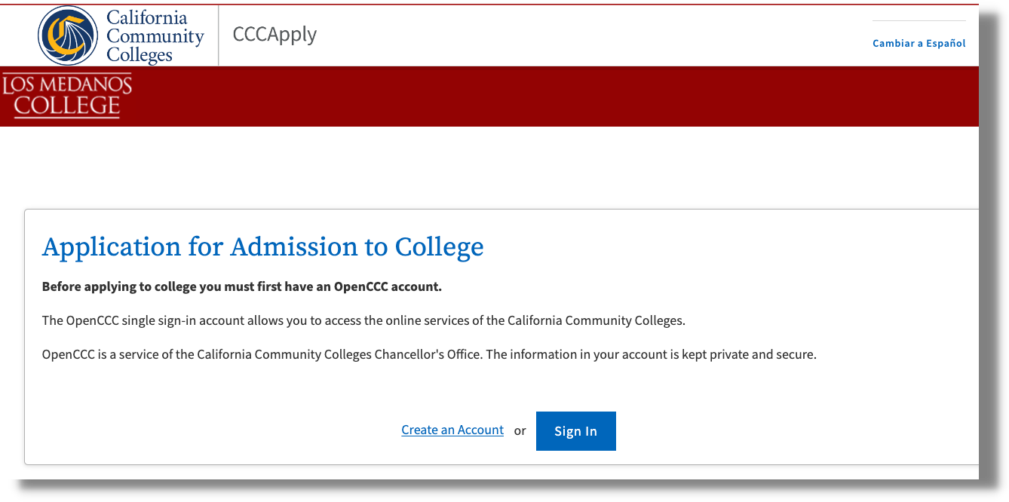
Apply to LMC
If you’ve never applied to a California Community College, you will click ”Create an Account”
If you already have an LMC ID#, you may click “Sign In” with your OpenCCC username &
password or follow the prompts to retrieve them.

Slide 7
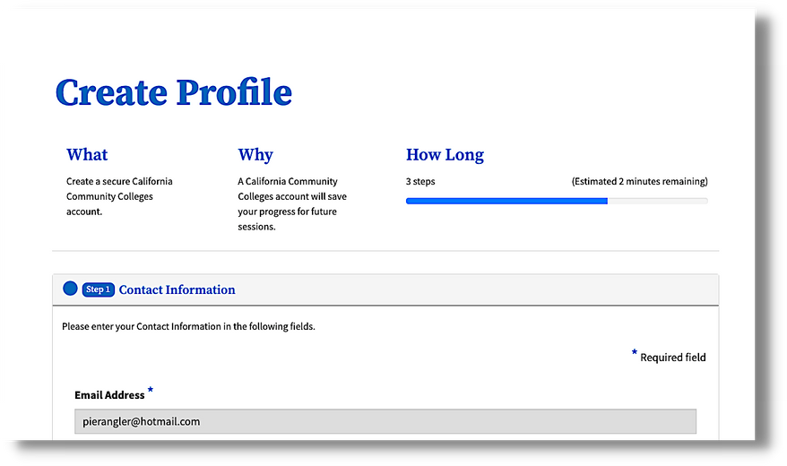
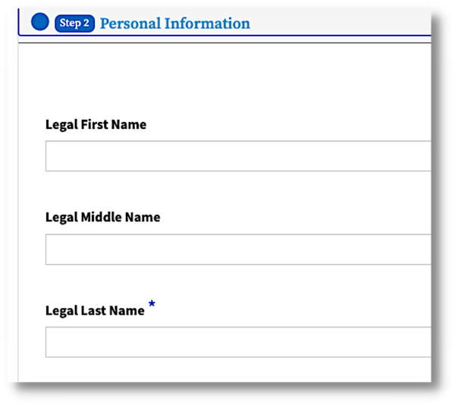
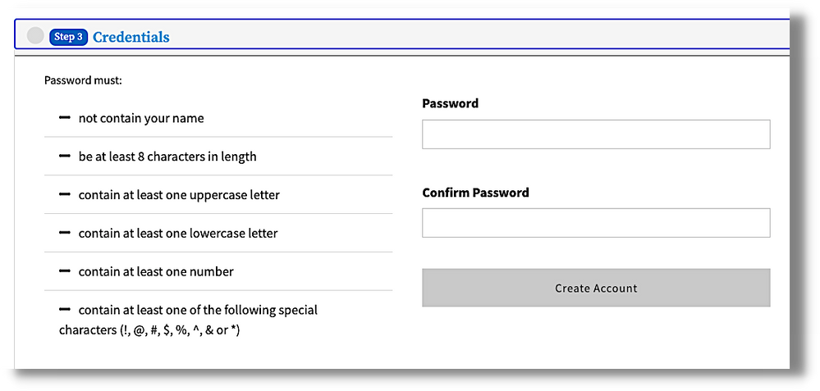
Apply to LMC
Follow the prompts to create your OpenCCC account
IMPORTANT
Be sure to use your LEGAL name on ALL college applications and accounts!
Make sure to write down your password as soon as the system accepts it!

Slide 8
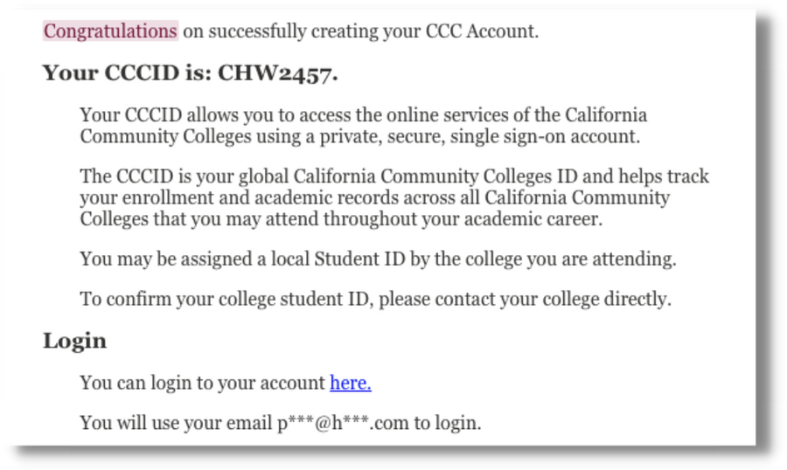
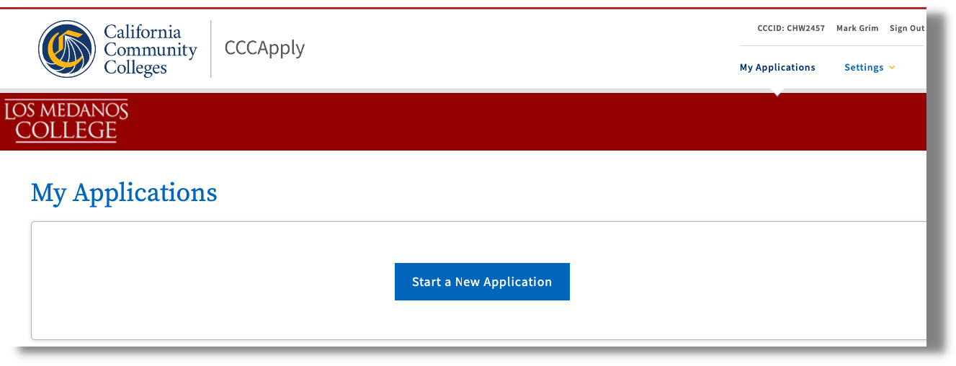
Apply to LMC
Check your email to verify your new CCCID#
Write down your CCCID#
(you will need this number to register for your articulated class)
Click ”Start a New Application”

Slide 9
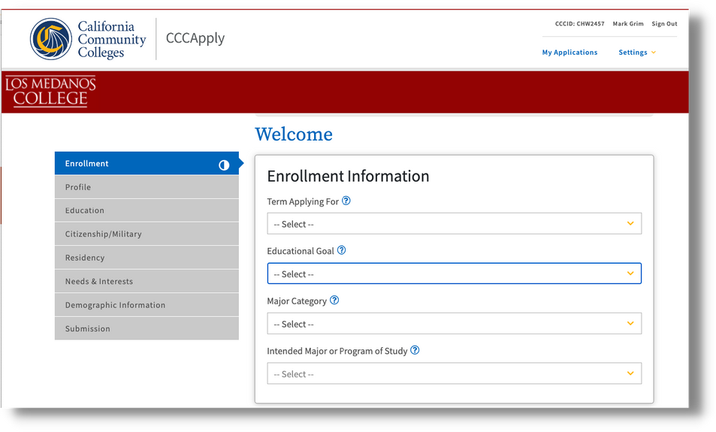
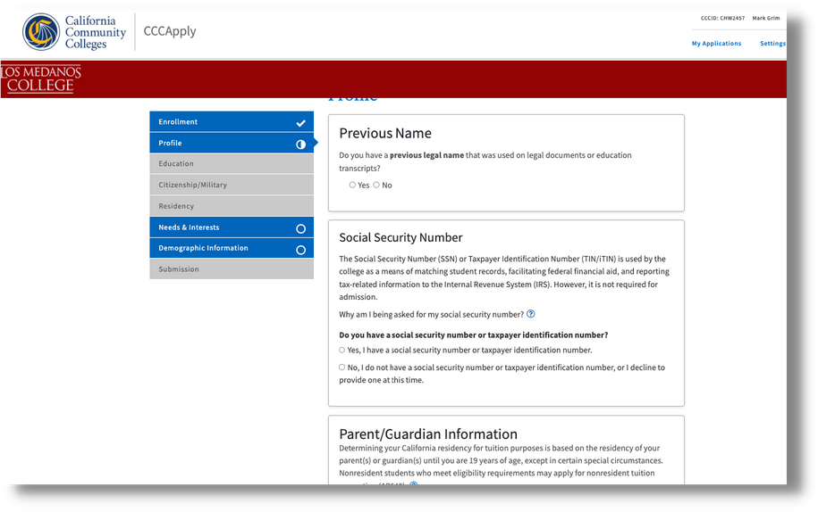
Apply to LMC
Begin the LMC Application
APPLICATION NOTES:
Enroll in the current term available to you
(Fall, Spring or Summer)
Social Security Numbers are NOT required*
*however, students will need to provide information when applying later for financial aid.

Slide 10
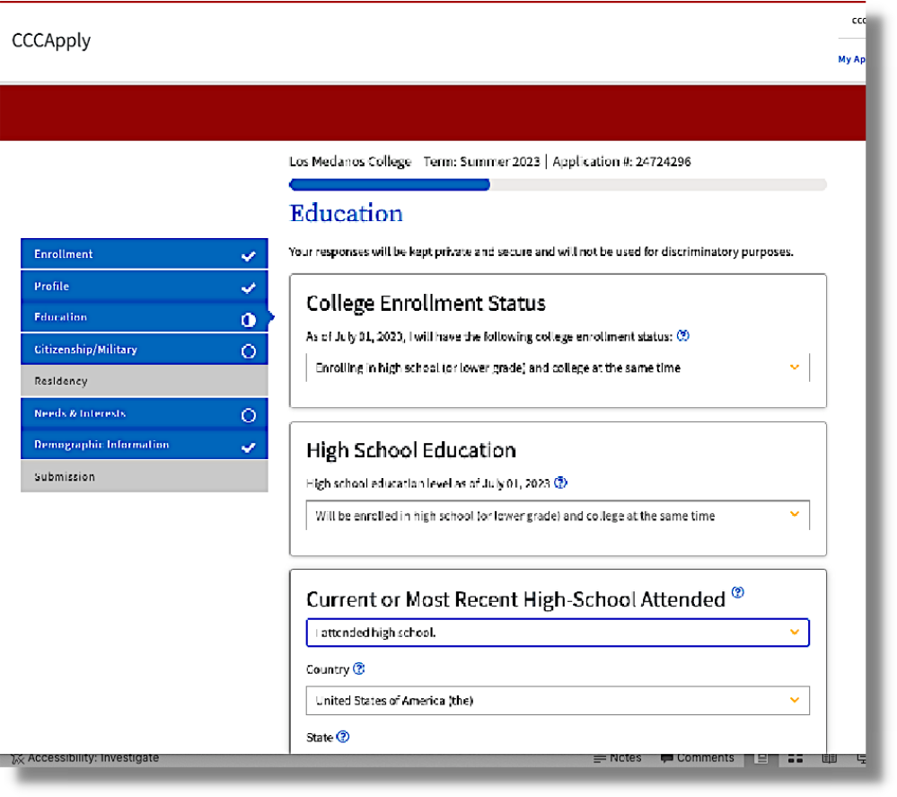
Apply to LMC
Continue the LMC Application
APPLICATION NOTES:
Enrollment Status for articulated high school students is:
“Enrolling in high school (or lower grade) and college at the same time
Choose “I attended high school”
Follow the rest of the prompts to complete the application.
COMPLETE ALL SECTIONS OF THE APPLICATION

Slide 11
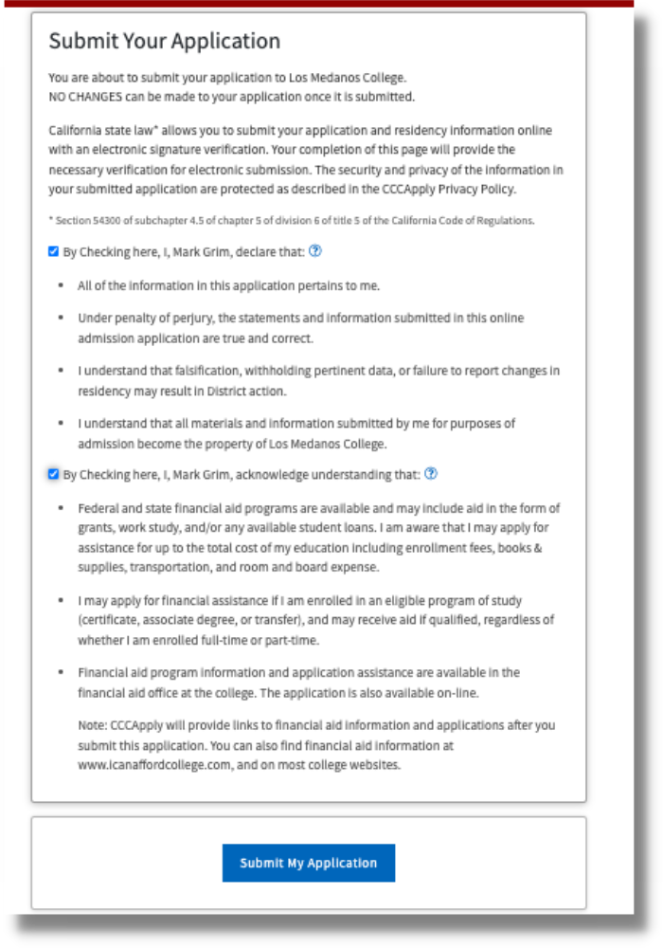
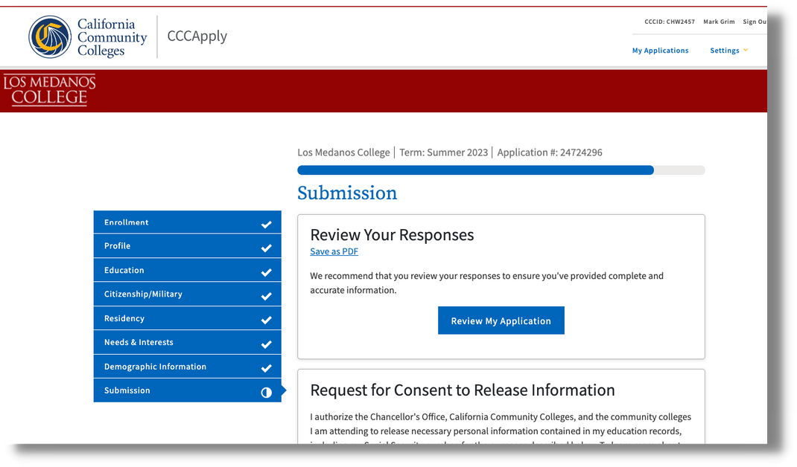
Apply to LMC
Submit the LMC Application
APPLICATION NOTES:
All application sections must be marked with a checkmark
Review your application
Check verification boxes
MAKE SURE TO CLICK THE SUBMIT BUTTON!

Slide 12
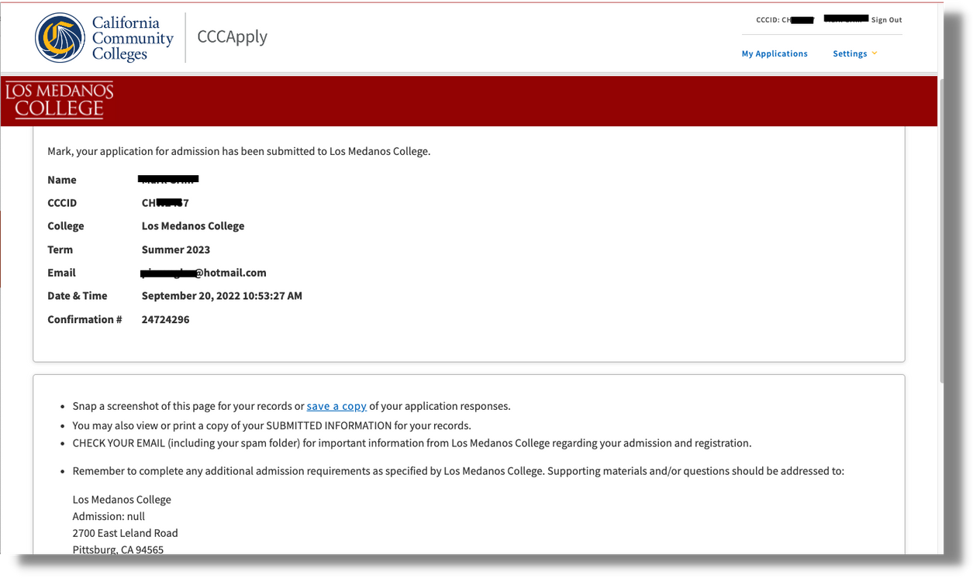
Apply to LMC
Confirm the LMC Application
APPLICATION NOTES:
Confirm and write down your CCCID#
Within 2-24 hours look for an email from
InSite with your new LMC Student ID#
(you will need this number to register for your articulated class)

Slide 13
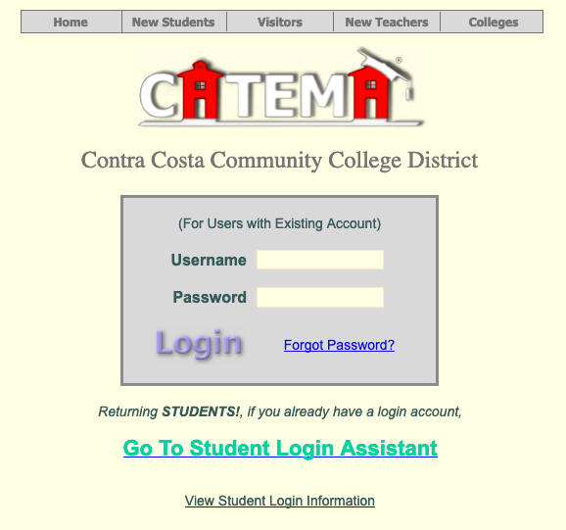
Prepare to Register for CATEMA
Have your CCCID# and your LMC Student ID# ready
Go to www.CATEMA.net/contracosta
(Be sure to use “contracosta” to get to the correct college district!)
New Students to CATEMA
Click on "New Students"
Click on "Create Account

Slide 14
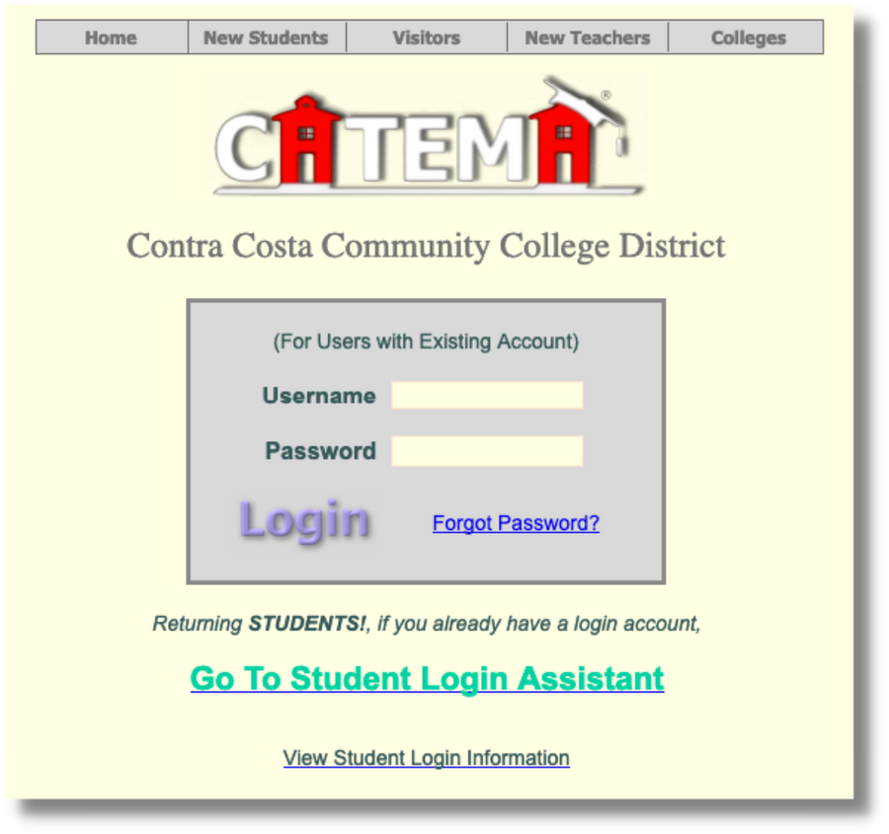
Students with EXISTING CATEMA Accounts ONLY!
Sign In to CATEMA
Create your CATEMA account
From www.catema.net/contracosta (be sure to use "contracosta")
Students with Existing CATEMA Accounts
Click on "Go To Student Login Assistant”
OR
2. Click ”View Student Login Information” to get the
“hints” for their auto-assigned usernames/passwords
This box is for HS Teachers/
Staff only

Slide 15
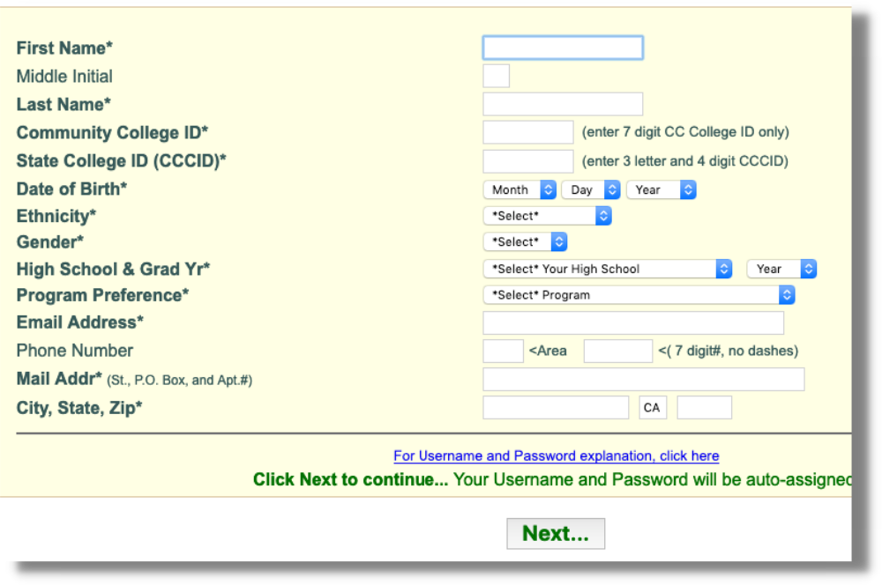
Create Your CATEMA Account
Create Account
Create your CATEMA account
IMPORTANT NOTES:
Always use your LEGAL Name
Community College ID is your LMC Student ID#
State College ID is your CCCID#
Indicate your Graduation Year
No dashes in the phone box

Slide 16
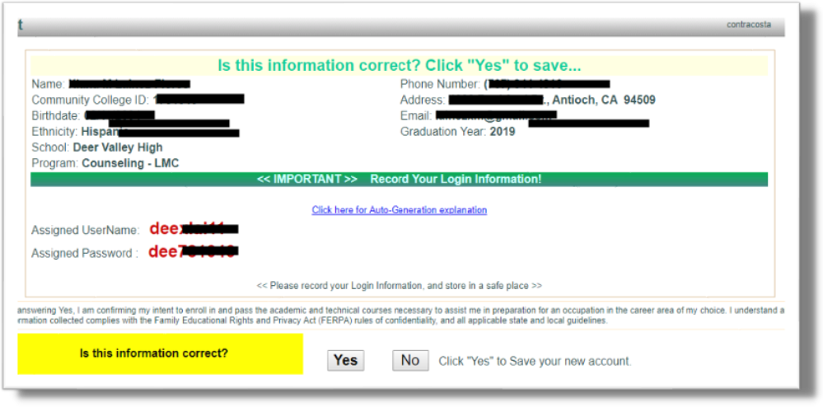
Check Your CATEMA Account
Create Account
Create Account
Create your CATEMA account
Check your information
Write down your Username and Password
Click Yes to create your CATEMA account

Slide 17
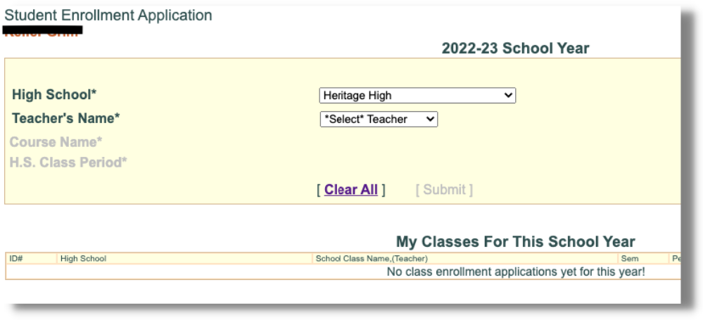
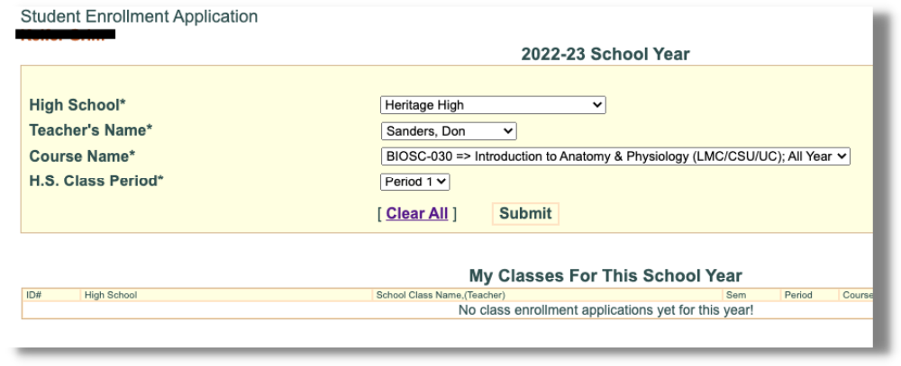
Choose Your Teacher's Name
Create Account
Create Account
Create Account
Create your CATEMA account
Choose your Teacher’s Name from the drop down list
Choose the LMC Course that your High School Class is articulated with
Choose your class period
Click Submit and you will see the class under ”My Classes For This School Year” (you will have a “pending” until your teacher approves you

Slide 18
Checking for your College Credit
Create Account
Create Account
Create Account
Create Account
Create your CATEMA account
Your teacher will recommend credit at the end of your class term.
You will receive a Congratulatory Email with instructions on how to login to your college InSite account and check your transcripts.
Great Job!
For more information about LMC Early College Credit
or to Contact Us,
Please visit our website at:
www.losmedanos.edu/earlycollegecredit

Slide 19
Los Medanos College
Articulated High School Classes & CATEMA Registration
www.losmedanos.edu/earlycollegecredit

