Slide 1
How To Check Your Financial Aid Status in Self Service

Slide 2
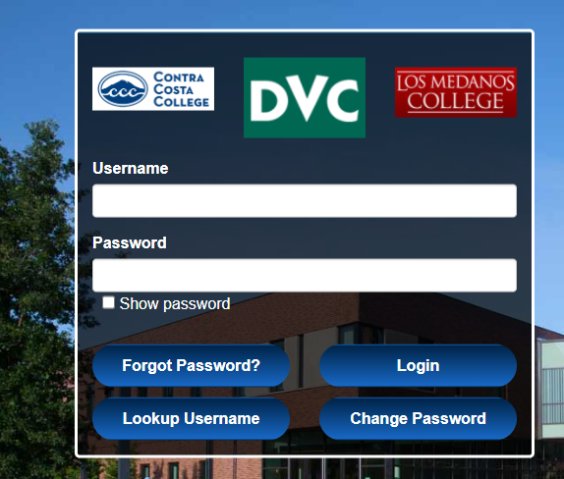
Log in to Insite

Slide 3
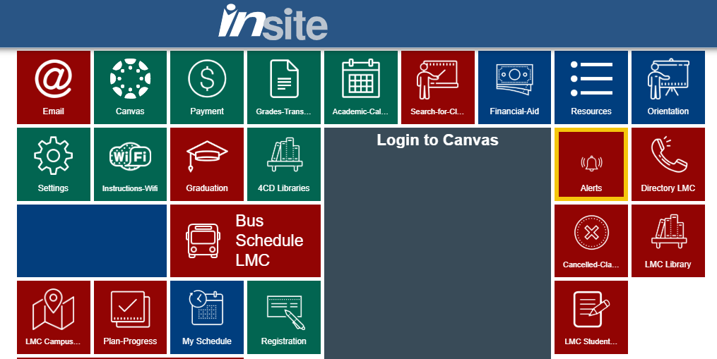
Click on the Financial Aid Tile

Slide 4
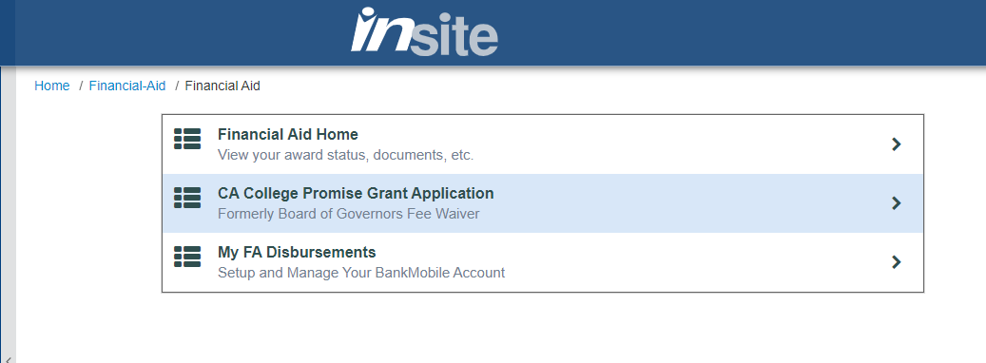
Click on Financial Aid Home

Slide 5
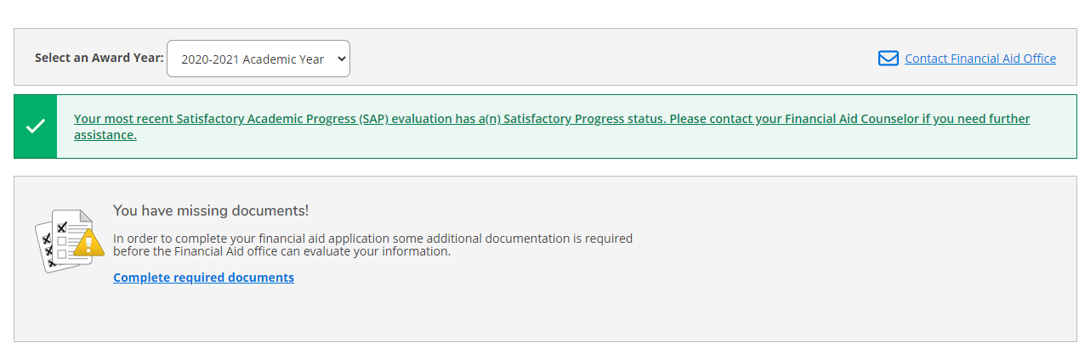
Click Complete Required Documents

Slide 6
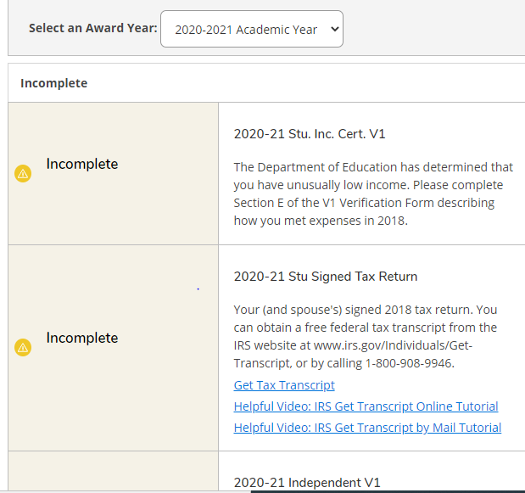
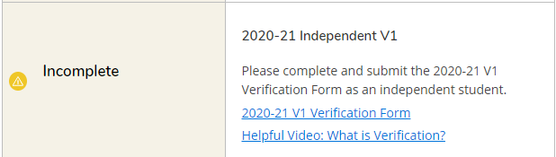
Your Documents are Listed Here with Links to Documents and Helpful Videos

Slide 7
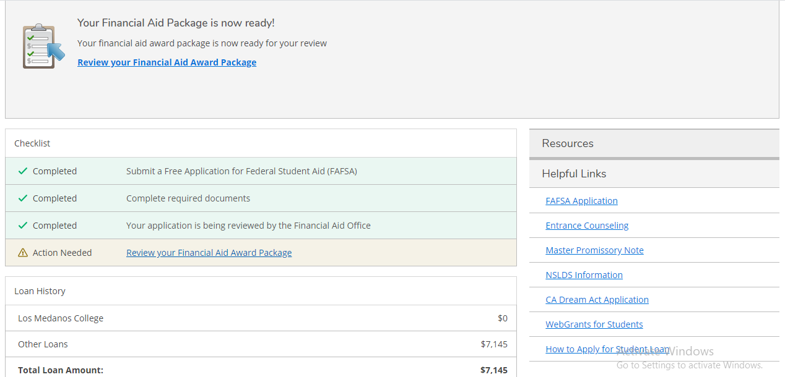
Once Awarded, you can Click on Review Your Financial Aid Package

Slide 8
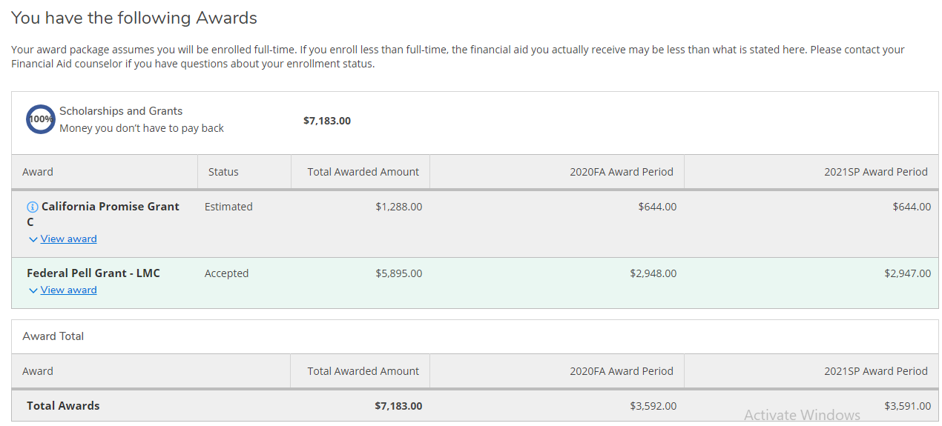
Your Financial Aid Package

Slide 9
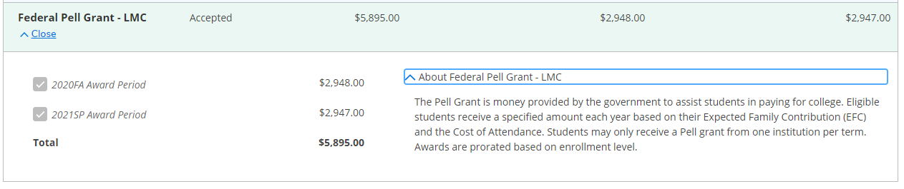
Click on the Arrow Next to Each Award for Descriptions

Slide 10
How to Make Your Disbursement Choice with BankMobile

Slide 11
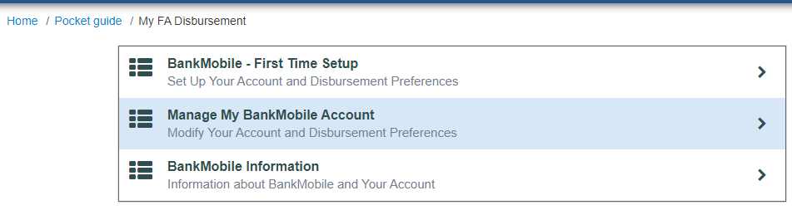
Click First Time Set Up and Follow Instructions to make your Choice

