Slide 1
DISTANCE EDUCATION AT 4CD
Overview and Update
07.24.19
JOANNA MILLER, DEAN OF DISTANCE EDUCATION (DE); ANNE KINGSLEY, DE COORDINATOR, DVC;
MICHAEL KILIVRIS, DE COORDINATOR, CCC; LAURIE HUFFMAN, DE COORDINATOR, LMC

Slide 2
Introductions: Districtwide DE Team Leaders
Distance Education Overview
Dr. Anne Kingsley, Districtwide Distance Education (DDEC) Chair, Diablo Valley College (DVC) DE Coordinator, DVC DE Committee member, English professor
Dr. Michael Kilivris, DDEC member, Contra Costa College (CCC) DE Coordinator, Chair CCC DE Committee, Philosophy professor and Department Chair
Dr. Laurie Huffman, DDEC member, Los Medanos College (LMC) DE Coordinator, DE Committee member, Spanish and World Languages professor
Dr. Joanna Miller, District Distance Education Dean
v

Slide 3
Distance Education
Distance Education Overview
What is Distance Education?
Instruction in which instructor and student are separated by time and/or distance, interact with assistance of technology (Title 5 Section 55200)
Distance Ed is Growing!
Demand is increasing statewide; nearly one-third of 2.1 million California community college) students take online classes. (CCCCO)
At 4CD, more than 14,000 students take DE classes Online and another 8,000 take Partially Online (4CD Research)
v

Slide 4
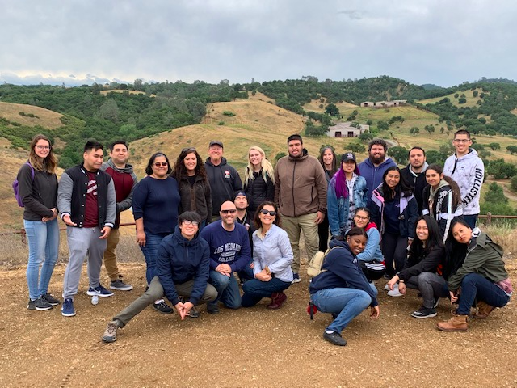
Who are our Distance Education students?
Distance Education Overview
Traditional students, 18-24
Non-traditional students, 24 and up
Students who work
Students who have children
Students who take care of parents
Students without transportation or gas money
Students with physical or emotional disabilities
Active military and veterans
v
Dr. Laurie Huffman on a field trip with one of her online classes.

Slide 5
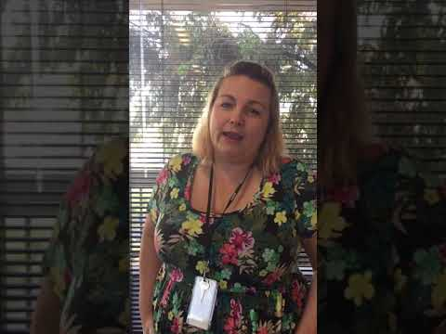
Who are our Distance Education students?
Distance Education Overview
Kristy Myers
Full-time District Payroll Specialist at 4CD
Classified Senate President
Small business entrepreneur
Mother with two young children
STUDENT AT LMC, CCC, DVC and CSUCI
v

Slide 6
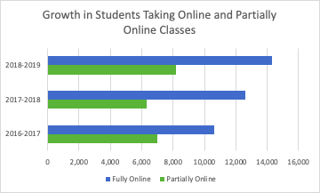
Students Taking Online DE Courses at 4CD
Distance Education Overview
v
Source: 4CD Research
Notes:
This chart shows the decline in demand for Hybrid classes and On-campus classes, and growth in Online classes

Slide 7
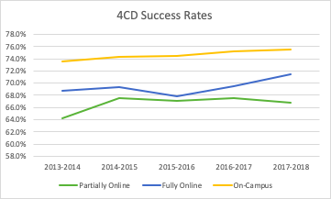
Distance Education Overview
Success Rates Increasing Overall and Online
v
Notes:
CD Success rates
Have increased about 2% over 5 years across all delivery modes

Slide 8
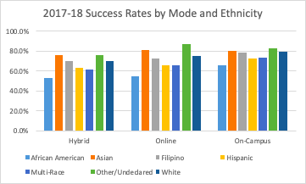
Distance Education Overview
Success Rates Improve, but Gaps Persist in Underrepresented Populations
v
Notes:
Success rates by demographic have improved about 6% over five years, but they are persistently and consistently below the district and statewide average for all groups.

Slide 9
Districtwide Distance Education Council (DDEC)
Distance Education Overview
The DDEC includes members across three campuses with a focus on effective, equitable Distance Education across the District.
This DDEC has been established to provide strategic direction, guidance and support to each college and District leadership to ensure that distance education is an effective and consistent part of how the District meets its mission. The DDEC will be the primary mechanism by which this can be achieved and maintained.
v

Slide 10
DDEC Members
Distance Education Overview
Anne Kingsley, Co-Chair, DVC
Joanna Miller, Co-Chair, District
Richard, Robison, DVC
Mario Tejada, DVC
Kat King, DVC
Mike Kilivris, CCC
Mónica Landeros, CCC
Courtney Diputado, LMC
Laurie Huffman, LMC
*Members from each campus meet twice a month
v

Slide 11
DDEC Initiatives and Projects
Distance Education Overview
Three Broad Areas of Current Initiatives
Open Educational Resources (OER)
California Community Colleges California Virtual Campus-Online Education Initiative (CVC-OEI)
Grants to be approved today total nearly $1.5 million to bring new classes and programs online
Peer Mentoring Program prepares courses for CVC-OEI
Membership in CVC-OEI Consortium
4CD Professional Development to improve online instruction, and make courses accessible to all
Rotating schedule of three fully online training courses
Beginner’s Guide to Teaching with Canvas; Becoming an Effective Hybrid Instructor; Becoming an Effective Online Instructor
v

Slide 12
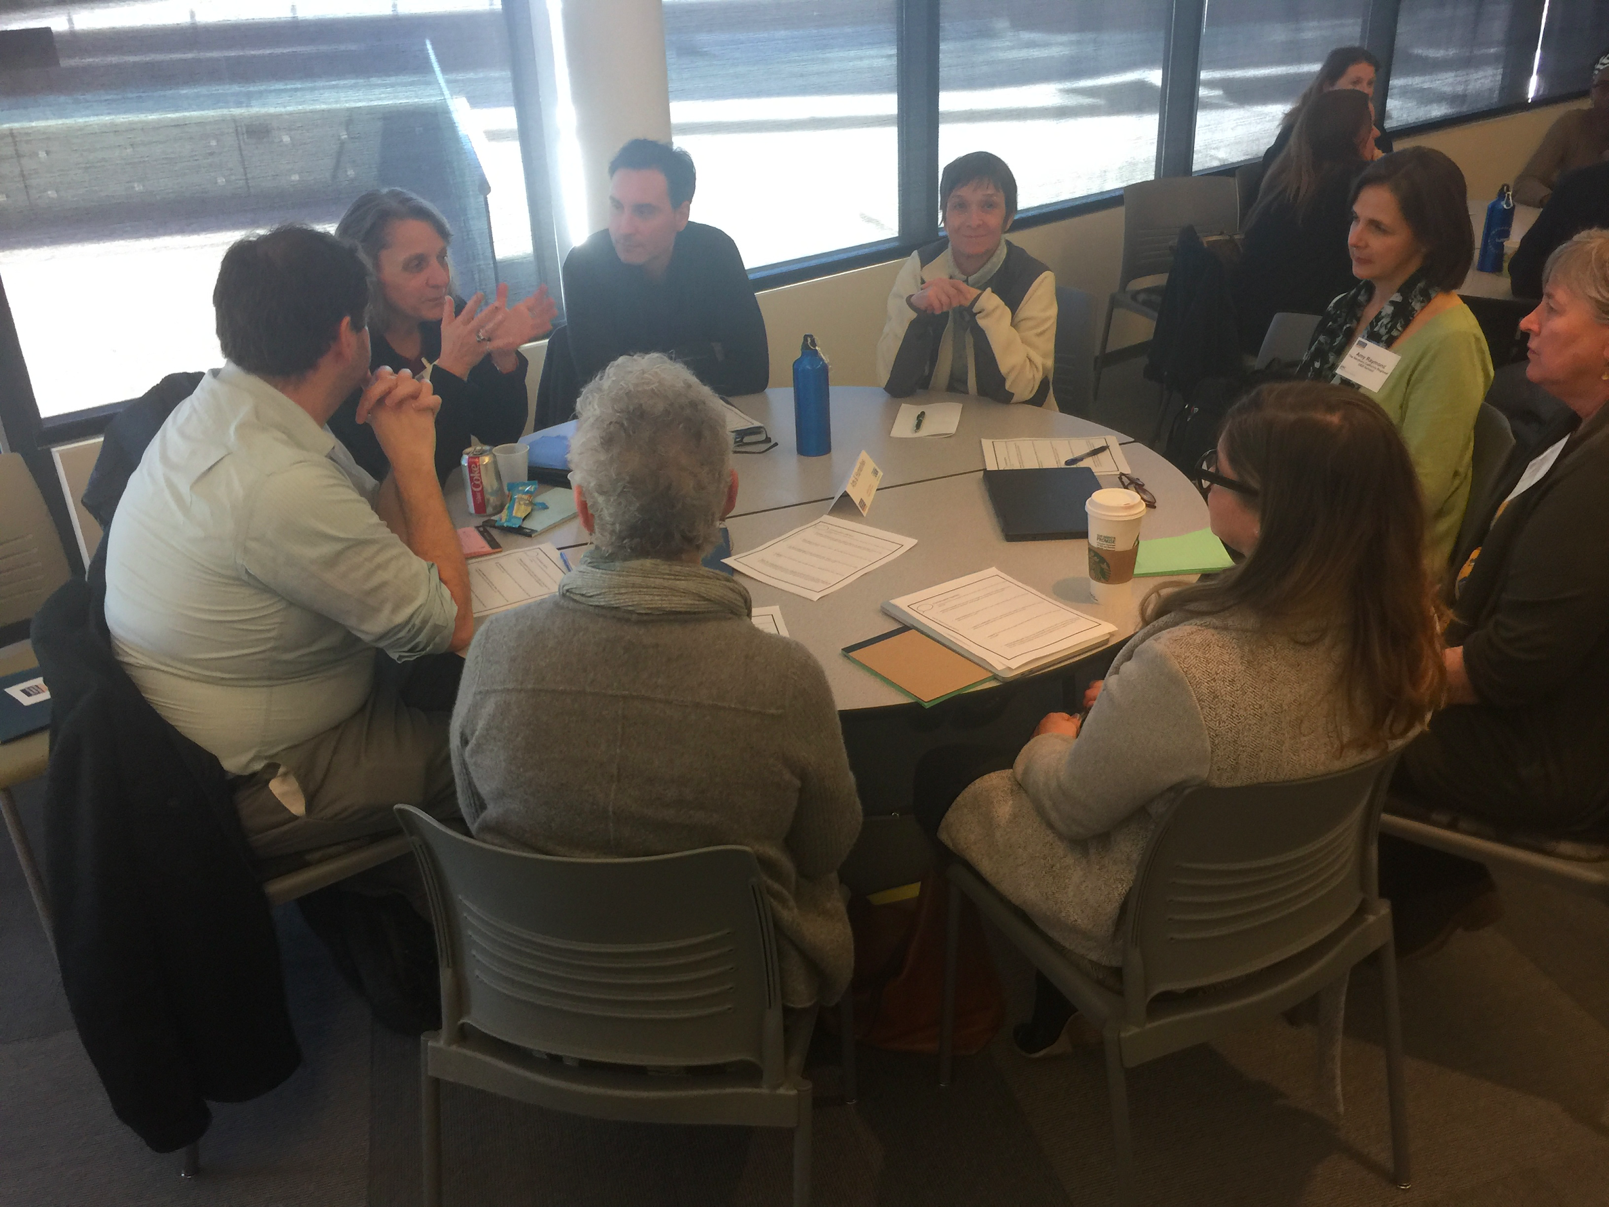
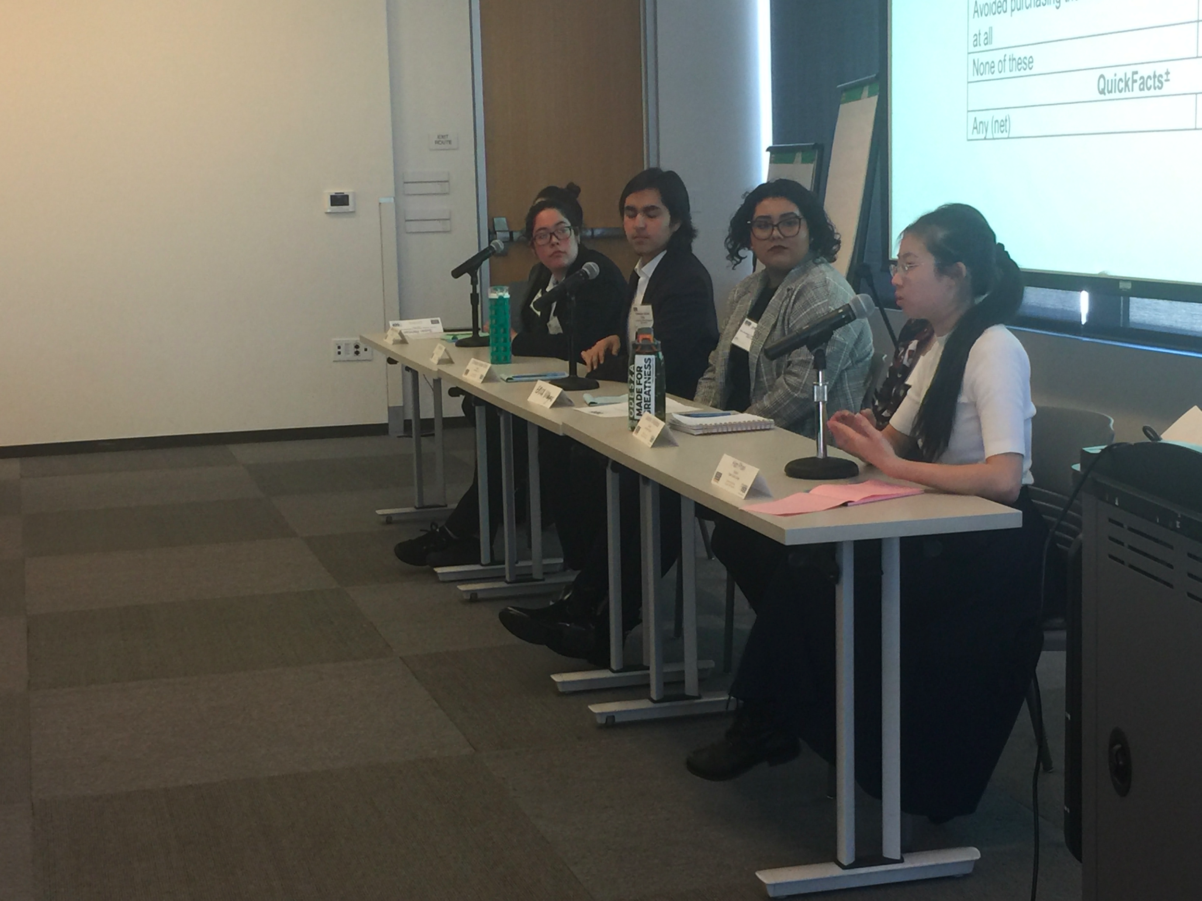
Initiative 1
Open Educational Resources (OER)
Distance Education Overview
Regional OER Summit, February 22, 2019 at DVC
Goal: To increase opportunities to provide students with no-cost online course resources
District sponsored
Partnered with OER Consortium and College
of the Canyons
125 participants from throughout California,
majority from 4CD
Quote from student: “We feel like our teachers who use OER care more about our success”
v

Slide 13
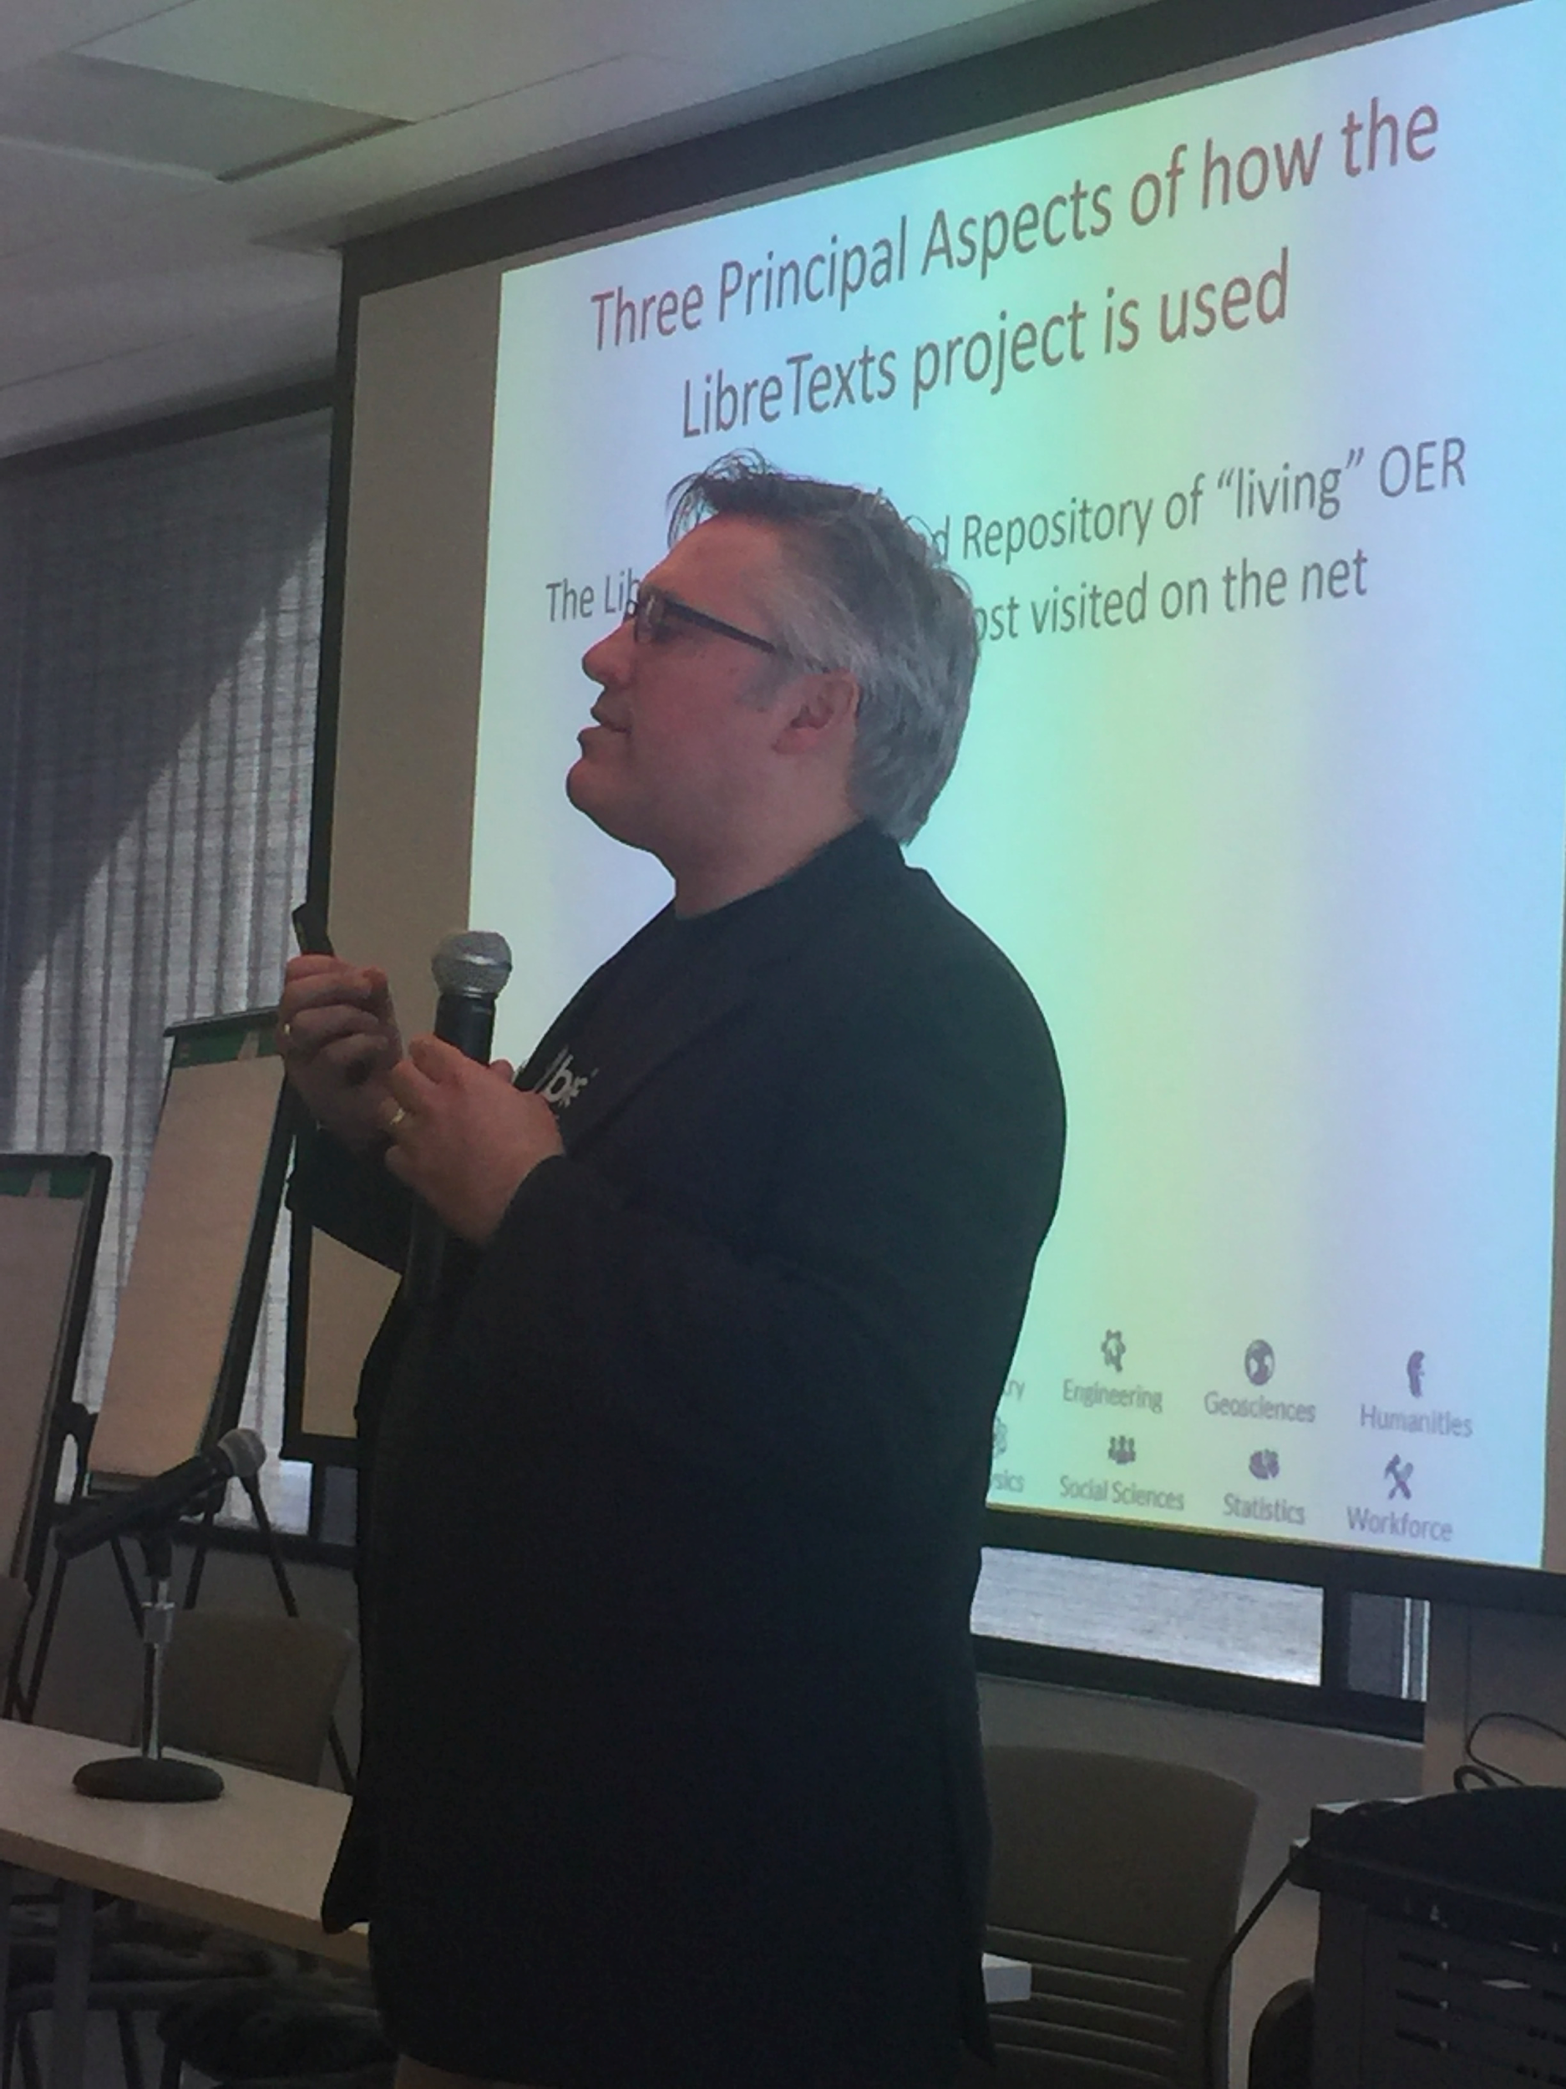
Initiative 1
Open Educational Resources
Distance Education Overview
US Department of Education through UC Davis
LibreTexts Founder Delmar Larsen
Provides $100,000 per year for three years across campuses
Faculty receive stipends to create and curate resources to provide no-cost resources
On Campus Hackathon sponsored with 25 faculty in May 2019 (Follow up event in Fall 2019)
v

Slide 14
Initiative 2
California Virtual Campus - Online Education Initiative
Distance Education Overview
Three broad areas under CVC-OEI
Grants to be approved today total nearly $1.5 million to bring new classes and programs online
Peer Mentoring Program prepares courses for alignment with CVC-OEI Course Design Rubric
Membership in CVC-OEI Consortium
Two colleges are currently part of the consortium, which provides approximately $500,000 in services annually
LMC applying in September
Colleges will work towards 20% online course alignment
v

Slide 15
Initiative 2
CVC- OEI Grant: Contra Costa College
Distance Education Overview
Contra Costa College (CCC) will receive $461,246 (the amount requested) to increase the quantity of online CTE programs and improve the quality of online CTE and GE courses.
Develop 10 new online courses to make six CTE programs fully online.
AS-T degree in Business Administration
Certificate in Business: Accounting Technician
Certificate in Business Office Technology: Administrative Assistant
Certificate in Business Office Technology: Business Information Worker
Certificate in Business Office Technology: General Office
Certificate in Computer Information Systems: Computer Operations
v

Slide 16
Initiative 2
CVC- OEI Grant: Contra Costa College
Distance Education Overview
Additionally, through the grant, CCC will
Align 20 existing online Career Education and General Education courses to the CVC-OEI Course Design Rubric through local and Districtwide Peer Online Mentoring and Review (POMR) program
5 experienced faculty will mentor new online faculty
v

Slide 17
Initiative 2
CVC- OEI Grant: Contra Costa College
Distance Education Overview
CCC will expand its Distance Education team to include:
2 Instructional Designers
to work one-on-one with faculty developing new online courses
and design templates for all online faculty to use in their courses
1 Online Accessibility Specialist
to review new and existing online courses for accessibility compliance
1 Peer Online Mentoring & Review Lead
to organize and participate in CCC’s local POMR program
1 Open Educational Resources Coordinator
to help faculty identify and integrate OER (Open Educational Resources) materials into their courses
v

Slide 18
Initiative 2
CVC- OEI Grant: Contra Costa College
Distance Education Overview
CCC will use the remaining grant funds to:
Design and implement online student readiness materials;
to improve online student retention and success
Provide additional professional development opportunities for faculty;
Example: increased funding to attend the Online Teaching Conference
Support training for online counseling (Cranium Cafe); and
Enhance marketing of online courses and programs
Open Educational
v

Slide 19
Initiative 2
CVC- OEI Grant: Diablo Valley College
.
Distance Education Overview
Strengthening Quality & Quantity of Online Certificates in...
Administration of Justice
Business
Computer Information Systems
Computer Network Technology
Digital Marketing
Digital Media Web/Mobile Design
GIS/GPS
Music Industry
CAD/Digital Media for Industrial Design and Engineering
v

Slide 20
Initiative 2
CVC- OEI Grant: Diablo Valley College
.
Distance Education Overview
Highlights:
Aligning 10 online courses with OEI Design Rubric & Developing 10 new online courses
Fully Online Digital Marketing certificate (1 year completion pathway) starting Fall 2019
Selecting Nine Discipline Online Leads
Jumpstart-ing pilot in Peer Mentoring Online Course Review (POMP)
9 Peer mentors trained
Developing badging for student readiness
Strengthening marketing to clarify online certificates
Selecting Student Services Online Lead to develop online degree audit infrastructure and strengthen advisement in distance education
Selecting Accessibility Expert to review online courses for ADA compliance
v

Slide 21
Initiative 2
CVC- OEI Grant: Los Medanos College
Distance Education Overview
Certificates and Badging in:
Travel/Marketing
Child Development
Process Technology
Help Desk Tech Support
Networking/Info Systems Security
Counseling
v

Slide 22
Initiative 2
CVC- OEI Grant: Los Medanos College
Distance Education Overview
Cohort Trainings beginning Summer 2019
Over 40 faculty volunteers to Begin Alignment to the OEI Rubric- GE and CTE
First Fully Online AA-T, for Transfer, in Spanish launched Summer, 2019
v

Slide 23
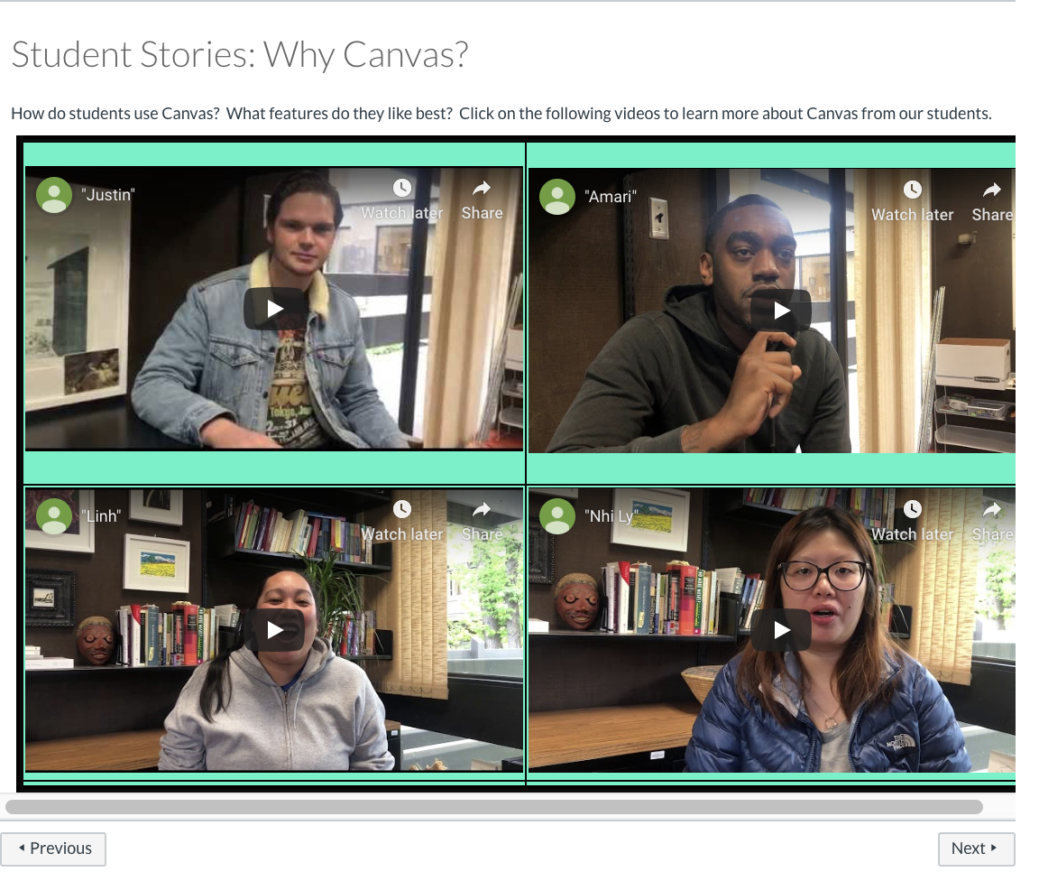
Initiative 3
Districtwide Professional Development
Distance Education Overview
Beginner’s Guide to Teaching with Canvas
Encourage faculty to use Canvas for on-campus classes
Teach basic usage of Canvas tools
Teach pedagogical use of Canvas for increased student success
v
Student Stories from “Beginner’s Guide”

Slide 24
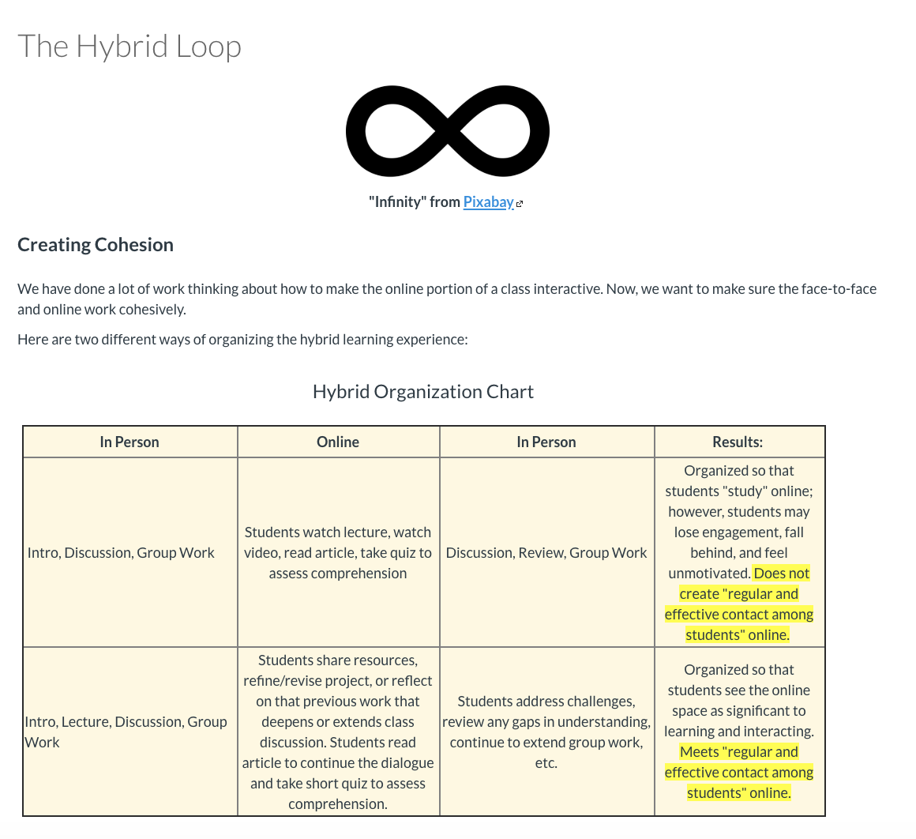
Initiative 3
Districtwide Professional Development
Distance Education Overview
Becoming an Effective Hybrid Instructor (BEHI)
Create regular & substantive contact during “online” portion
Apply effective principles of course design and accessibility
Build learning experiences that move seamlessly from in person to online
v
Hybrid Loop from “BEHI”

Slide 25
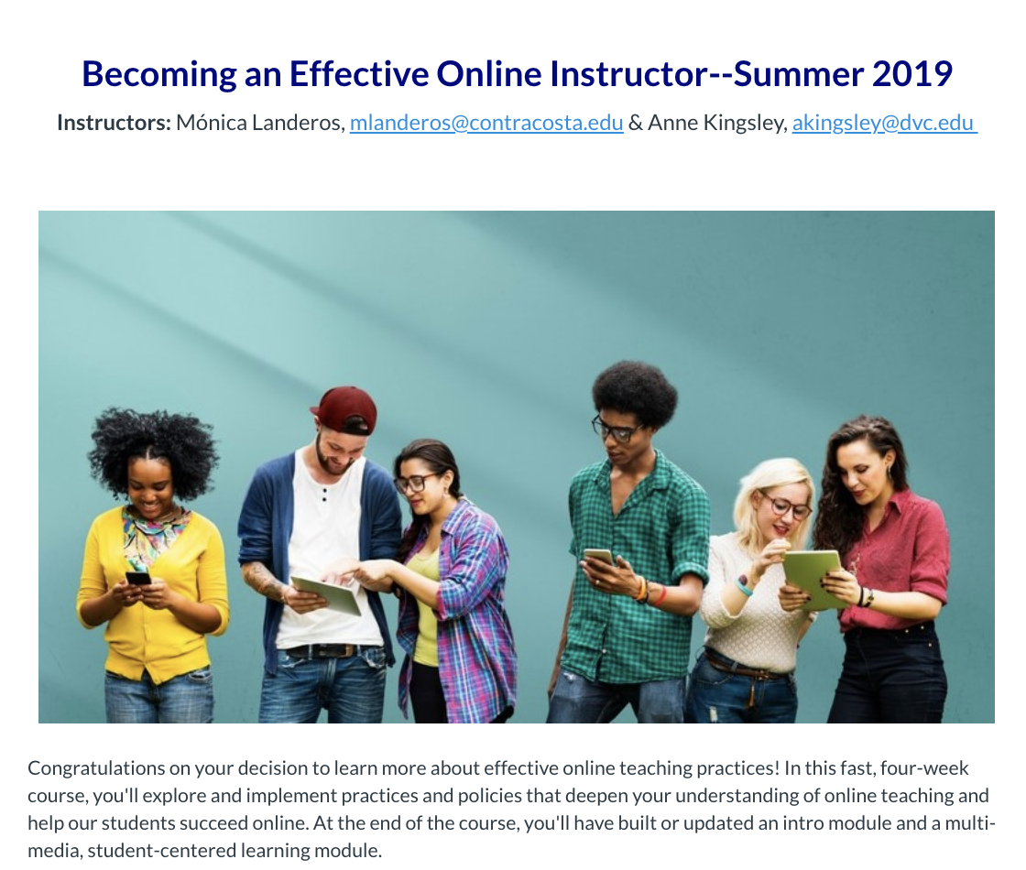
Initiative 3
Districtwide Professional Development
Distance Education Overview
Becoming an Effective Online Instructor
(BEOI)
Apply pedagogical concepts for excellence in online teaching
Acquire knowledge in effective use of Canvas Tools
Build two complete (and accessible) learning modules or units of an online course
v
Home Page for “BEOI”

Slide 26
Initiative 3
Districtwide Professional Development
Distance Education Overview
4CD Institute Course | Instructor Completions
Beginners Guide (Winter 2019) | 13
Becoming an Effective Hybrid (Spring 2019) | 10
Becoming an Effective Online (Summer 18, Fall 18, Spring 19, Summer 1 2019, & Summer 2 2019) | 90
First Year Total Trainings Completed | 113
v

Slide 27
Initiative 3
Districtwide Professional Development
Distance Education Overview
Additional Area of Interest: Preparation for all instructors
Ensuring that faculty are ready and well-trained for teaching in an online environment.
The District is in discussion through negotiations.New Title 5, § 55208 requires that :
“instructors ‘shall be prepared to teach in a distance education delivery method consistent with local district policies and negotiated agreements.”
v

Slide 28
Newer Initiatives for the year ahead
.
Distance Education Overview
Create a program to reach Incarcerated college-aged youth via online education
Create a program to train and hire student interns to assist faculty in making their online courses accessible to all students
Create a Districtwide General Education Online Pathway to provide online students a means to complete GE online
Create a program to increase awareness and training for reaching underrepresented students online
v

Slide 29
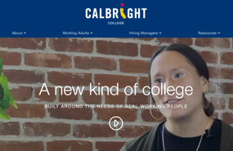
Calbright College - the 115th
Opening October 2019
Distance Education Overview
Job Ready Programs and Courses: Non-Credit
•Calbright Badge- Career Essentials
•Calbright Certified-
Employment in Medical Coding
•Calbright Certified-
I.T. Support and Cyber-•Security Support
COMPTIA Security+Certification
v

Slide 30
Calbright College - the 115th
.
Distance Education Overview
Preparing Working Adults for Better Paying, More Upwardly Mobile Jobs
“Calbright Job Ready Program and Achieve Certification will glide directly into a paid apprenticeship in the job our learners trained for which can lead to a new, full-time job.
The best part? All of this is free to our enrolled learners. And all of it has been designed to be done in under one year.” Derek Gordan, Chief Operating Officer
v

Slide 31
4CD Goals for 2019-2020 for Distance Ed
Distance Education Overview
Maintain and improve quality in online education as demand grows
Provide opportunities for high-quality professional development
Create new collaborative opportunities for disciplines that may not find online is correct mode
Eliminate the success gap across underrepresented groups
Expand use of Open Educational Resources
Improve outreach to all students
Continue to provide access to quality education for students with jobs, young children, physical or emotional disabilities
Ensure equity in educational opportunities across the 4CD!
v

Slide 32
Recap and the Year Ahead
Distance Education Overview
Continued efforts
Open Educational Resources
CVC-OEI
LMC will apply in September
Grant work continues
Peer Online Mentoring
Professional Development
New Initiatives
Incarcerated youth
Student accessibility interns
General Education Online Pathway
Reach underrepresented students online
v
IMPROVE ONLINE EDUCATION OPPORTUNITIES AND ACCESS FOR ALL 4C STUDENTS!

