Slide 1

A&R Updates for Faculty
Opening Day
Spring 2023

Slide 2
Add Authorization Process
From the start date of the section until the last date to add, you may grant add authorization to students interested in adding your class.

Slide 3
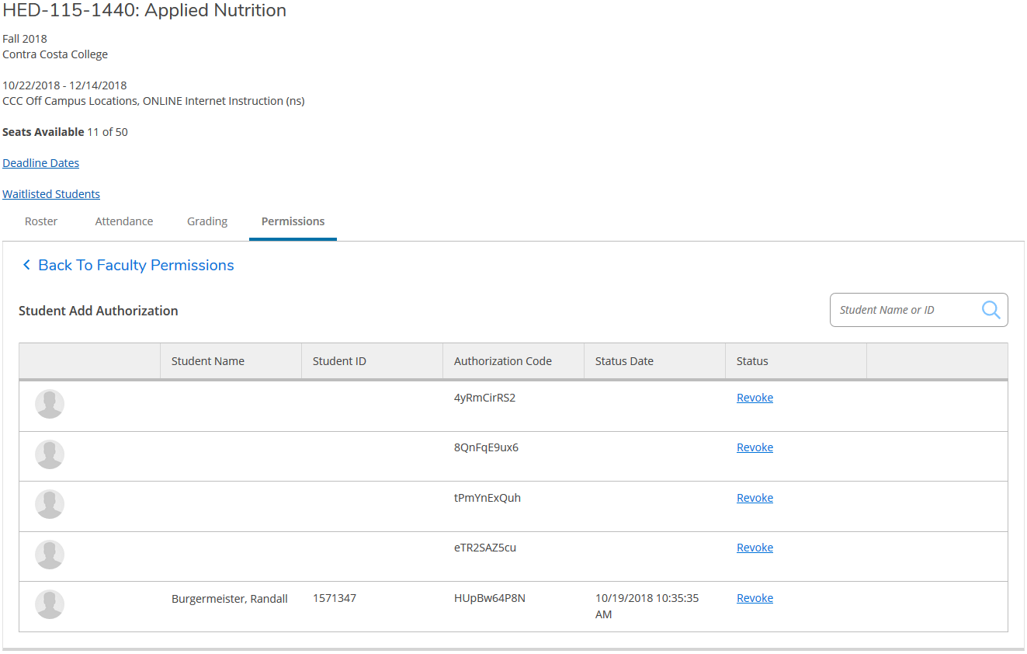
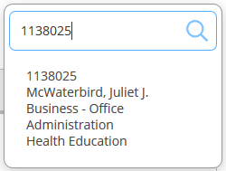


Multi-Purpose Roster – Add Authorizations
Enter Student ID
to authorize add

Slide 4
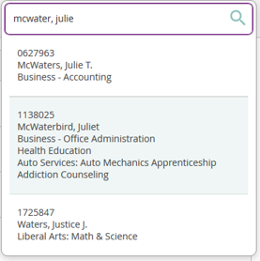
Multi-Purpose Roster – Add Authorizations
Or search by student name
Notes:
When searching for a student by name, multiple entries might populate a match. Be sure to select the correct student.

Slide 5
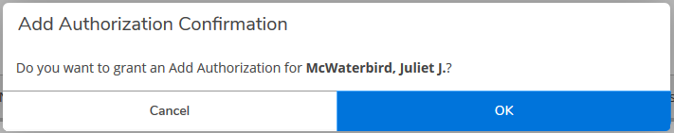
Multi-Purpose Roster – Add Authorizations
Select student and confirm

Slide 6
Multi-Purpose Roster – Add Authorizations
Add Authorization
is assigned
Notes:
It is important to keep in mind that although add authorization has been assigned, it is not active until the first class meeting. The student will receive an InSite email once add authorization is approved giving them the start and end date that add authorization is active. Active on the start date of the course and expires on the last date to add.

Slide 7
Multi-Purpose Roster – Add Authorizations
Authorized students are not prompted for code at registration. Registered students appear on your roster and are noted here.
Notes:
This is something important for faculty to monitor as students who have been granted add authorization must add the course by the end of the add period or a late add petition is required.

Slide 8
Late Add Petition Update
NEW-Faculty Initiated from LMC Faculty Forms
Electronically routes to student for signature.
Requires Director of A&R signature or Instructional Dean signature.
Manual registration by A&R Team.

Slide 9
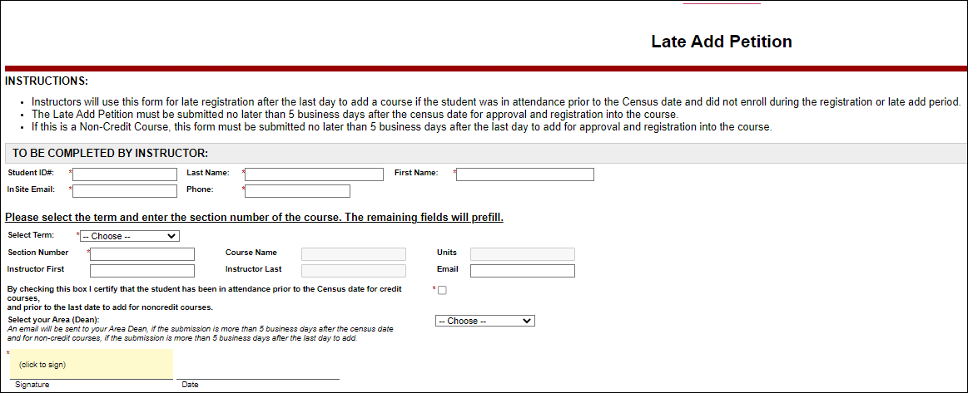

Slide 10
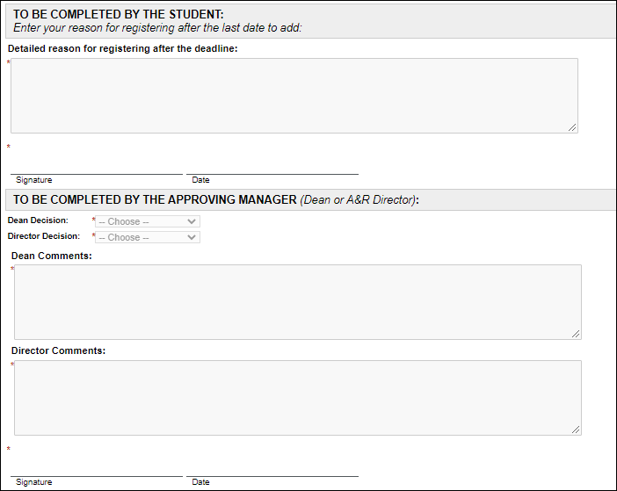

Slide 11
Drop Process Updates
Never Attended:
Section Start Date-One Day Prior to Census
Last Date of Attendance:
Start Date-Last Date to Drop

Slide 12
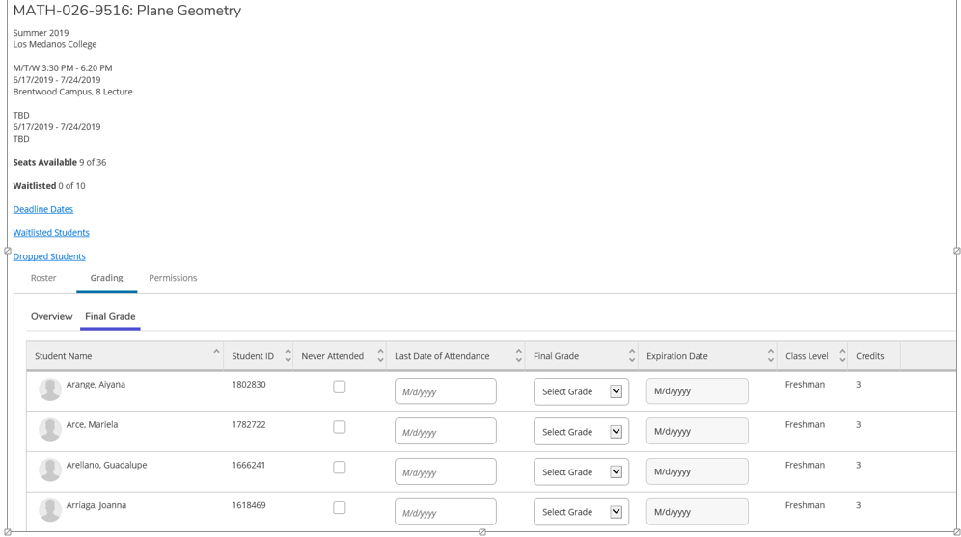
Multi Purpose Roster
Dropping & Grading
Never Attended, Last Date Attended & Final Grade are entered here
Notes:
Only students who are No Shows (NS) should be marked with the “Never Attended” box checked. If you have students who are NS-No Shows and you do not mark them in the multi-purpose roster, you can indicate the NS drops on your census roster. This is important because Title 5 requires mandatory reporting of all NS students. Students may also be dropped after the first date of attendance by entering the “Last Date of Attendance”. This might happen when a student is only present the first day of class and then does not return. Or, you may have students who attend throughout the term and then stop attending. One important thing to note is that all drops by students and faculty must be completed by the deadline date which is at the 75% mark of the course. Grades are due within three working days of the course end date. You will click on the “Final Grade” tab to use the drop-down arrow to select the final grade for each student. If your class is marked as SC and students have elected the P/NP option rather than letter grading, you will enter the letter grade that the student earned. A-C grades will automatically convert to P and D-F grades will convert to NP. If you have a student with an unforeseen emergency at the end of the term, they might request an incomplete contract with you. You will enter the grade earned of IB, IC, ID, IF, and the expiration date that the incomplete must be completed which cannot exceed more than one year.

Slide 13
Drop Email Results
Email: InSite@InSite.4cd.edu
Subject: Drop results for section COURSE-#-SECT
The following students were successfully dropped today by (Faculty Name) via the multi-purpose roster:
1111111 Sample, Student
2222222 Sample, Student
The following students were NOT dropped today via the multi-purpose roster:
NOTE: These students will remain on your roster, and the entries you made when attempting to drop them will be cleared.
Please contact your campus Admissions office for assistance if needed.
2333333 Smith, John - After drop grade req'd date (This means you attempted to drop a student as NS on or after census.)
2444444 Smith, Jane - After drop end date (This means you attempted to drop a student after the last date to drop.)
2555555 Sample, Student - Student has restrictions preventing drop (Forward this to admissions@losmedanos.edu for assistance.)

Slide 14
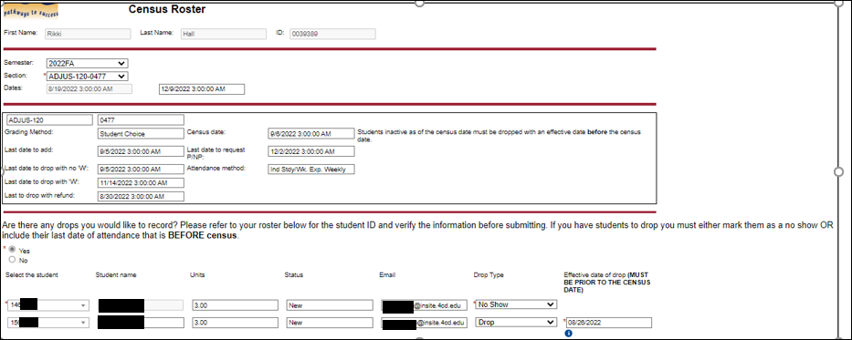
Census Roster Updates

Slide 15
THANK YOU!
LMC Admissions and Records Team
admissions@losmedanos.edu
925-473-7500

