Slide 1
LMC Accreditation 2020 Update
Presented by
LMC Accreditation Steering Committee
LMC Standard Captains
College Assembly
10. 28. 2019
Notes:
Bob
What is accreditation/Why accreditation
Timeline/Tasks
Members
Structure
Involvement
Speed Dating A Standard

Slide 2
What is Accreditation?
The purposes include encouraging institutions to improve academic quality, institutional effectiveness, and, ultimately, student success.
ACCJC evaluation of institutions assures the educational community, the general public, and other organizations and agencies that an institution:
  has clearly defined objectives appropriate to higher education;
  has established conditions under which their achievement can reasonably be expected; and appears in fact to be accomplishing them;
  is so organized, staffed, and supported that it can be expected to continue to do so.
https://accjc.org/purpose-and-process/
Notes:
Josh (Academic Senate President)

Slide 3
Why Accreditation is important?
Attending an unaccredited program/institution can mean that:
    Students will not be eligible for federal financial aid
    Students will not be able to transfer credits to another institution
    Students will not be able to obtain appropriate professional licensure in your field
Accreditation can make the difference between boarding on an exciting career path, or being loaded with debt and worthless credits.
Faculty/Teachers will/may not receive credit for the years during which they taught at a non-accredited school by many schools/districts nationwide.
https://www.acswasc.org/why-accreditation/
Notes:
Thyra (Student Senate President)

Slide 4
What is the Accreditation Process?
PEER REVIEW PROCESS
  Each institution affiliated with the ACCREDITING COMMISSION FOR COMMUNITY AND JUNIOR COLLEGES (ACCJC) accepts the obligation to participate in a cycle of periodic evaluation through institutional self-evaluation and review by teams of peer evaluators.
  Teams conduct an evaluation review following completion of institutional self-evaluation (ISER) in order to determine the extent to which an institution meets the Commission’s Standards.
  Team members, selected for their expertise, make recommendations to meet the Commission’s Standards, make recommendations for improvement, commend exemplary practices, and provide both the college and the Commission with a report of their findings.
https://accjc.org/purpose-and-process/
Notes:
Tanisha

Slide 5
Accreditation Standards (4 big standards, a total of 138 sub-standards)
Standard I: Mission, Academic Quality and Institutional Effectiveness, and Integrity (27)
  A. Mission (4)
  B. Assuring Academic Quality and Institutional Effectiveness (9)
  C. Institutional Integrity (14)
Standard II: Student Learning Programs and Support Services (28)
  A. Instructional Programs (16)
  B. Library and Learning Support Services (4)
  C. Student Support Services (8)
Standard III: Resources (40)
  A. Human Resources (15)
  B. Physical Resources (4)
  C. Technology Resources (5)
  D. Financial Resources Planning (16)
Standard IV: Leadership and Governance (43)
  A. Decision-Making Roles and Processes (7)
  B. Chief Executive Officer (6)
  C. Governing Board (13)
  D. Multi-College Districts or Systems (7)
https://accjc.org/wp-content/uploads/Accreditation-Standards_-Adopted-June-2014.pdf
Notes:
Chialin

Slide 6
Accreditation Steering Committee
Member | Role
Bob Kratochvil (co-chair) | CEO, President
Sally Montemayor Lenz | CIO, Vice President of Instruction
Tanisha Maxwell | CSSO, Vice President of Student Services
Carlos Montoya | CBO, Vice President of Business and Administrative Services
Sabrina Kwist | Equity Officer
Josh Bearden | Academic Senate President
Nicole Almassey | Classified Senate President
Thyra Cobbs | Student Senate President
Scott Warfe | Accreditation Technical Writer
BethAnn Stone | Senior Admin Assistant
Chialin Hsieh (co-chair) | ALO, Senior Dean of Planning and Institutional Effectiveness
Notes:
Nicole (Classified Senate President)

Slide 7
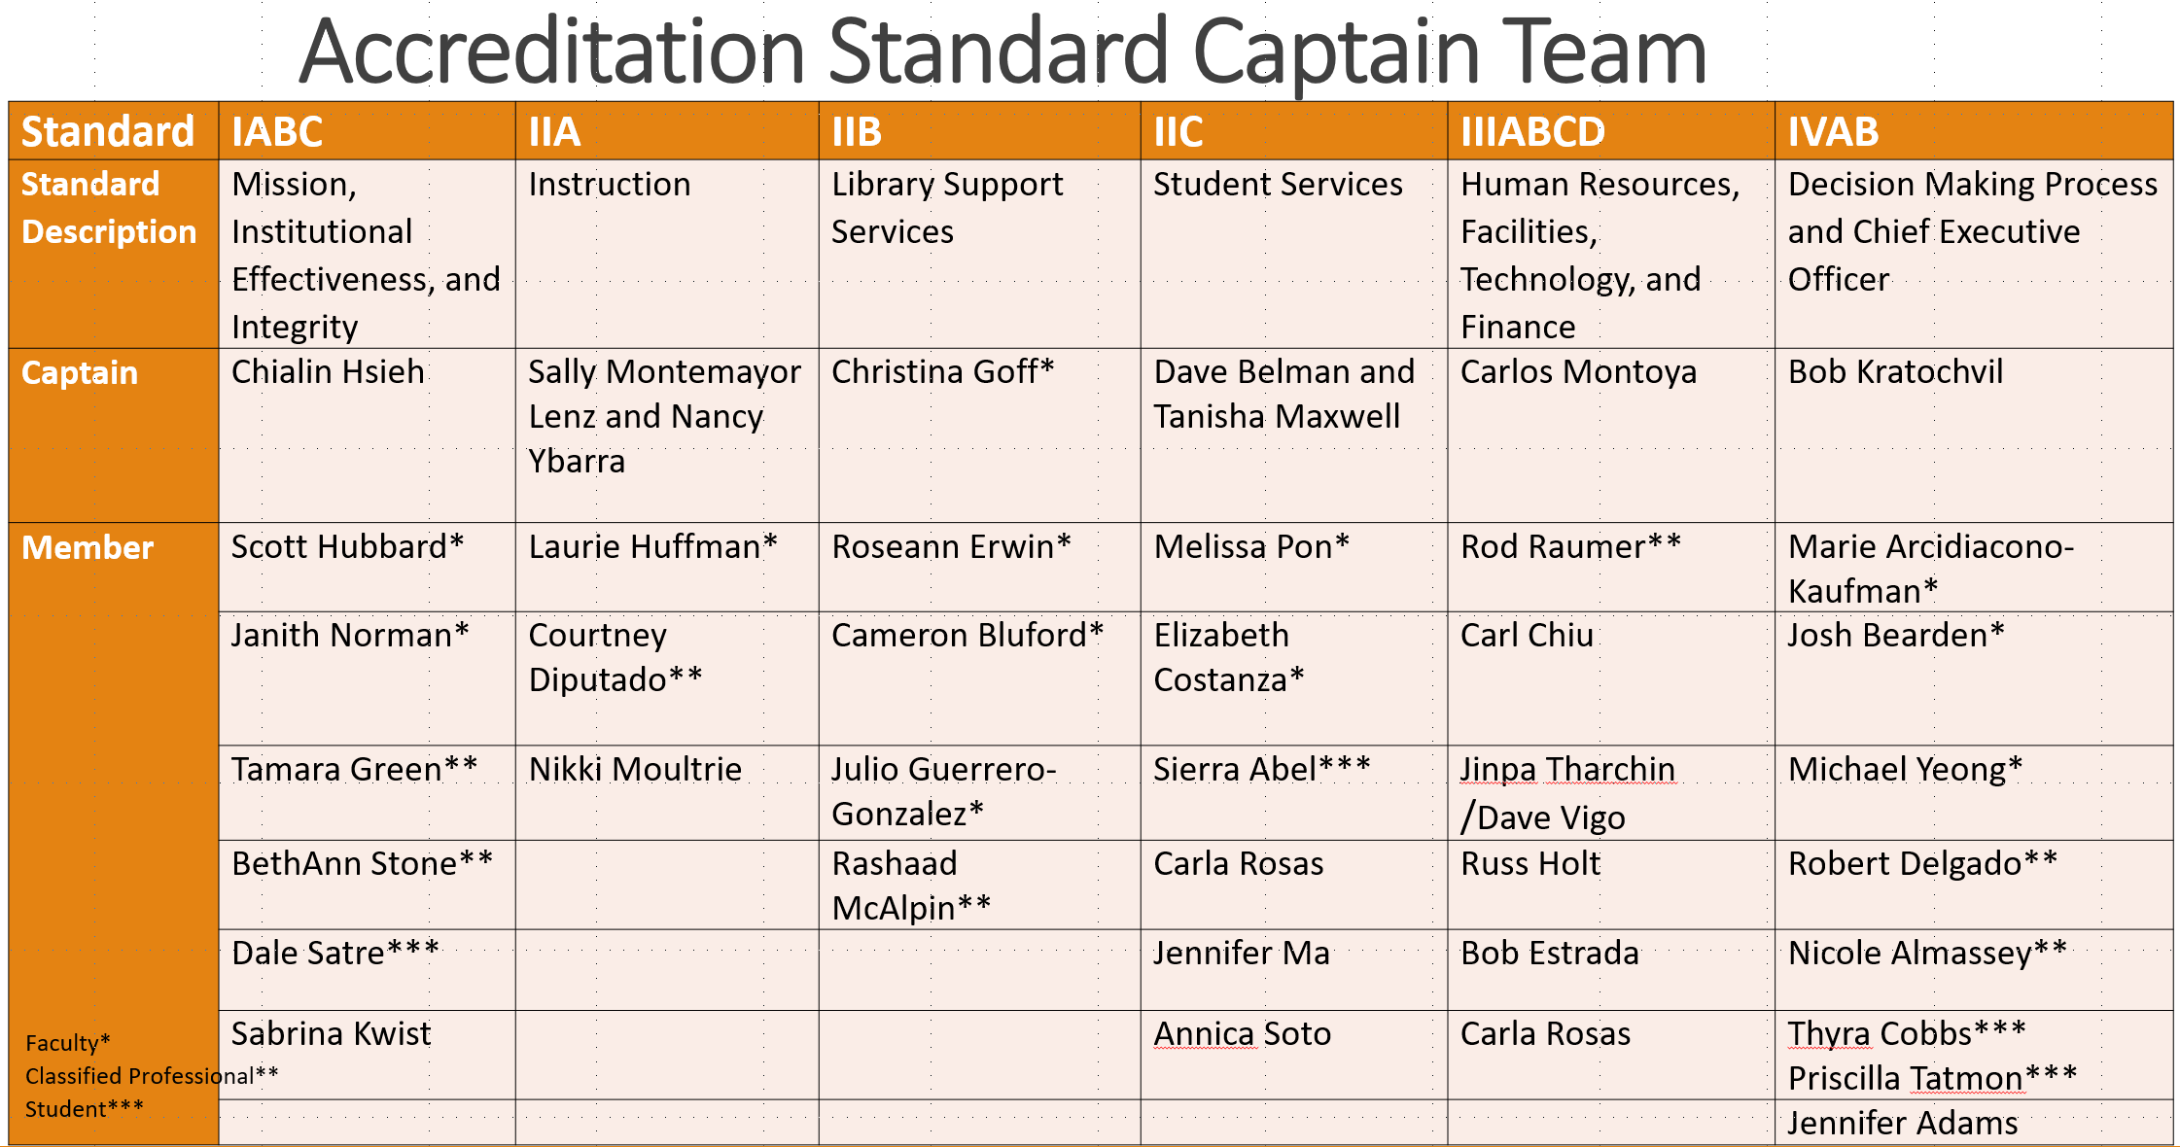
Accreditation Steering Committee
Notes:
Nicole (Classified Senate President)

Slide 8
Timeline and Process for Institutional Self Evaluation Report 2020 (ISER)
Semester/Month | Task/Process
Fall 2018 | Captains worked with team members to draft its assigned standard: Evidence of Meeting Standard
Spring 2019 | Captains worked with team members to draft its assigned standard: Evidence of Meeting Standard
April 12, 2019 | First draft sent to campus to review and provide feedback
Summer 2019 | Captains worked with team members to draft its assigned standard: Evaluation and Analysis
Fall 2019 | Various committees viewed and provided feedback on various substandards based on their charges. Feedback were incorporated to the content by working with the captains.
October 23, 2019 | Second draft sent to campus to review and provide feedback
Spring 2020 | Go through governance committees
June 2020 | Board approval
July 2020 | Submit to ACCJC
Oct 5-8, 2020 | ACCJC Visit
Jan 2021 | Evaluation Report
June 2021 | Reaffirmation
Notes:
Chialin

Slide 9
Writing: Evidence of Meeting Standards
1st Draft to Campus
2nd Draft to Campus
Board Approval
ACCJC Visit
Reaffirmation
Fall 2018
April 12, 2019
Oct 28, 2019
June 2020
Oct 5-8, 2020
June 2021
Spring 2019
Fall 2019
Spring 2020
July 2020
Jan 2021
Writing: Evidence of Meeting Standards
Governance Process
Submit to ACCJC
Evaluation & Analysis
External Evaluation Report
Timeline and Process for Institutional Self Evaluation Report 2020
Notes:
Chialin

Slide 10
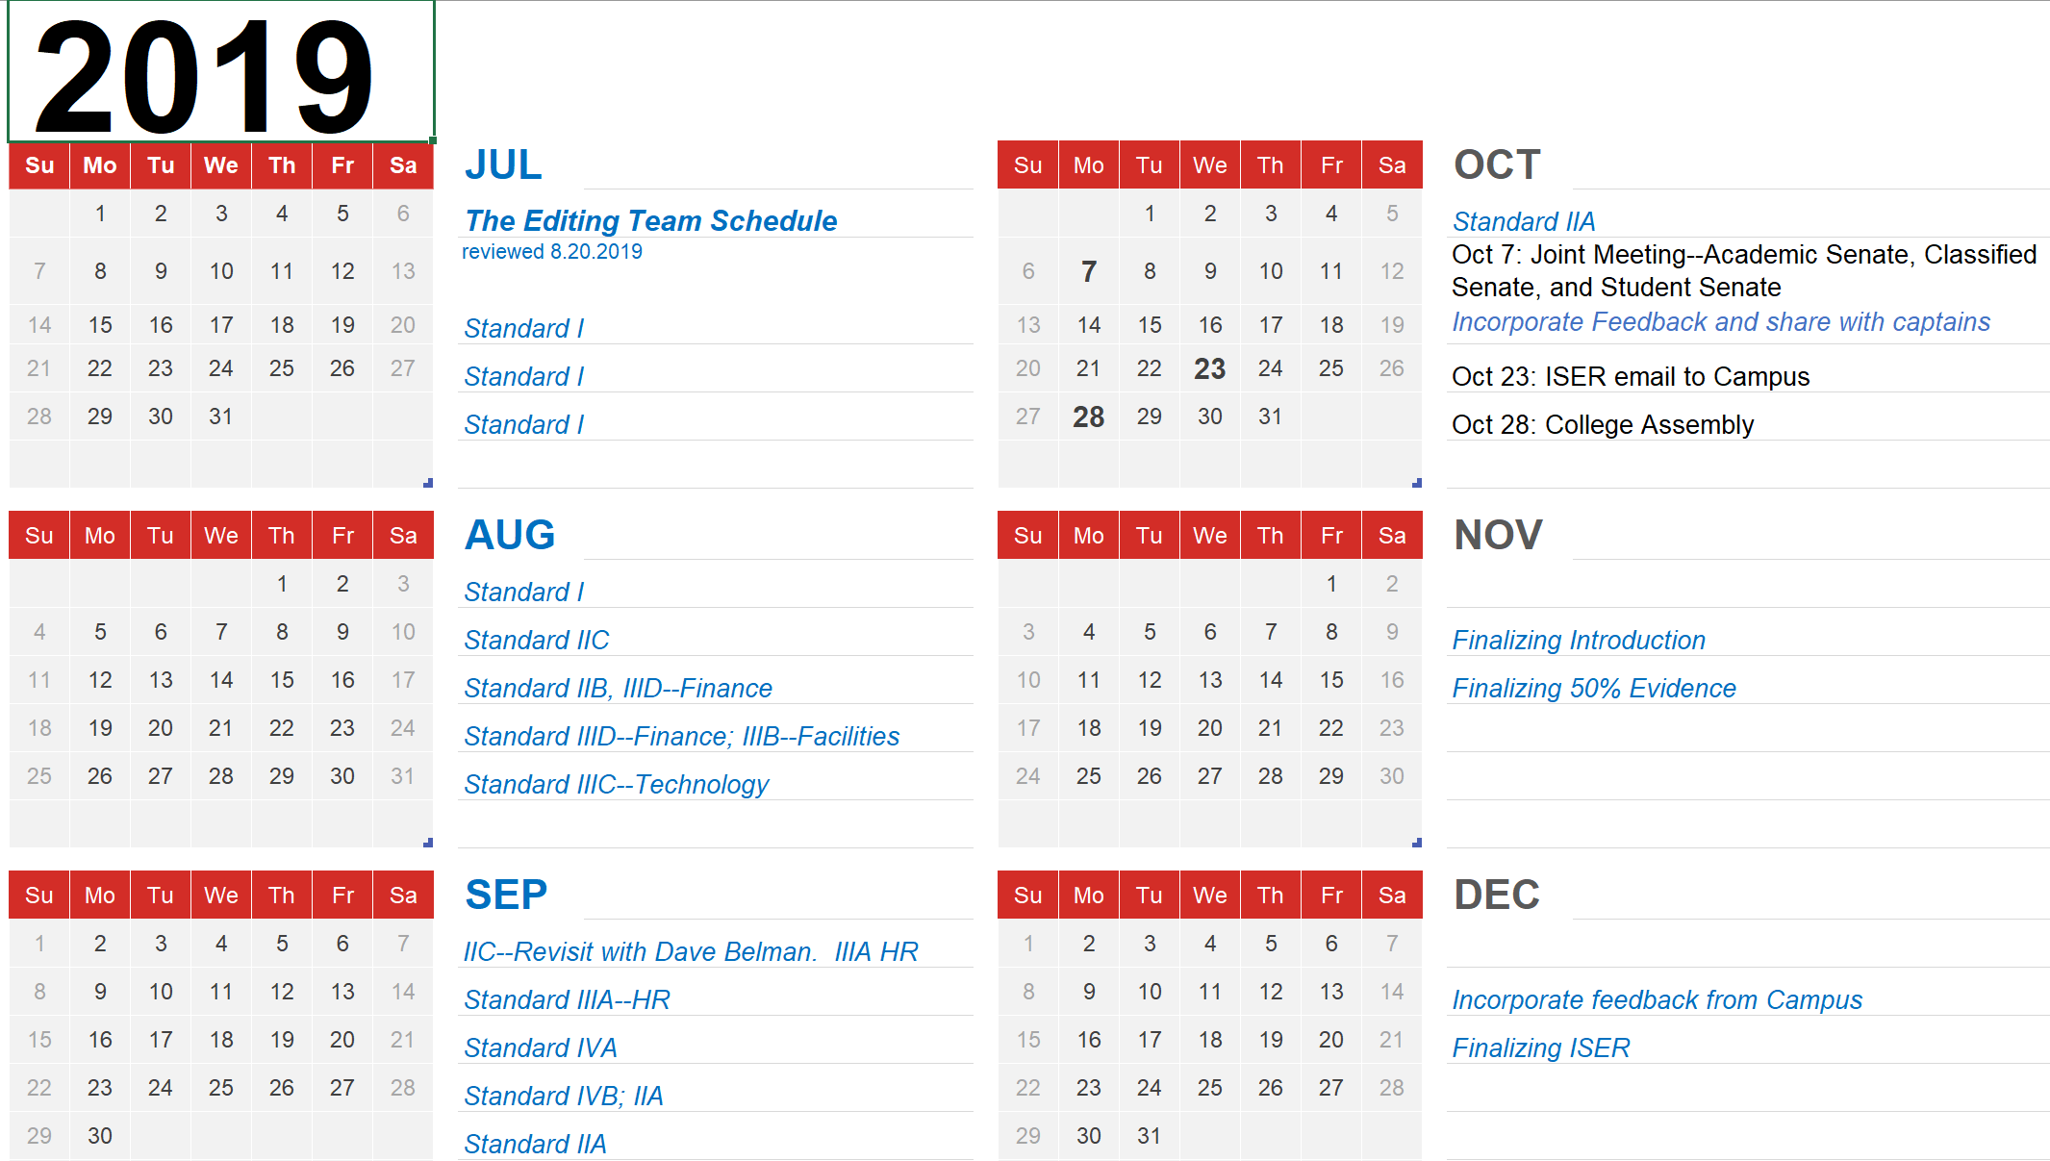
Notes:
BethAnn and Scott (Chialin)

Slide 11
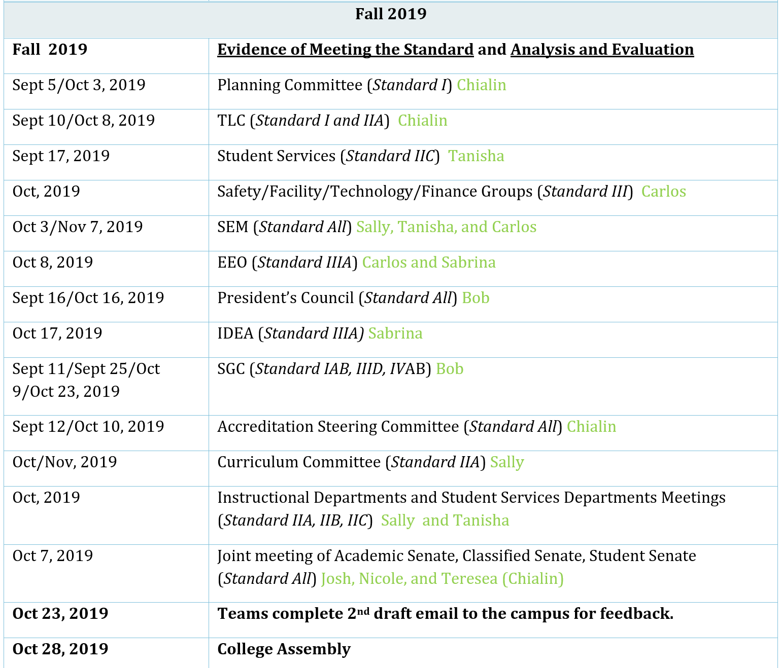
Notes:
BethAnn and Scott (Chialin)

Slide 12
Participation and Involvement
  Standard Work Group
  Contribute to Writing
  Identify/Participate as an Expert
  Provide Evidence (i.e., via committee)
  Provide Feedback (i.e., via committee, via captain, via ALO)
  Be asked to Validate the Content or Evidence
  Read the Draft ISER
Notes:
Josh: Ask people to “stand” and remain standing?

Slide 13
Not Your Standard Meet & Greet conversations with our Accreditation Standard Teams to provide your feedback
LEARNING OUTCOMES
  Review ISER draft
  Validate content
  Provide additional feedback and/or alternative content
Notes:
Bob (Scott)

Slide 14
Not Your Standard Meet & Greet conversations with our Accreditation Standard Teams to provide your feedback
INSTRUCTIONS
Get in groups based on your given number.
Assign the following roles to group members:
    Director: Ensure group follows directions.
    Note Taker: Logs group discussion of a given standard.
    Evidence Finder: Consults with group to find possible examples of evidence.
    Skeptic: Leads group review by offering skeptical view of the College’s alignment with the given substandard.
Notes:
Bob (Scott)

Slide 15
Not Your Standard Meet & Greet conversations with our Accreditation Standard Teams to provide your feedback
Standard I—Mission, Institutional Effectiveness, and Integrity
Standard IIB—Library and Learning Resources
Standard IIC—Student Services
Standard III—Human Resources, Facilities, Technology, and Finance
Standard IV—Decision Making and Leadership
Standard IIA--Instruction
Notes:
Standard I Table: Chialin
Standard IIA Table: Nancy
Standard IIB Table: Christina
Standard IIC: Table: Dave
Standard III Table: Jinpa
Standard IV Table: Josh

Slide 16
Stop here

Slide 17
Accreditation Standard Captain Team
Standard | IABC | IIA | IIB | IIC | IIIABCD | IVAB
Standard Description | Mission, Institutional Effectiveness, and Integrity | Instruction | Library Support Services | Student Services | Human Resources, Facilities, Technology, and Finance | Decision Making Process and Chief Executive Officer
Captain | Chialin Hsieh | Sally Montemayor Lenz and Nancy Ybarra | Christina Goff* | Dave Belman and Tanisha Maxwell | Carlos Montoya | Bob Kratochvil
Member | Scott Hubbard* | Laurie Huffman* | Roseann Erwin* | Melissa Pon* | Rod Raumer** | Marie Arcidiacono-Kaufman*
 | Janith Norman* | Courtney Diputado** | Cameron Bluford* | Elizabeth Costanza* | Carl Chiu | Josh Bearden*
 | Tamara Green** | Nikki Moultrie | Julio Guerrero-Gonzalez* | Sierra Abel*** | Jinpa Tharchin /Dave Vigo | Michael Yeong*
 | BethAnn Stone** |  | Rashaad McAlpin** | Carla Rosas | Russ Holt | Robert Delgado**
 | Dale Satre*** |  |  | Jennifer Ma | Bob Estrada | Nicole Almassey**
 | Sabrina Kwist |  |  | Annica Soto | Carla Rosas | Thyra Cobbs*** Priscilla Tatmon***
 |  |  |  |  |  | Jennifer Adams
Faculty*
Classified Professional**
Student***
Notes:
Update membership list

