Slide 1
The Who, What, Where, and When of Equivalency
Michelle Grimes-Hillman, ASCCC Curriculum Committee Chair
Kale Braden, ASCCC North Representative
Los Medanos College
March 23, 2015

Slide 2
What are Minimum Quals?
Minimum qualifications for each discipline are established through the statewide academic senate.
They are determined for each discipline through a rigorous process.
MQs are established at the state level, but may be increased locally

Slide 3
Where can you find them?

Slide 4

The Disciplines List
Disciplines List

Slide 5
Sample MQ in Discipline List
Master’s degree in business, business management, business administration, accountancy, finance, marketing, or business education OR bachelor’s degree in any of the above AND master’s degree in economics, personnel management, public administration, or Juris Doctorate (J.D.) or Legum Baccalaureus (LL.B.) degree OR bachelor’s degree in economics with a business emphasis AND master’s degree in personnel management, public administration, or J.D. or LL.B. degree OR the equivalent.

Slide 6

Who Determines Equivalency?
“The process, as well as criteria and standards…shall be developed and agreed upon jointly by …the [local] governing board and the [local] academic senate.” (Title 5, § 53430)

Slide 7
Criteria for Equivalency
Procedures established by agreement between local senates and boards of trustees for each district
  In multi college districts, the criteria for equivalency must be the same at all colleges in the district.
Discipline faculty determine criteria
Burden of proof belongs to the applicant
Notes:
slide 7 - not state mandate

Slide 8
What are the minimum standards for equivalency?
A district may hire a person who “possesses qualifications that are at least equivalent to the [state] minimum qualifications.” They cannot be less rigorous than the state-established MQs.
A district may establish additional qualifications which are more rigorous than the state-established MQs.
Equivalency may also be granted on the basis of eminence in the field.
Notes:
slide 8 - not state standard and must be on a job description

Slide 9
Single Course Equivalency?
Ed Code and Title 5 refer to qualifications in terms of Disciplines not courses or subject areas within a Discipline (Ed Code §87357; Title 5 §53410 and §53430)
Legal Opinion L 03-28, Chancellor’s Office Legal Division
  Faculty are hired to teach a discipline, not a course
Notes:
Faculty may be hired to teach a single course but not determined to be qualified based exclusively on that course

Slide 10
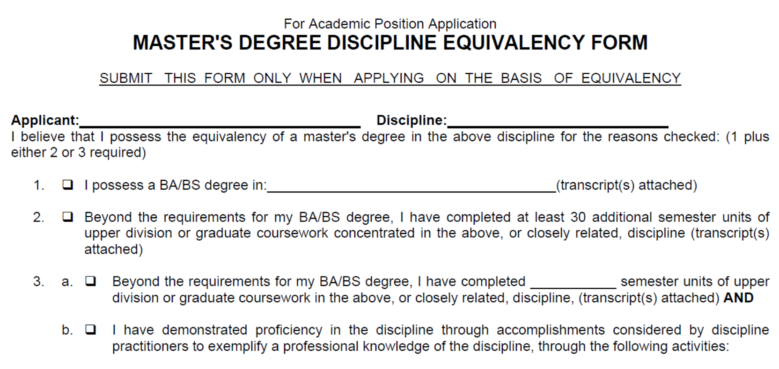
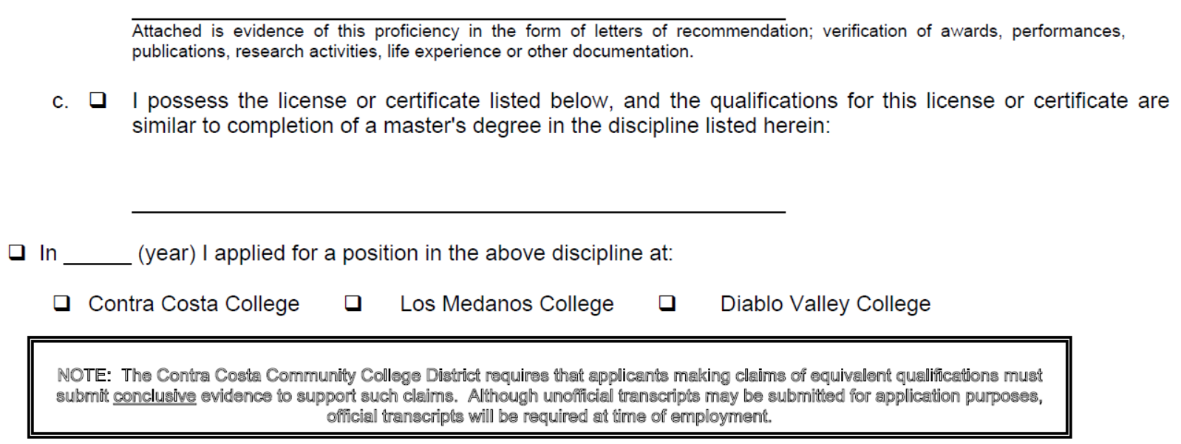
Contra Costa: What the Applicant Must Prove

Slide 11
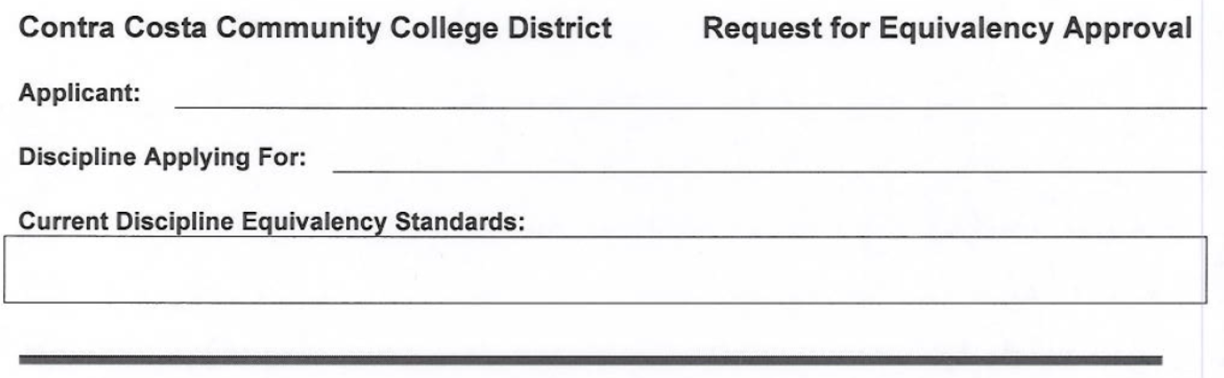
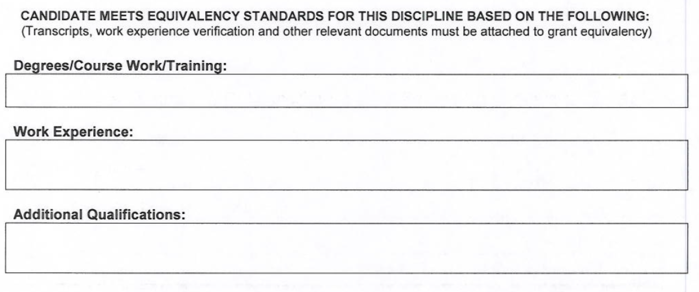
Contra Costa: What the department must prove

Slide 12

When is an equivalency determination necessary?

Slide 13
Is it equivalent?
Group activity

Slide 14
Three Case Studies
Although inspired by real events, these three case studies are fictional

