Slide 1
Transfer Webinar
Dolores Davison, ASCCC Vice President
Ginni May, ASCCC Treasurer
Miguel Rother, Director of Grants and Initiatives - facilitator
January 22, 2020 | 2:00-4:00

Slide 2
Overview
Concept
Associate Degree for Transfer (ADT) and University of California Transfer Pathway (UCTP)
UCTP Pilot – Chemistry and Physics
The Seven Disciplines
Engineering Model Curriculum
Next Steps

Slide 3
Concept
ASCCC Resolution F17 15.01 Aligning Transfer Pathways for the California State University and the University of California
Resolved: That the Academic Senate for California Community Colleges work with the Academic Senates of the California State University and the University of California to identify a single pathway in each of the majors with an Associate Degree for Transfer to ensure that students will be prepared to transfer into either the California State University or the University of California systems.

Slide 4
ADT UCTP
SB1440 and SB440
Students guaranteed to transfer to a CSU in a similar major
40 TMCs
20 most sought-after majors
Single set of major preparation courses for any of the 9 campuses

Slide 5
UCTP Pilot – Chemistry and Physics
The TMCs are different from the UCTP Pilot
UCTP Pilot is not an ADT – general education is completed after transfer, but Title 5 GE minimum requirements are met
3.5 GPA required in major for guaranteed transfer into a UC Campus
A student should be able to complete a baccalaureate degree within two years of full time status after transfer

Slide 6
The Seven Disciplines
Anthropology
Business Administration*
Economics
History
Mathematics*
Philosophy
Sociology
Pathway in each TMC that aligns with the UCTP
Requires the use of IGETC general education pattern for transfer to CSU or UC
A slight modification is needed

Slide 7
Anthropology (1/2)

Slide 8
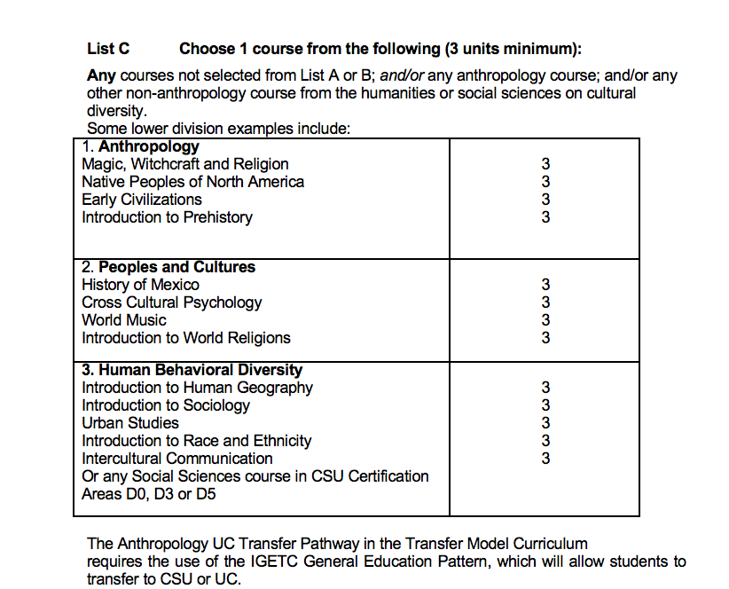
Anthropology (2/2)

Slide 9
Business Administration
Note: The existing TMC may need to be expanded to include the option of a Single Variable STEM Calculus series

Slide 10
Economics

Slide 11
History

Slide 12
Mathematics

Slide 13
Philosophy

Slide 14
Sociology

Slide 15
Engineering Model Curriculum
Recommended by the Intersegmental Curriculum Workgroup (ICW)
Not an ADT – too many units

Slide 16
Next Steps
Survey to Faculty Discipline Review Groups (FDRGs) on each UCTP Program Map in the TMC: 10-day turnaround
Follow up webinar:
February 4, 2020
2:00-4:00
At state level – make agreements between CCC and UC

