Slide 1
ONLINE EDUCATION INITIATIVE (OEI) Cranium Café & Cranium Classroom Update
Sophia Ramirez, LMC Counseling

Slide 2
About Cranium Café & Cranium Classroom
What is Cranium Café & Cranium Classroom?
Online platform that allows for virtual counseling using various forms of communication (chat, email, video conferencing and lobby access;
How can Cranium Café & Cranium Classroom be used?
Cranium Café can be used for one-on-one sessions, group sessions, workshops and class sessions (up to 100 students);
How do we access it?
We access Cranium Café through Canvas at:
https://losmedanos.craniumcafe.com/login
Single sign-in approach:
counselors and students sign in using Insite login and setting a passcode
Equipment & Browser
Desktop, laptop, tablet; webcam with mic; suggest using headset to reduce noise and feedback
Preferred browser is Chrome or Firefox
Additional Features
Student Informed Consent form
Individual Counselor Contact Cards & Lobby

Slide 3
Cranium Café Online Counseling Training
The Online Counseling Network in collaboration with OEI offers two 6-week online counseling courses for counselors;
Online College Counseling;
Online Mental Health;
Continuing Education Units (CEU) are available-
4 units of graduate level work from Fresno Pacific University;
Examples of Online College Counseling Course Topics:
How to handle technology challenges
Disruptive students
Counseling students w/ disabilities
Group counseling
Designing online workshops
Developing online resources

Slide 4
So How Does Cranium Café Work?

Slide 5
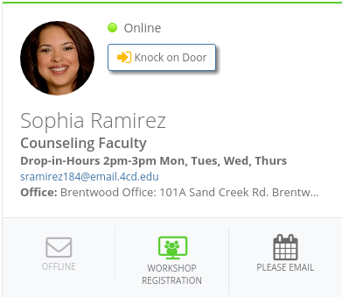
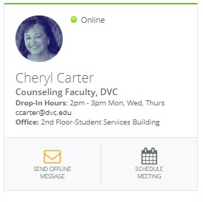
Cranium Café Contact Cards

Slide 6
Online Counseling Start to Finish Synchronous “Real Time” Sessions
Student receives email with link to counselor’s virtual office;
Students log in through DVC Canvas website using their Insite ID;
Automated consent form appears for each session;
Student is “transported” to the counselor’s virtual lobby where they wait until the counselor brings them into their virtual office;
Students can meet with counselors:
Face-to-face (webcam)
Audio only
Chat
Features:
Document share
Screen-share
Closed Captioning
White board with tools

Slide 7
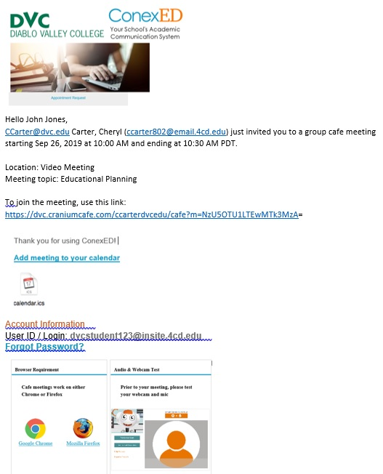
Cranium Café Appointment Email

Slide 8
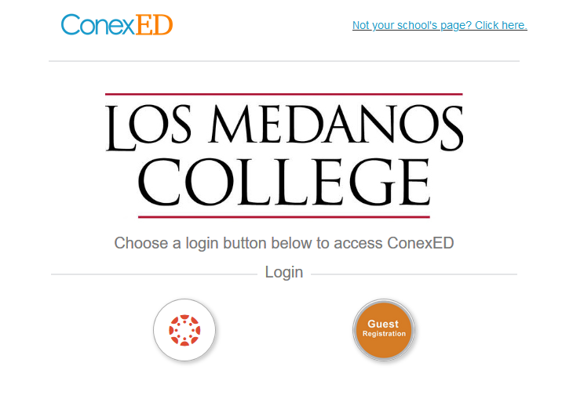
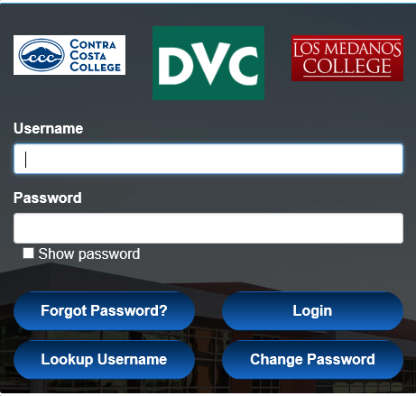
Cranium Café Single Sign In Via Canvas

Slide 9
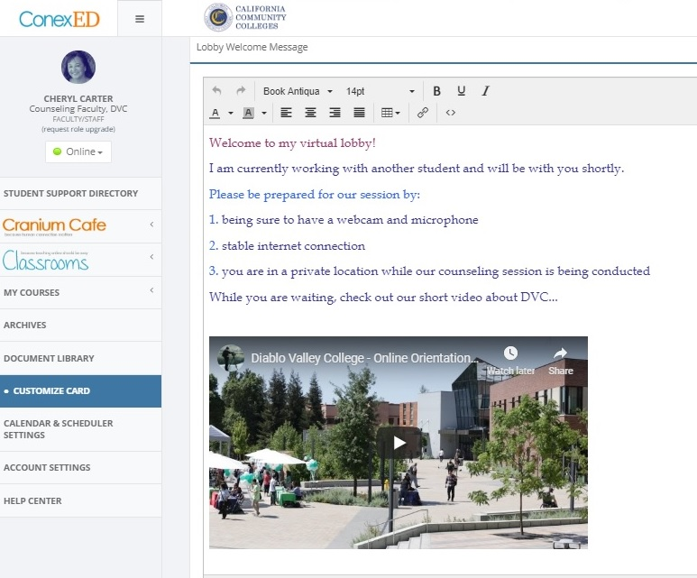
Cranium Café ~ Counselor Lobby

Slide 10
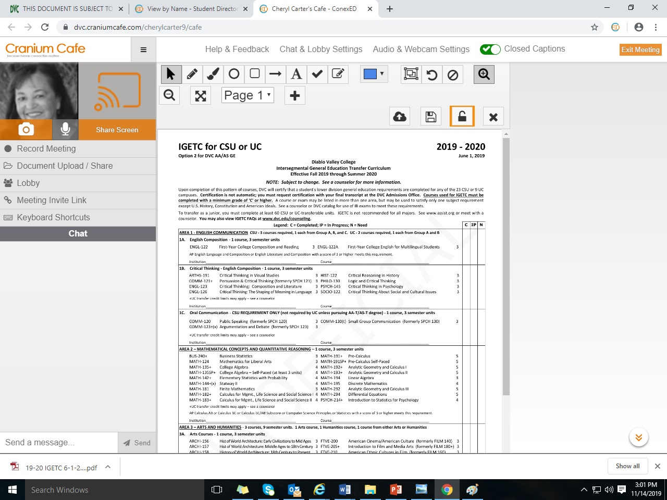
Cranium Café ~ Document Share + Tools

Slide 11
Where We’re At & Where We’re Going
OEI launch is scheduled for fall 2020;
DVC, CCC and LMC counseling leads are meeting regularly to share resources and to determine some consistency in our approach to online counseling;
Currently, about half of our LMC counselors are registered for the 6-week Online Counseling Course;
Counseling plans a sloooow roll out by piloting the platform with a few already trained counselors for Spring 2020 semester;
Cranium Café training is scheduled for our Counseling staff;

Slide 12
Where We’re At & Where We’re Going
Develop online counseling web page, documents and resources;
Meet with ConexEd and District IT to integrate Cranium Café with SARS our counseling appointment system;
Determine online counseling schedule and virtual drop-in policies:
Training requirements for conducting online counseling sessions;
How many hours per week should we offer the service;
Mental health online counseling policies;
Storing session archives;

Slide 13
Questions? Sophia Ramirez, LMC Counseling

